Slide 1
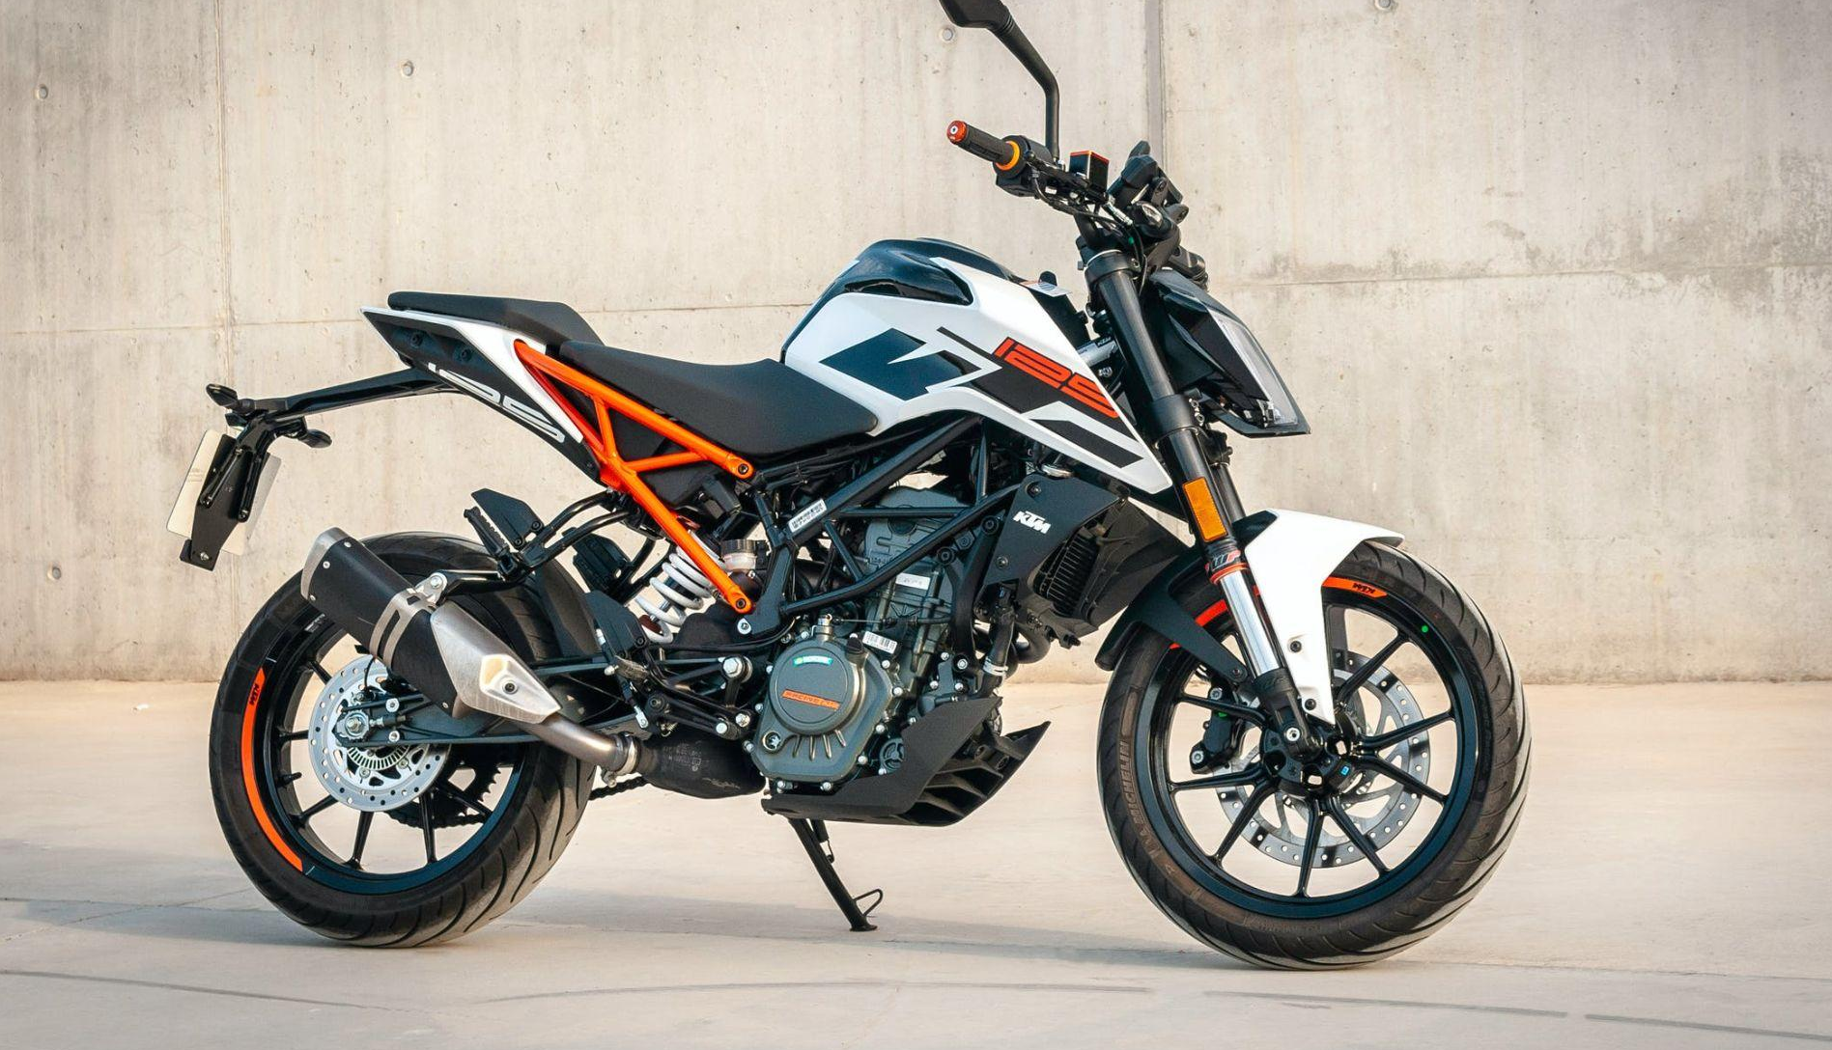
012-345-6789
example.com
PREMIUM
MOTORCYCLES

Slide 2
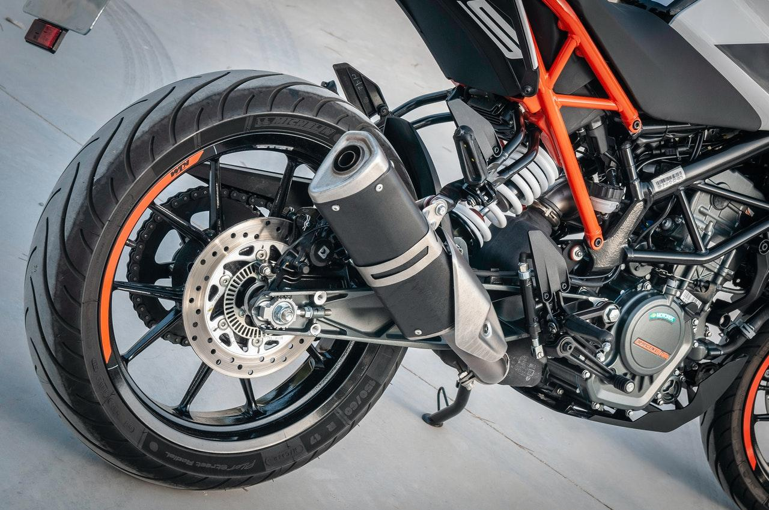
MOTORCYCLES
SALE & REPAIR
Asia Gutmann
General Manager
Mobile: 012-345-6789
Mobile: 012-345-6789
Website: example.com
Email: example@mail.com
Address: 5703 Rippin Crescent Apt, Bilzen
57073-7014

