Slide 1
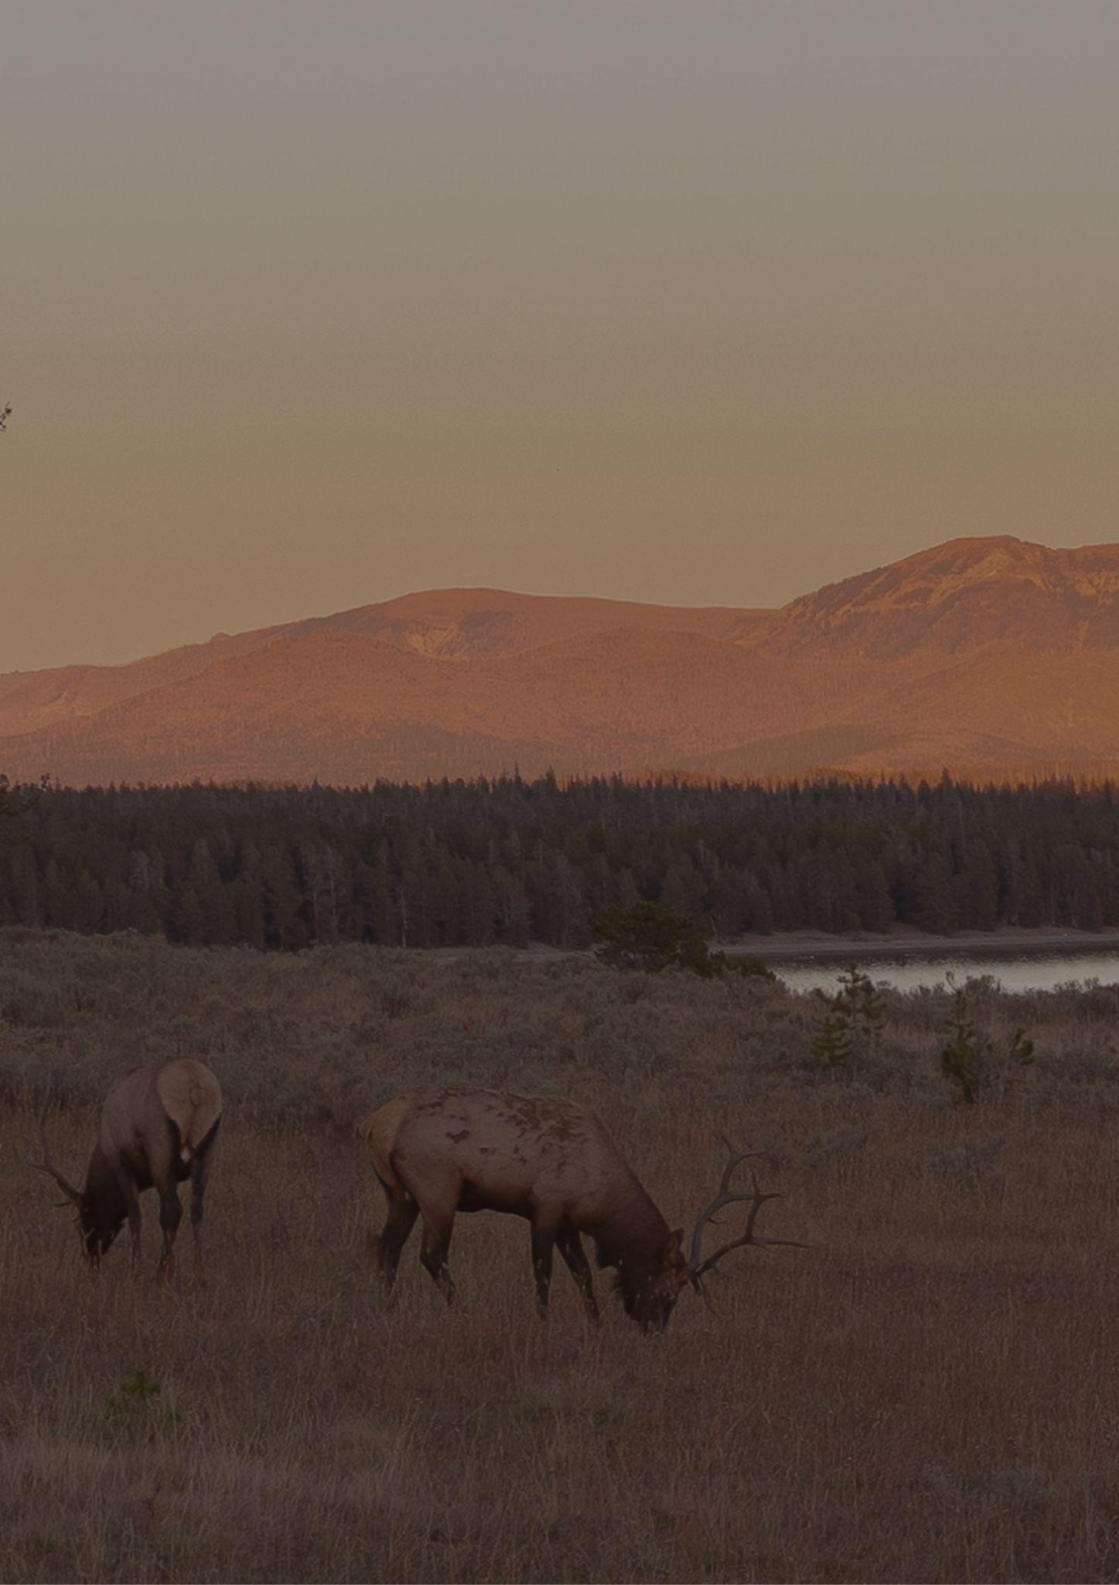
Montana
Travel bucket list
Glacier National Park
Sweet Palace in Philipsburg
Explore a National Forest
Little Bighorn
Big Sky Resort
Museum of the Rockies
Moss Mansion in Billings
Lake McDonald
Wolf Discovery Center
Historical Society Museum
Museum of the Rockies
Montana State Capitol
Yellowstone National Park
Big Sky Resort
World Museum of Mining
Zoo Montana
State Capitol in Helena
Conrad Mansion Museum
Flathead Lake
Tizer Botanic Gardens
Lewis & Clark Trail
Ringing Rocks
Montana's Hot Springs
American Computer Museum
Russell Museum Complex
Whitefish Mountain Resort
Smelter Stack in Anaconda
Western Heritage Centre

