Slide 1
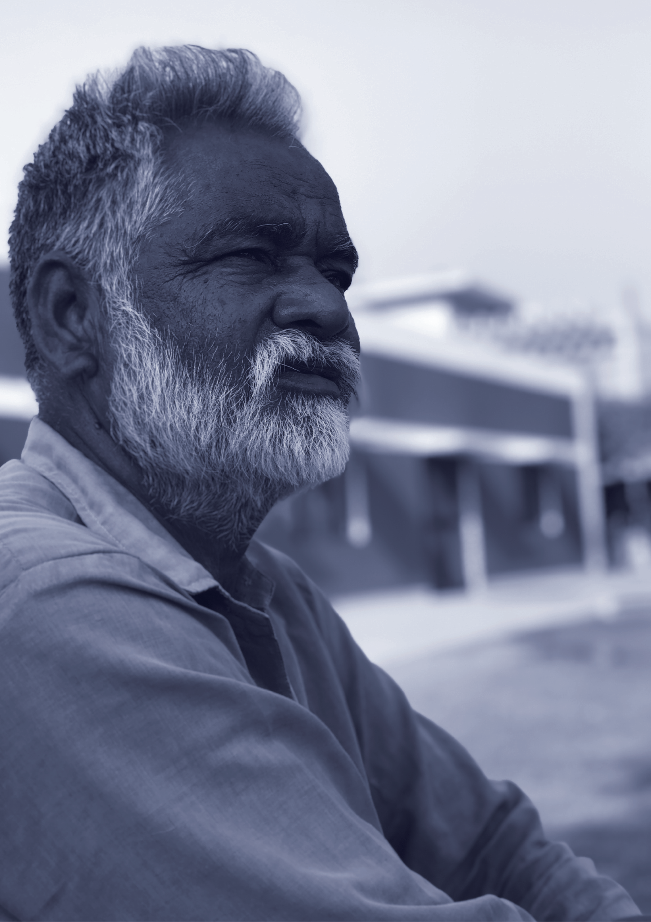
In Loving Memory...
Angel
Becker
MARCH 1, 1922 - JUNE 9, 2020

Slide 2
Order of Service
PROGRAM
Prayer In The Home
Prelude Music
Invocation
Guest Speakers
Remarks
Closing Remarks
Benjamin Shah
Neil Tran
Estelle Darcy
Aaron Loeb
Juliana Silva
Aaron Loeb
MONDAY | 12 JUNE 2025 | 10 PM
Heroes’ Memorial
123 Anywhere St. any City

