Slide 1
Meet the
Teacher
Your presentation starts here

Slide 2
About the Teacher
Full Name: | [Your Name]
Education: | [Degrees, University, Year of Graduation]
Teaching Experience: | [Number of Years, Subjects Taught]
Specialization: | [Main Teaching Areas or Expertise]
Certifications & Awards: | [Relevant Credentials or Recognitions]
Hobbies & Interests: | [Personal Interests]
Teaching Philosophy: | [Brief Statement on Teaching Approach]

Slide 3
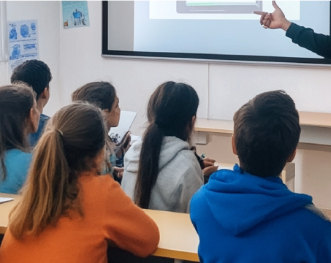
Teaching Experience in Detail
Year of Teaching
Year of Teaching
Year of Teaching
Briefly tell about the
place where you
taught before.
Briefly tell about the
place where you
taught before.
Briefly tell about the
place where you
taught before.

Slide 4
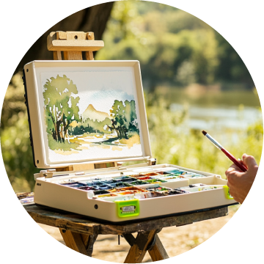
Briefly About Favorite Hobbies
Briefly tell about
this hobby
Briefly tell about
this hobby
Briefly tell about
this hobby
Painting
Construction
Toys
Photography

Slide 5
Favorite Countries for Travel
Canada
China
Briefly tell what attracts you to these countries.
Brazil
Briefly tell what attracts you to these countries.
Briefly tell what attracts you to these countries.

Slide 6
Classroom Expectations
WHAT IS DESIRABLE TO DO | WHAT IS UNDESIRABLE TO DO
Respect each other | Disrupting the class
Be prepared and on time | Speaking out of turn
Follow classroom rules | Being disrespectful to others
Ask questions and participate | Not completing assignments
Have a positive attitude | Using mobile phones without permission

Slide 7
Teacher Likes & Dislikes
Likes:
Dislikes:
Seeing students excited about learning
Creative projects and hands-on activities
Reading books and storytelling
Friendly and respectful classroom atmosphere
Helping students overcome challenges
Disruptive behavior in class
Lack of effort in completing assignments
Disrespect towards classmates or teachers
Negative attitudes towards learning
Dishonesty and cheating

Slide 8
Teacher Goals
Create a positive and engaging learning environment
Support students in achieving their full potential
Encourage critical thinking and problem-solving skills
Foster a love for lifelong learning
Provide constructive feedback and guidance
Adapt teaching methods to meet diverse learning needs

Slide 9
Subjects Taught
(Grades 1-3)
(Grades 1-3)
(Grades 1-3)
Math
Reading
& Writing
Science

Slide 10
Teaching Schedule
Day | Grade | Subject | Beginning and End
Monday | 1st grade | Math | 09:00 AM to 10:00 AM
Tuesday | 3st grade | Reading & Writing | 10:30 AM to 11:30 AM
Wednesday | 1st grade | Science | 11:00 AM to 12:00 PM
Thursday | 2st grade | Math | 01:00 PM to 02:00 PM
Friday | 3st grade | Science | 09:30 AM to 10:30 AM

Slide 11
Motivational Statement
"In a world where
you can be anything, be kind."

Slide 12
Contact Information
Email: teacher@mail.ltd
Office Hours: Monday - Friday,
03:00 PM to 04:00 PM
Classroom Website: yourclasswebsite.ltd
Phone: +1 123-456-7890
Messaging Apps:
[AppName] (ID: yourname)

Slide 13
Final Message
"Looking forward to
a fun and exciting year together!"

