Slide 1
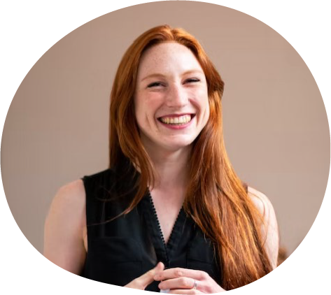
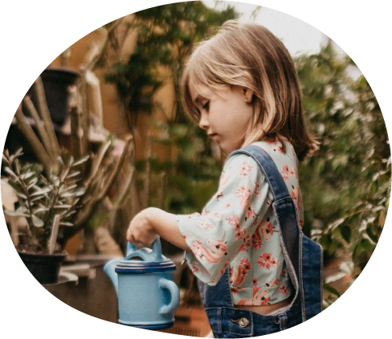
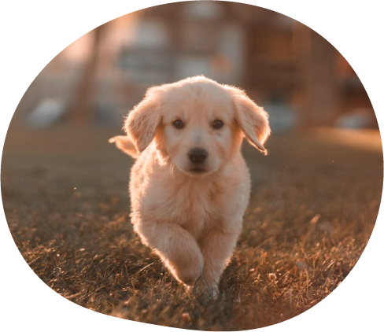
Hi students! I’m
Mrs. Smith
I teach English
and I'll be your teacher this year!
I have so many things I want to share with
you and I can't wait to start learning together and get to know all of you.
I am 30 years old, I have a 4 year-old daughter and we have a beautiful dog named Jack.
Here are some of my favorites so you can
know a little bit more about me:
MEET THE TEACHER
Favorite season: Summer!
Favorite color: Lilac
Favorite drink: Apple juice
Favorite food: Sushi and pizza!
Do you need to contact me? No problem! here's my contact info:
Mobile number: +123-456-7890
Email: hello@reallygreatsite.com
Office hours: 8:00 AM - 5:00 PM
Fun Facts:
I love to go swimming, and I know the name of lots of sea creatures!
I have a Persian cat named Star.
I love table tennis and badminton.
My favourite colour is dark blue.

