Slide 1
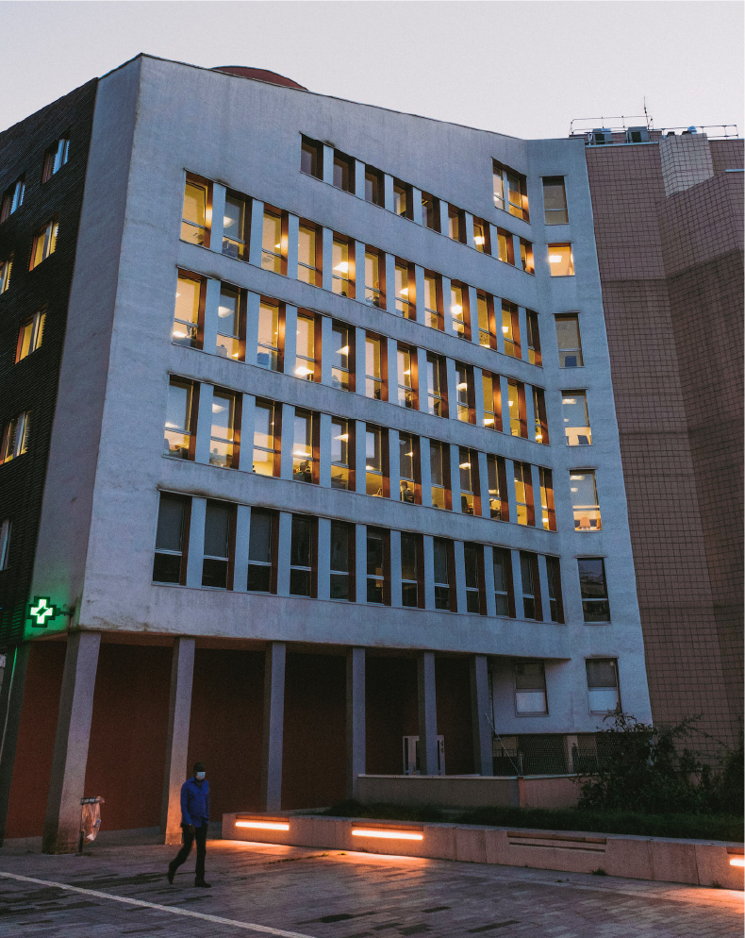
More
Information
Your Trusted Healthcare Partner
CONTACT US:
Introduction
P: +1 615-618-2559
M: HealthcarePartner@mail.com
W: HealthcarePartner.com
Welcome to [Medical Facility Name], where your health is our priority.
We are dedicated to providing compassionate and comprehensive healthcare services to our community.
A: 261 Green Street, North Little Rock, Arkansas, North Little Rock
SOCIAL MEDIA:
INS: @nstagram
F: facebook
Our mission
YOUR
LOGO
Our mission is to enhance the well-being of our patients through personalized, high-quality care delivered with integrity and respect.
YOUR
LOGO

Slide 2
YOUR
LOGO
Our Service:
Why
Choose Us
PRIMARY CARE:
EXPERIENCED STAFF:
01
Annual check-ups, vaccinations, and preventive care.
Our team of skilled healthcare professionals is committed to delivering excellence in medical care
SPECIALIZED SERVICES:
Caring
for Your Wellness, Every
Step of
the Way
PATIENT-CENTERED
APPROACH:
02
[List specific specialties offered, e.g., cardiology, dermatology, etc.]
Our team of skilled healthcare professionals is committed to delivering excellence in medical care
DIAGNOSTIC SERVICES:
CONVENIENT LOCATION:
03
State-of-the-art diagnostic imaging and laboratory services.
Located in the heart of [City], we strive to make access to quality healthcare easy and convenient.
YOUR
LOGO
We are waiting for you!

