Slide 1
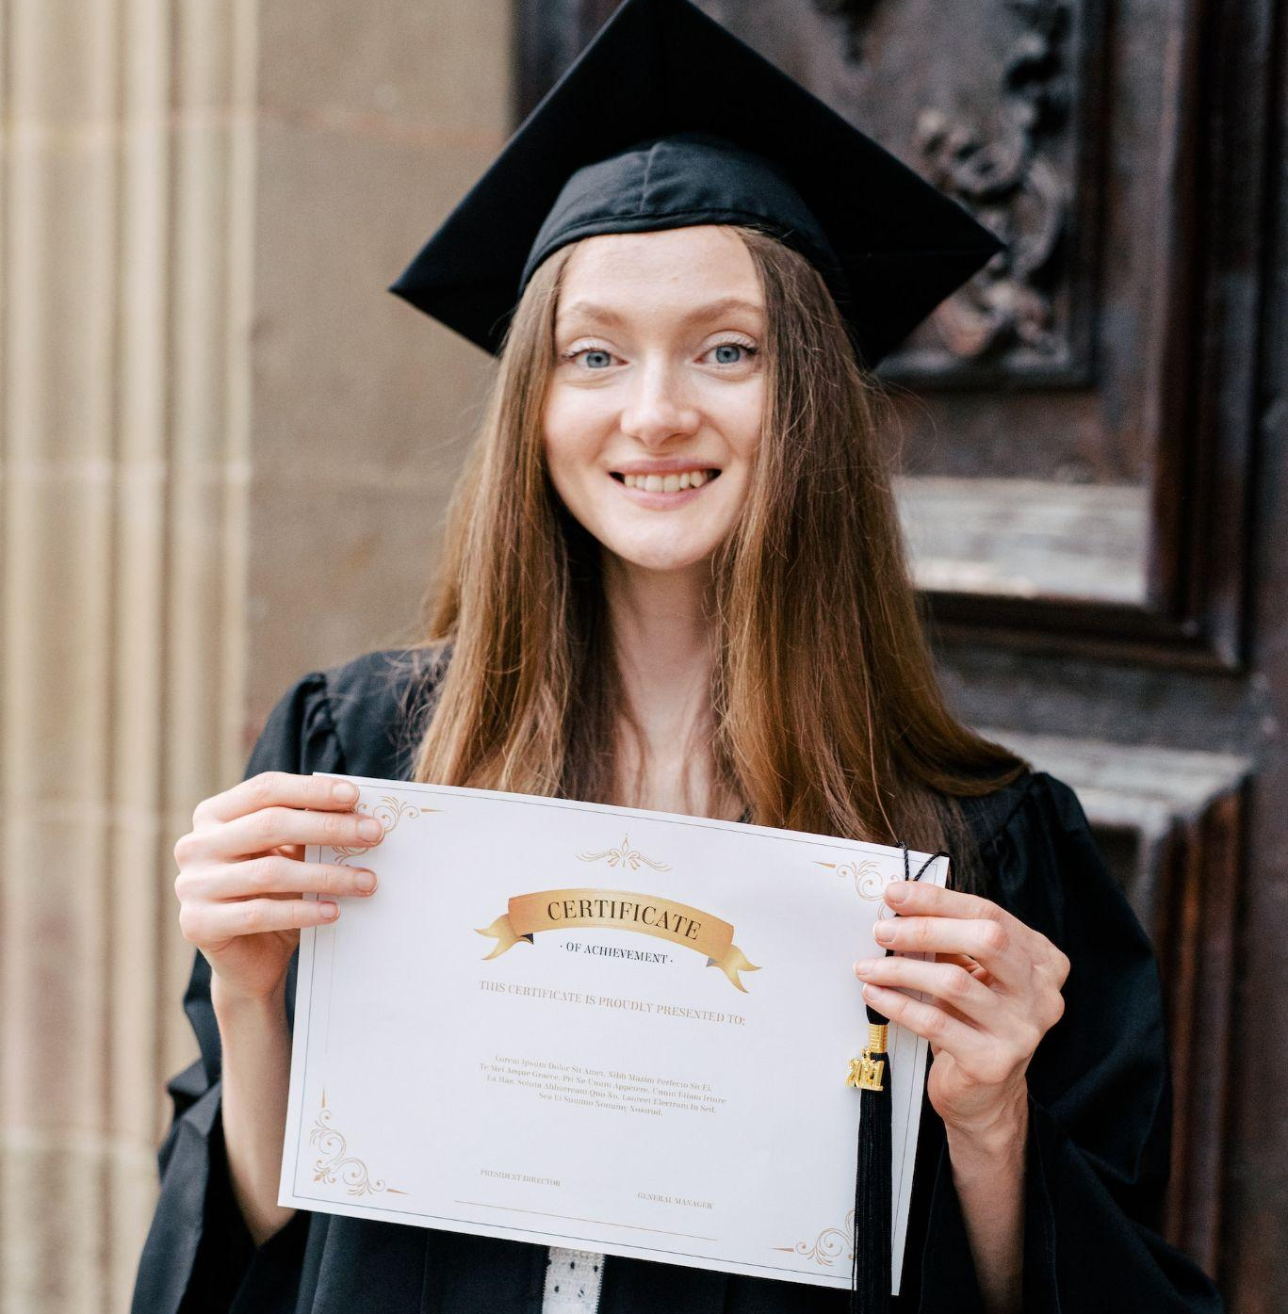
Louvenia Morar

Slide 2
Medical School Graduation
Announcement Card
Louvenia Morar
Gorczanyton University School of Medicine
Medical Assisting Services
Join Us to Celebrate
May 25, 2025 1-4 PM
2171 Chelsea Plains, Gorczanyton

