Slide 1
EASY
MATH
LEARNING!
Making Numbers Your Best Friends

Slide 2
Why Learn Math?
Math is everywhere!
Helps in everyday life.
Develops problem-solving skills.
Page 2/20

Slide 3
What We'll Learn Today
Basic operations: Addition, Subtraction,
Multiplication, Division.
Fun math tricks.
Solving simple mathematical
problems.
Page 3/20

Slide 4
Addition Basics
Explanation: Adding means combining numbers.
Example: 2 + 3 = 5
Activity: "Find the sum of 4 + 6!"
4 + 6 = ?
Page 4/20

Slide 5
Subtraction Basics
Explanation: Subtraction means finding the difference.
Example: 8 - 3 = 5
Activity: "What is 10 - 7?"
10 - 7 = ?
Page 5/20

Slide 6
Multiplication Basics
Explanation: Multiplication is repeated addition.
Example: 3 × 4 = 12
Activity: "What is 5 × 2?"
5 x 2 = ?
Page 6/20

Slide 7
Division Basics
Explanation: Division is splitting into equal parts.
Example: 12 ÷ 4 = 3
Activity: "What is 15 ÷ 3?"
15 ÷ 3 = ?
Page 7/20

Slide 8
Math Trick #1
Magic of Zero
Trick:
Any number multiplied by 0 is always 0!
Example:
5 × 0 = 0
Page 8/20

Slide 9
Math Trick #2
Doubles Fun
Trick:
Doubling a number is the same as adding it to itself.
Example:
6 × 2 = 6 + 6 = 12
Page 9/20

Slide 10
Problem Solving
Scenario:
"If you have 10 apples and
give 4 away, how many are left?"
Page 10/20

Slide 11
Answer
6
Apples
Page 11/20

Slide 12
Fun Math Puzzle
Solve This!
What comes next?
2, 4, 6, 8, ?
Page 12/20

Slide 13
Answer
10
Well done
Page 13/20

Slide 14
Shapes in Math
Explanation: Shapes like circles, squares, and triangles.
Squares
Triangles
Сircles
Page 14/20

Slide 15
Math and Money
Counting Coins
"If you have 3 dimes and 2 nickels,
how much money do you have?"
Page 15/20

Slide 16
Answer
40
Cents
Page 16/20

Slide 17
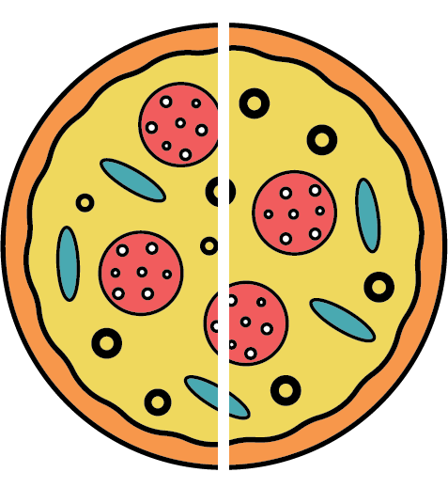
Understanding Fractions
Explanation: Fractions show parts of a whole.
1
=
2
Example: ½ of a pizza means one out of two parts.
Page 17/20

Slide 18
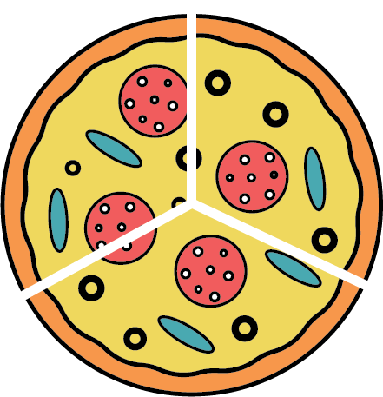
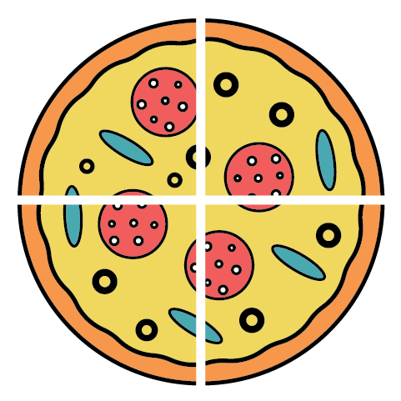
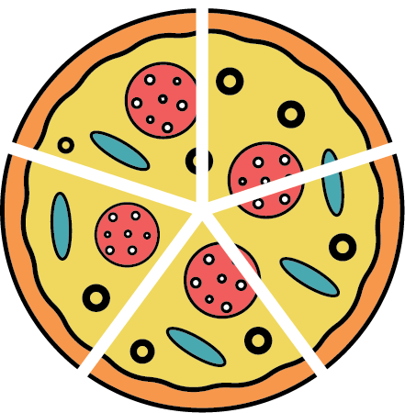
More Examples of Fractions
1
1
1
3
4
5
Page 18/20

Slide 19
Questions & Answers
Encourage kids to ask questions or share
their favorite math trick.
Page 19/20

Slide 20
Keep Exploring Math!
The more you practice,
the more fun it becomes!
Page 20/20

