Slide 1
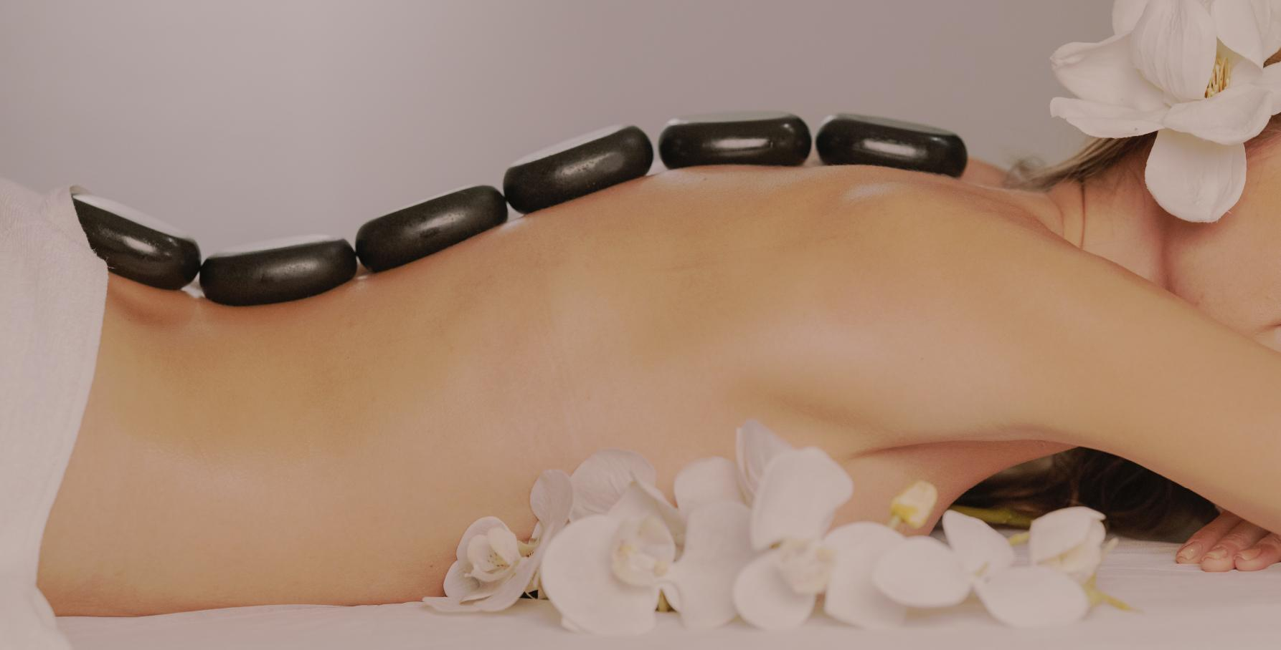
Your
Relaxing
Remedy
BEAUTY
PACKAGES
AFFORDABLE RATES
Back Massage w/ Reflex
Back Massage w/ Oil
Head Massage w/ Reflex
Head Massage w/ Oil
$24.99
$19.99
$24 99
$19.99
Swedish + Foot
Swedish + Head
Aromatherapy + Head
Aromatherapy + Foot
Back + Head
Back + Foot
$55
$55
$50
$50
$40
$40
REGULAR RATES
Back Massage w/ Oil
Back Massage w/ Reflex
Head Massage w/ Reflex
Head Massage w/ Oil
Head & Back Massage w/ Reflex
$35.99
$30.99
$32.99
$28.99
$44 99
ESSENTIALS
FULL BODY MASSAGE
In-House Oil
Eucalyptus Oil
Peppermint Cream
$8
$10
$12
1 Hr. Thai Massage
1 Hr. Swedish Massage
1 Hr. Aromatherapy
1 Hr. Filipino Style (Hilot)
$35.99
$30.99
$32.99
$28.99

