Slide 1
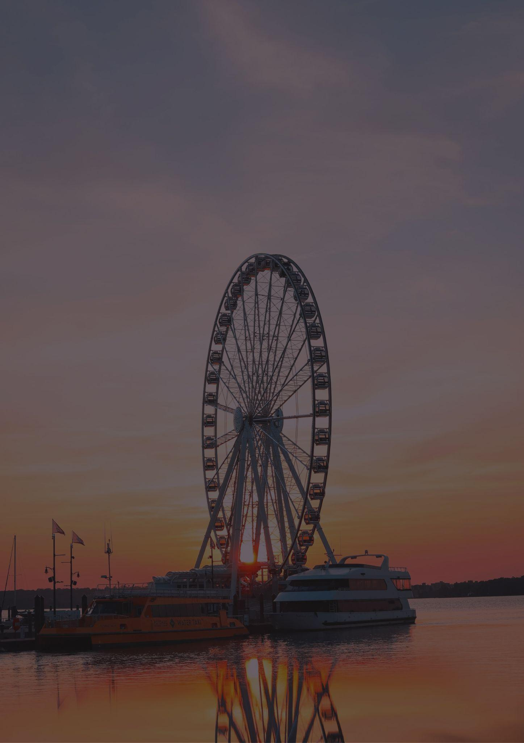
Travel bucket list
MARYLAND
#
Baltimore Inner Harbor
#
Blackwater Refuge
#
Annapolis
#
Oriole Park
#
Ohio Canal Park
#
Hotel Maryland
#
Rockville
#
Visionary Art Museum
#
Six Flags America
#
Children's Museum
#
Assateague State Park
#
Space Flight Center
#
Brookside Gardens
#
Maryland City
#
Fort McHenry
#
Baltimore
#
Ohio Railroad Museum
#
North Potomac
#
Strathmore Music Center
#
Ocean City
#
National Aquarium
#
Clarksburg
#
The Walters Art Museum
#
Gaithersburg
#
Antietam Battlefield
#
Deep Creek Lake Area
#
Swallow Falls State Park
#
Ocean City Boardwalk

