Slide 1
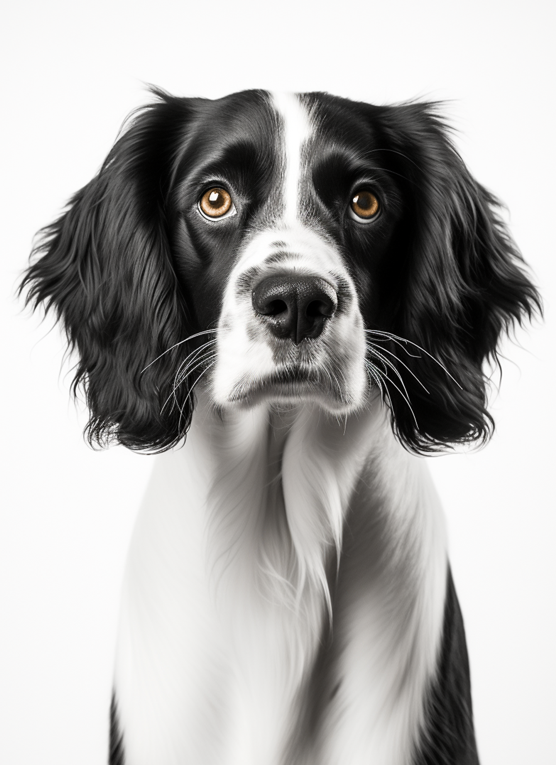
MISSING DOG
A CRY FOR HELP FOR OUR FUR BABY
NAME
REWARD
100$
MILO
Milo has been missing since July 2024 and was last seen at Central Park
COLOR
5 YEARS OLD
BLACK & WHITE
MALE
BROWN EYES
CALL OR TEXT WITH ANY INFORMATION
345-456-45-45

