Slide 1
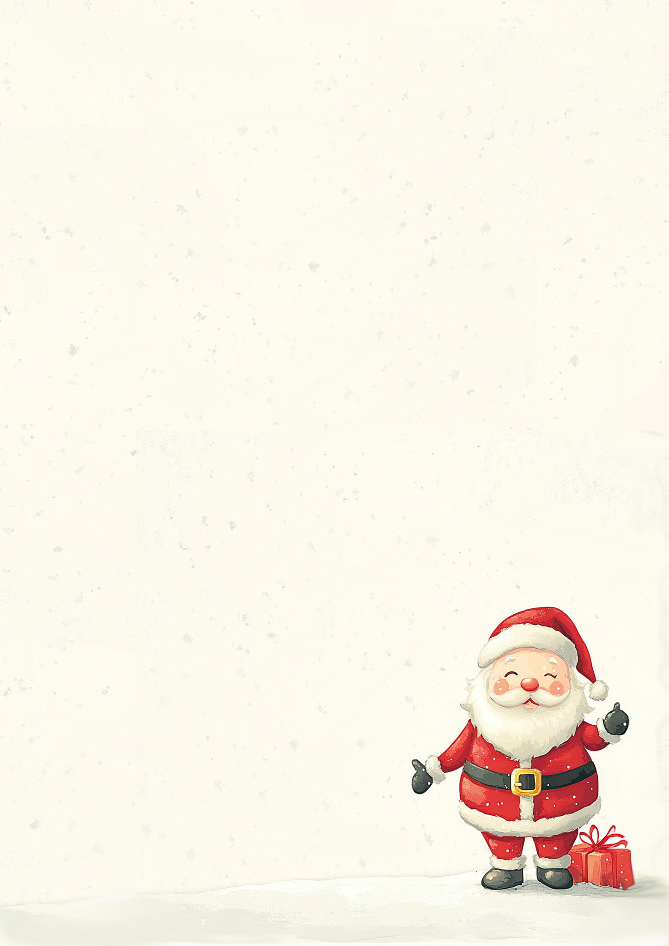
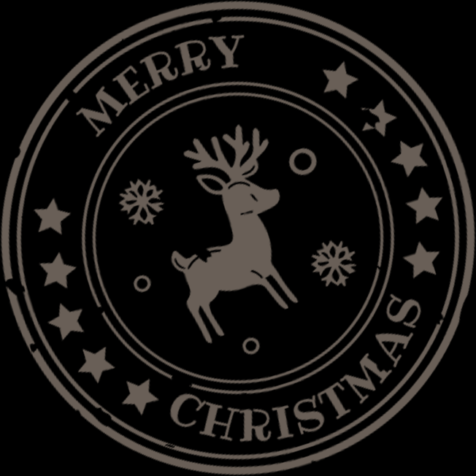
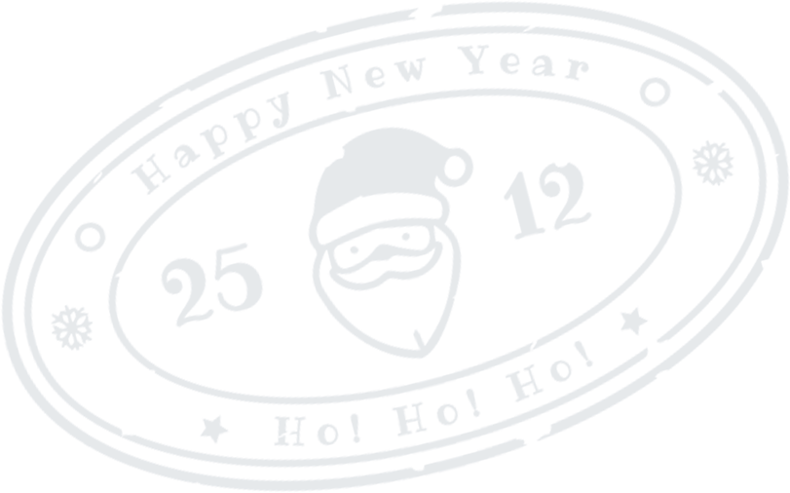
Letter from
Santa Claus
Hello [Child's Name],
Ho Ho Ho! Christmas is just around the corner, and the North Pole is buzzing with excitement! The elves have been busy wrapping presents and preparing for the big night, while the reindeer are practicing their flying.
I’ve been checking my list, and guess what? You’re on the Nice List this year! I’m so proud of you for all the wonderful things you’ve done. Your kindness and helpfulness are the true spirit of Christmas, and it’s something that makes me very happy.
I know you’ve been wishing for [Gift 1] and maybe a surprise or two. The elves and I will do our best to make sure you have a magical Christmas morning. Don’t forget to spread joy and cheer
with your family and friends—that’s the best gift of all!
Now, I must get back to my sleigh, but I can’t
wait to visit your home soon. Keep being the
amazing person you are, and have the
merriest Christmas!
With love and Christmas cheer,
Santa Claus!

