Slide 1










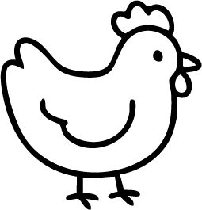


Name:
Date:
LIVING OR NOT LIVING?
Color the living things blue and the non living things yellow.

