Slide 1
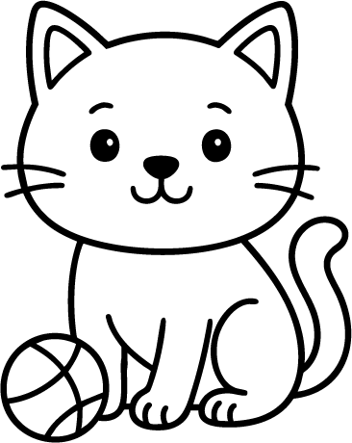
READING COMPREHENSION
Name
MAX THE CAT
The small cat is gray.
Max has green eyes.
Max likes his ball best.
Word Bank:
Max is gray:
cat
gray
green
likes
True
Max
ball
small
eyes
False
What is Max’s favorite toy?
Write 3 words describing Max.

