Slide 1
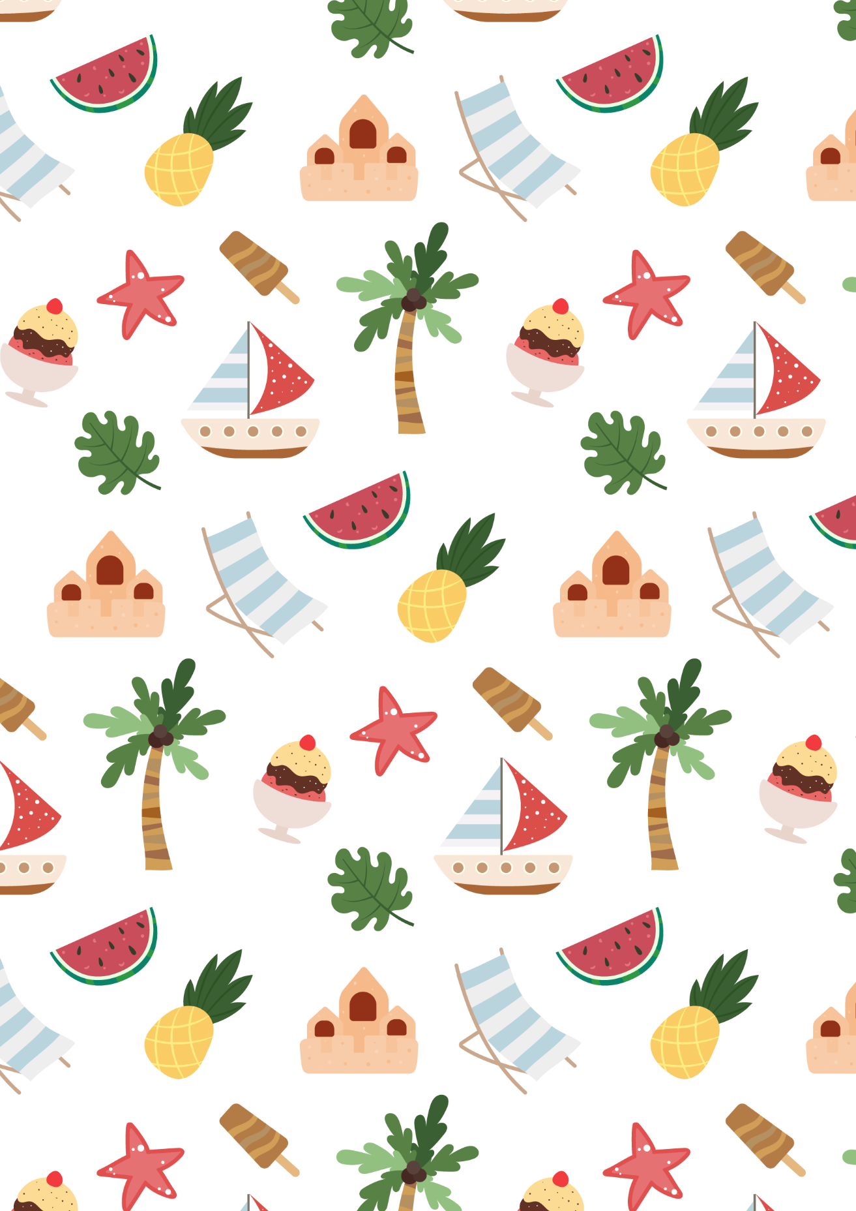
Kids Summer
Bucket List
Build a sandcastle at the beach
Create a backyard obstacle course
Have a picnic in the park
Visit a water park or amusement park
Learn to swim or improve your
swimming skills
Have a DIY fashion show with
clothes and accessories you create
Go on a nature walk and try to spot
different types of animals and plants
Have a themed party with
decorations, food, and costumes
Go on a nature walk and try to spot
different types of animals and plants
Make a time capsule and bury it
to be opened in the future
Have a water balloon fight with friends
Build a birdhouse or bird feeder
Visit a zoo or aquarium
Learn to play a musical instrument
Learn to ride a bike or improve your
biking skills
Go stargazing and learn about
different constellations
Have a movie marathon on a
rainy day
Create a mini-garden with flowers
or herbs
Learn a new sport, such as soccer
or basketball
Learn to speak a new language and practice
with a pen pal from another country.
Go on a camping trip and roast
marshmallows over a campfire
Visit a farm and pick fresh fruits
or vegetables
Have a game night with family or friends
Write and illustrate your own storybook
Visit a museum or art gallery
Go on a hike and have a picnic at the top
Have a sleepover with friends
Visit a zoo or aquarium
Volunteer at a local animal shelter
or community event
Have a scavenger hunt with clues
and prizes
Take a cooking class and learn to
make a new dish
Have a talent show with family
or friends
Have a lemonade stand and donate
the profits to charity
Have a game of capture the flag
with friends
Go on a road trip and explore new places
Make homemade ice cream or popsicles
Learn a new craft, such as knitting
or painting

