Slide 1
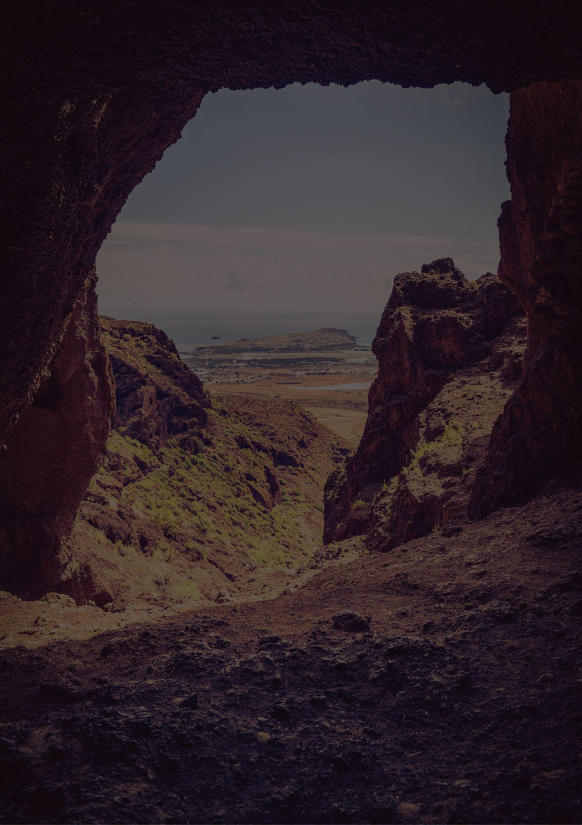
Travel bucket list
KANSAS
Wichita Gardens
Space Center
Kansas State Capitol
Boot Hill Museum
Sedgwick County Zoo
Wilson State Park
Tallgrass Prairie
Disneyland
Boot Hill, Dodge City
Death Valley Park
Evel Knievel Museum
Oz Museum
Spencer Museum of Art
Strataca
Flint Hills
Kansas City Aquarium
Monument Rocks
Safari Zoological Park
Fort Larned
Exploration Place
Keeper of the Plains
The Garden of Eden
Kansas Speedway
The Big Well
Kansas Cosmosphere
Mushroom Rock
Sedgwick County Zoo
Giant Van Gogh Painting

