Slide 1
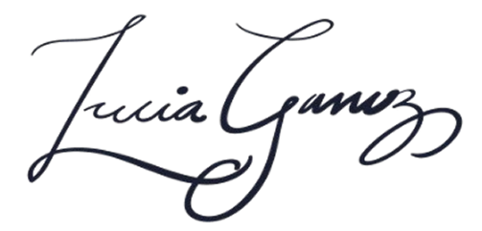
Lucia Ganung
123 Main Street, Portland, OR 97201
March 5, 2026
Clerk of the Court
Multnomah County Circuit Court
1200 SW 1st Ave
Portland, OR 97204
Subject: Request for Jury Duty Deferral – Juror #45872
Dear Clerk of the Court,
I am writing this letter to respectfully request to be excused from jury duty on March 20, 2026, because I am a full-time mother of my infant son.
At this time, making babysitting arrangements is not possible, as I am unable to afford child care.
I kindly ask that my name be placed back in the lottery, as I would be glad to serve on a jury at a future date when circumstances permit.
I sincerely appreciate your understanding of my situation. Please contact me at the phone number listed above if you need any further information.
Thank you for your time and consideration.
Sincerely,
Lucia Ganung

