Slide 1
Sale Event
Details:
Date: 12-26-2025
Time: From 9 a.m. to 5 p.m.
Location: 2222 Matthews Street,
Lockport, Illinois, 60441
Contact: +1 815-552-4758
Website: Domain.ltd
Social Media:
Facebook.com/salesbrochure
Sales Brochure
Sales Brochure
Instagram.com/salesbrochure
Massive Sale Extravaganza!
Tiktok.com/salesbrochure
Massive Sale Extravaganza!
Youtube/salesbrochure
Get ready for unbelievable deals at our exclusive sale event! We're thrilled to offer incredible discounts on a wide range of products.
Sales Brochure

Slide 2
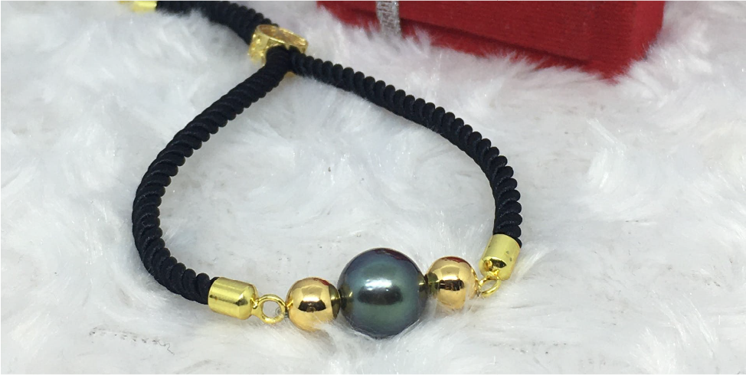
Why
Shop
With Us?:
Sale
Highlights:
Don't miss out on
these fantastic offers:
1
Quality Products:
Up to 50% Off:
Our commitment to quality ensures satisfaction
with every purchase.
Select items at jaw-dropping discounts.
2
Exceptional Savings:
Limited-Time Deals:
Unbeatable prices on top brands and trending items.
Special hourly sales throughout the day.
Customer Service:
3
Buy One, Get One:
Friendly and knowledgeable staff to assist you in finding the best deals.
Amazing BOGO offers on various products.
4
Doorbusters:
First-come, first-served
on exclusive items.

