Slide 1
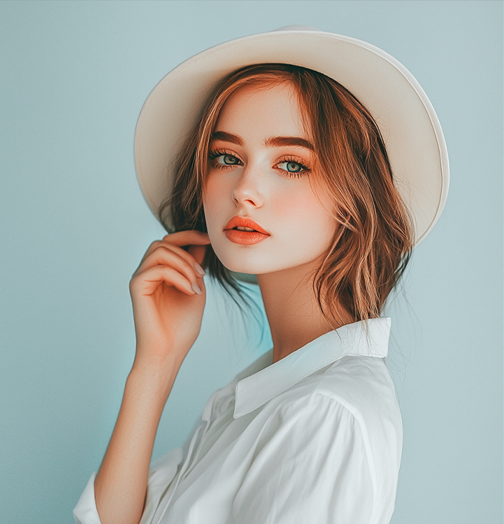
JASELLE LORNE
INTERIOR DESIGNER
CONTACT
WORK EXPERIENCE
jaselle.lorne@mail.ltd
Lead Interior Designer
05/2021 – Present
123 456 7890
BrightHaus Interiors
Designed and managed over 15 residential and commercial interiors with budgets up to $350,000.
San Diego, CA
Reduced project turnaround times by 22% through streamlined
vendor coordination.
jasellelorne-designs.ltd
Led material and furniture sourcing for large-scale redesigns, aligning with client branding and spatial goals.
linkedin.com/in/your-name
Produced full 3D visual walkthroughs to present design concepts to stakeholders.
HARD SKILLS
Maintained consistent client satisfaction ratings above 95%
post-project.
SketchUp, 3D Max
Junior Designer
01/2019 – 04/2021
Adobe Illustrator, Photoshop
NestForm Studio
3D Visualization, Render
Drafted floorplans and elevations using Revit and SketchUp for over 40 interior design proposals.
Space Planning, Material
Selected finishes and materials in accordance with sustainability
goals and client budgets.
Assisted in the installation and staging of residential interiors for
photography and real estate use.
SOFT SKILLS
Participated in weekly client strategy meetings, offering design input and visual updates.
Client Orientation
Conflict Resolution
EDUCATION
Time Management
Bachelor of Fine Arts in Interior Architecture
2014 – 2018
Savannah College of Art and Design
LANGUAGES
Focus: Human-centered design, Adaptive Reuse, and Wellness in
Interiors
English – Native
Capstone: “Biophilic Spaces for Mental Wellness in Urban Apartments and the Impact of Nature-Inspired Design on City Living”
Italian – Basic Proficiency

