Slide 1
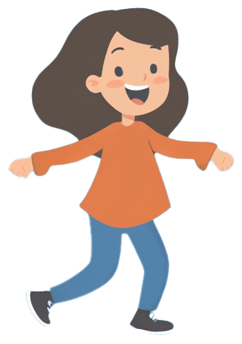
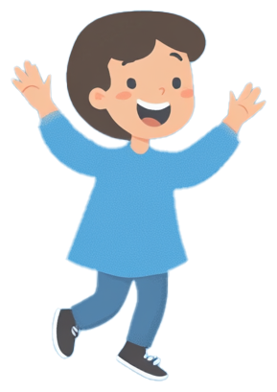
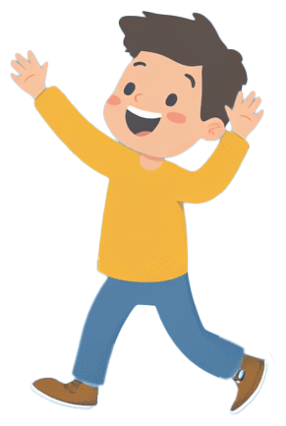
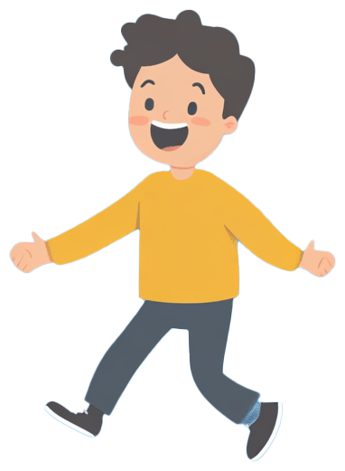
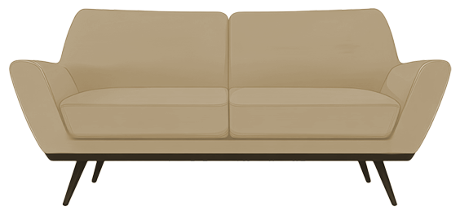
Interactive
SLIDES
SLIDES
Game
Join the Fun and Test Your Knowledge

Slide 2
Game Rules
Form Two Teams: Divide into two teams. Each team will compete to guess the most popular answers to survey questions.
Game Rounds: In each round, the host will ask a question that was previously asked to a group of people.
Your goal is to guess the most popular responses given by the survey participants.
Answering:
One player from each team will go head-to-head to answer the question first.
The player who gives the highest-ranking answer wins control for their team.
The team with control can continue guessing answers to complete the board.
Strikes: Each team has three strikes per round. If a team guesses incorrectly three times, control passes to the other team, which gets one chance to guess a remaining answer and steal the points.
Scoring: Points are based on the popularity of the answers. The more popular the answer, the more points it’s worth.
Fast Money Round: The team with the highest score goes to the Fast Money Round. Two players from the winning team will answer five questions. The goal is to reach a combined total of 200 points to win the game!

Slide 3
Scoreboard
Round
Team 1
Team 2
Round 1
-
-
Round 2
-
-
Round 3
-
-
Round 4
-
-
Round 5
-
-
Total
-
-
Add the points each team earns per round into the table.

Slide 4
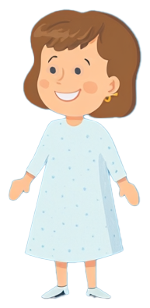
Question 1 (or 2, 3, etc.)
"What do people usually buy during the holiday season?"

Slide 5
Answer Question 1 (or 2, 3, etc.)
Answer 1 (most popular answer)
50
Answer 4
15
Answer 2
30
Answer 5
10
Answer 3
20
Answer 6
5

Slide 6
Fast Money Round
Question
Player 1 Answer
Points
Player 2 Answer
Points
What do you do to relax
-
-
-
-
Name a popular sport.
-
-
-
-
What do people buy for
their pets?
-
-
-
-
Name a common evening activity.
-
-
-
-
What do you do before bed?
-
-
-
-
Total
-
-

Slide 7
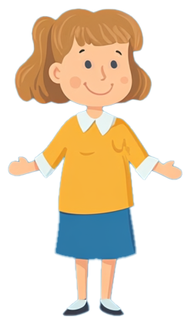
THE WINNER IS
Team 1
Congratulations to the
winning team!

