Slide 1
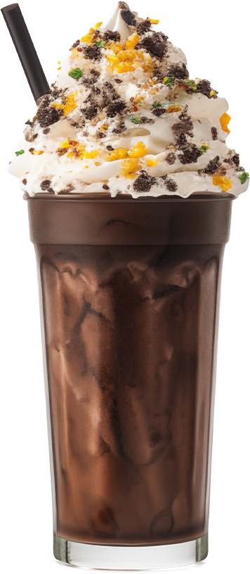
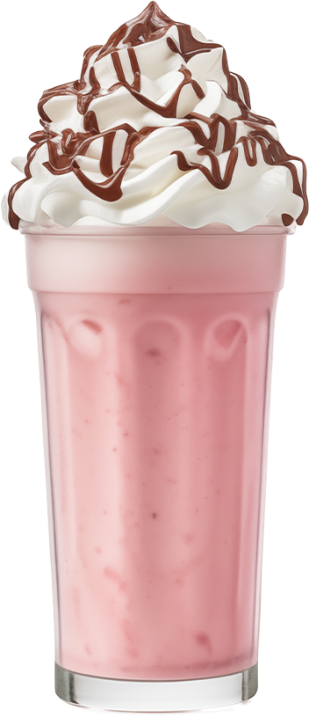
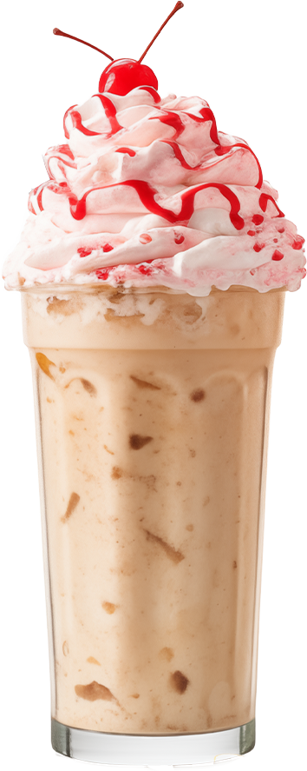
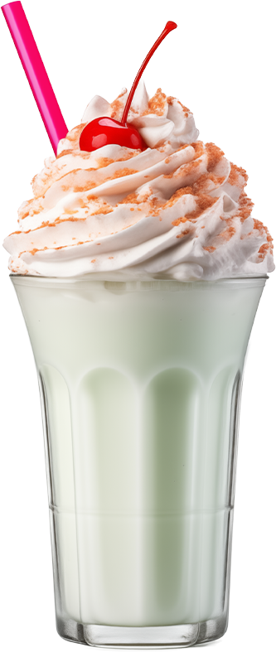
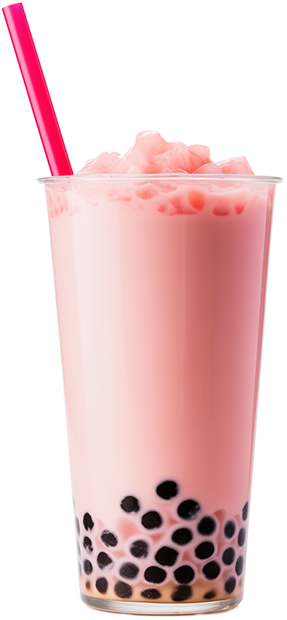
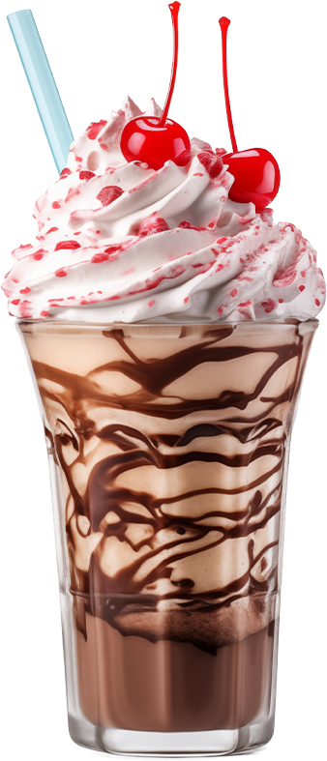
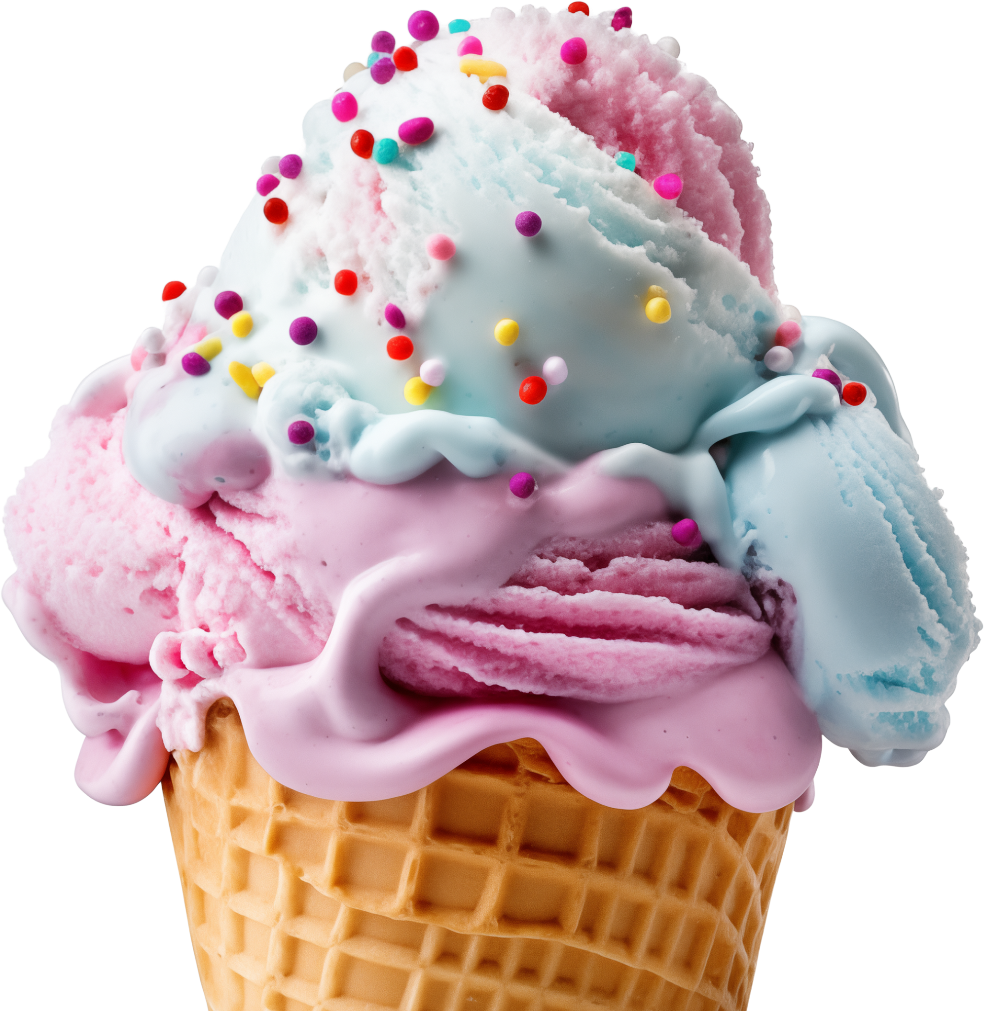
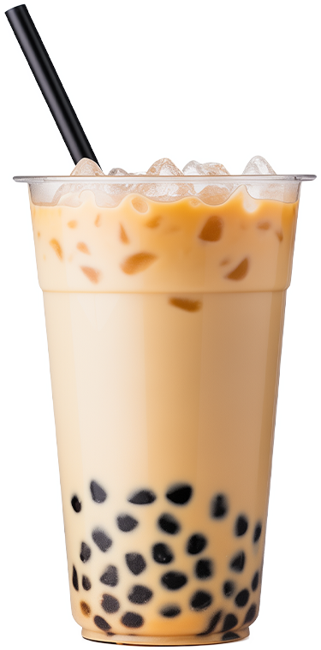
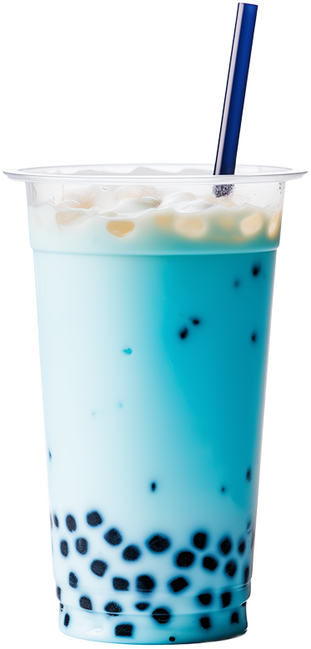
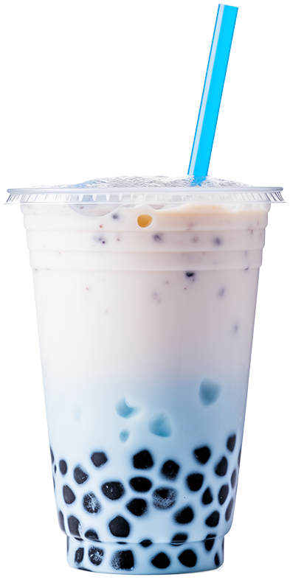
SCOOP YOUR HAPPINESS!
WELCOME TO SWEET HAVEN
DIVE INTO A WORLD OF SWEETNESS!
SWEET
$3.50
$3.80
$4.00
HAVEN
"CHOCO BLISS"
"BERRY CREAM"
"CARAMEL CRUNCH"
Ingredients: Chocolate milkshake topped chocolate.
Ingredients: Strawberry milkshake with whipped cream.
Ingredients: Coffee topped with whipped cream, caramel syrup.
ICE CREAM
ICE CREAM
$3.50
$3.80
$4.00
BLISS
BLISS
"VANILLA CHERRY"
"PINK CHOCO"
"DOUBLE CHOCO"
Ingredients: Cherry bubble
tea with chewy tapioca.
Ingredients: Chocolate milkshake with whipped cream.
Ingredients: Chocolate milkshake with whipped cream.
$3.50
$3.80
$4.00
"CARAMEL BOBA"
"BLUE LAGOON"
"FROSTY DREAM"
Ingredients: Milk tea with caramel syrup, chewy tapioca pearls, and ice.
Ingredients: Blueberry bubble tea with tapioca pearls and a hint of vanilla.
Ingredients: Icy vanilla milkshake with tapioca pearls and whipped cream.

Slide 2
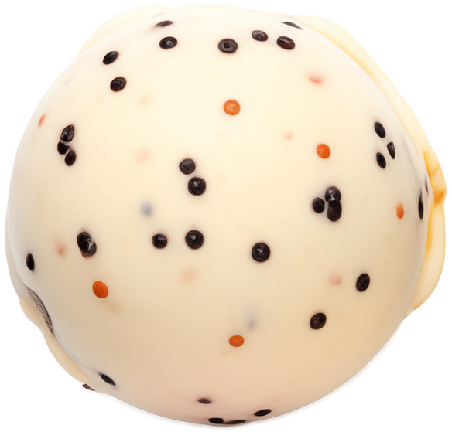
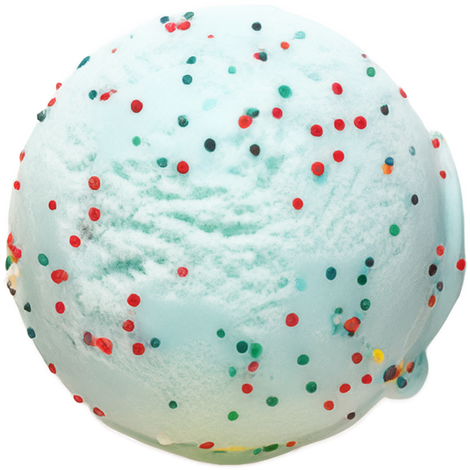
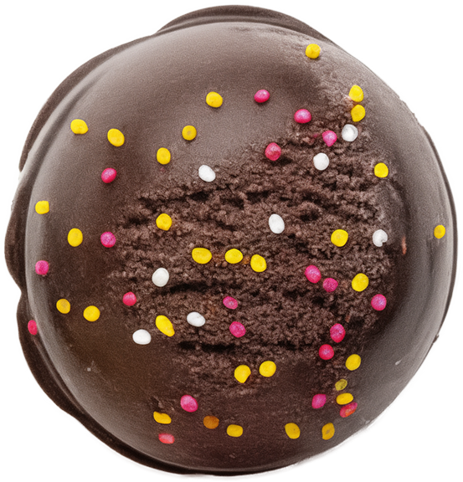
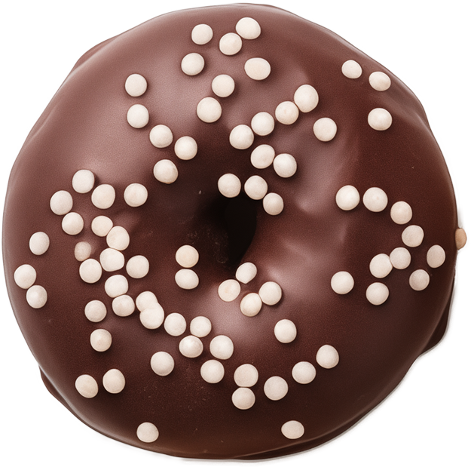
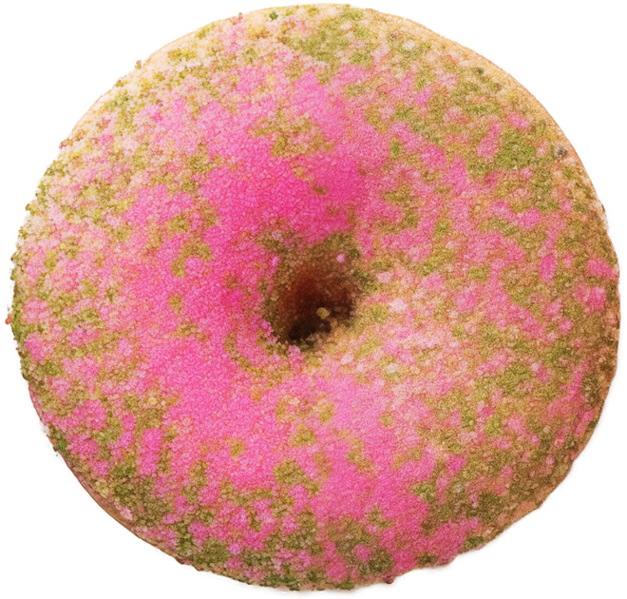
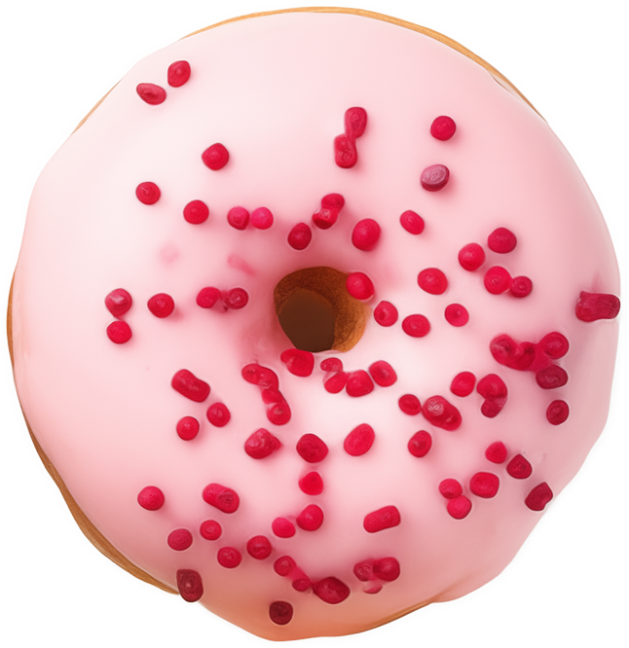
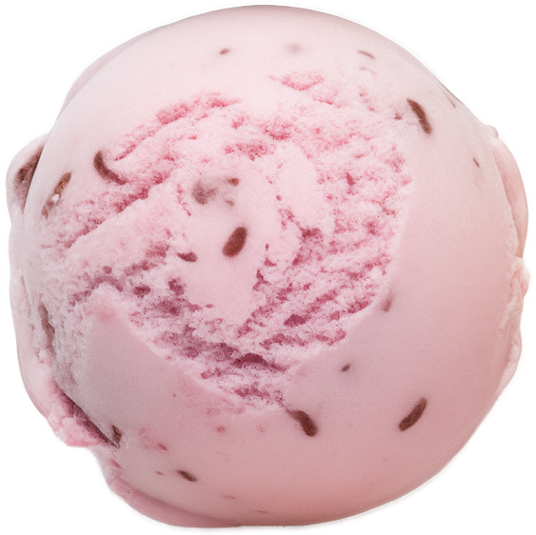
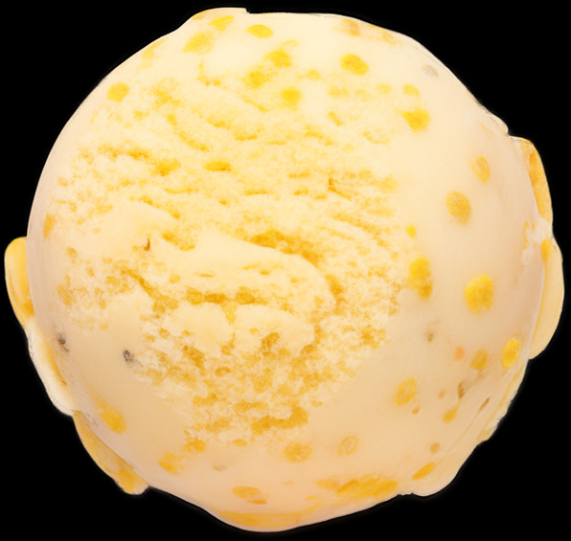
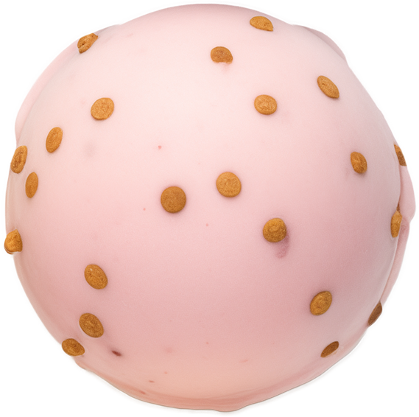
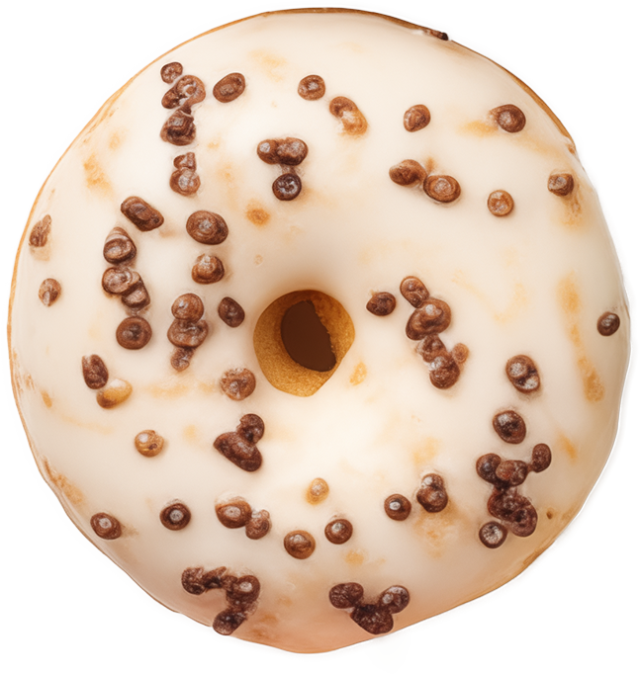
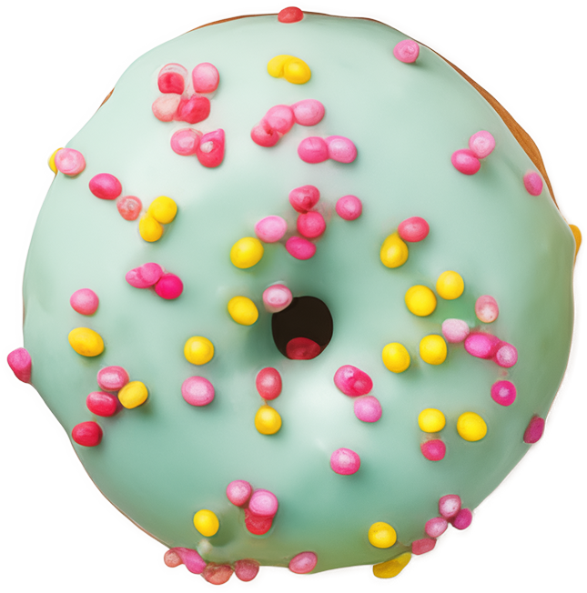
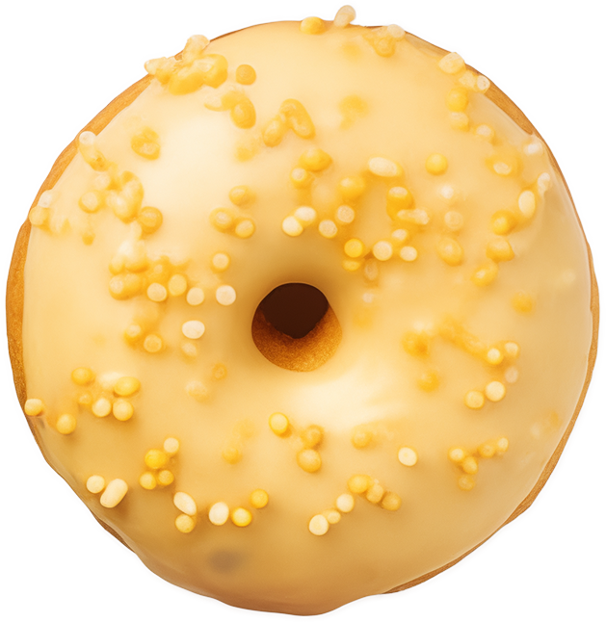
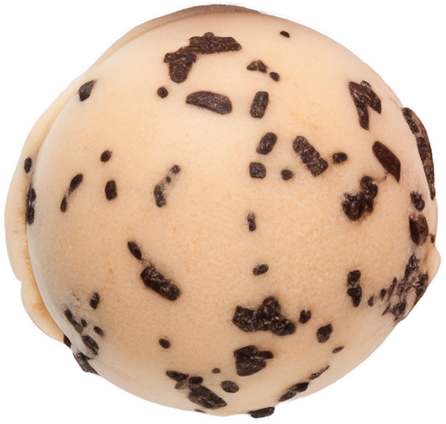
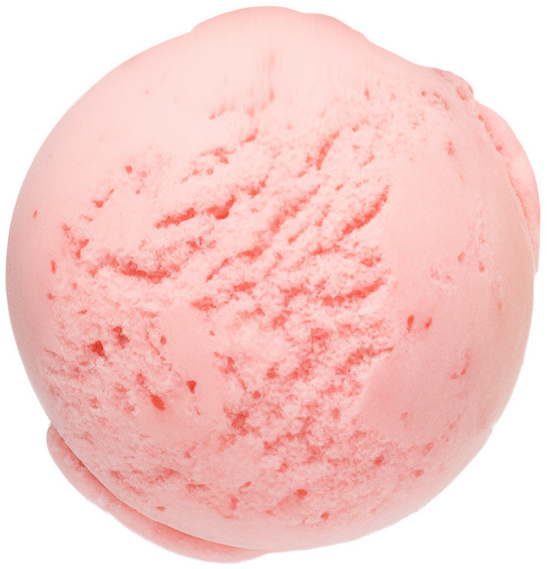
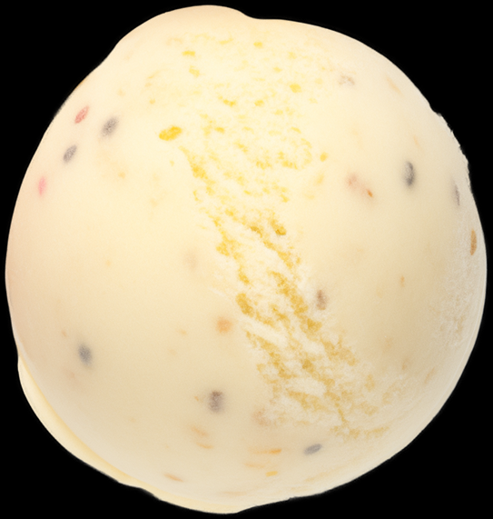
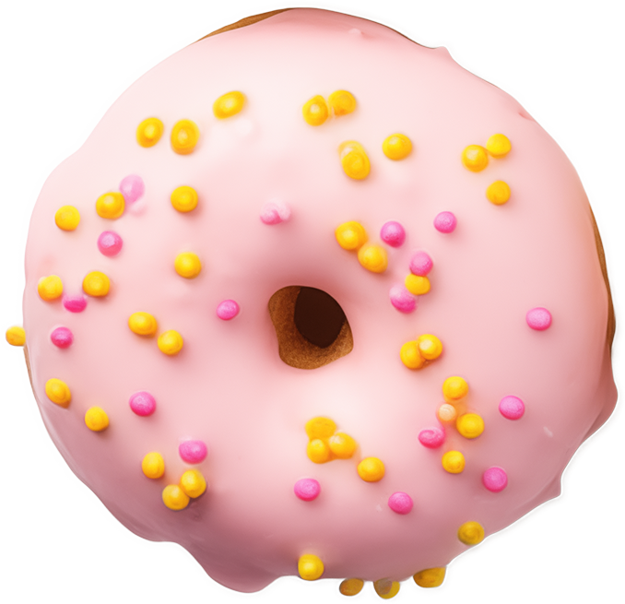
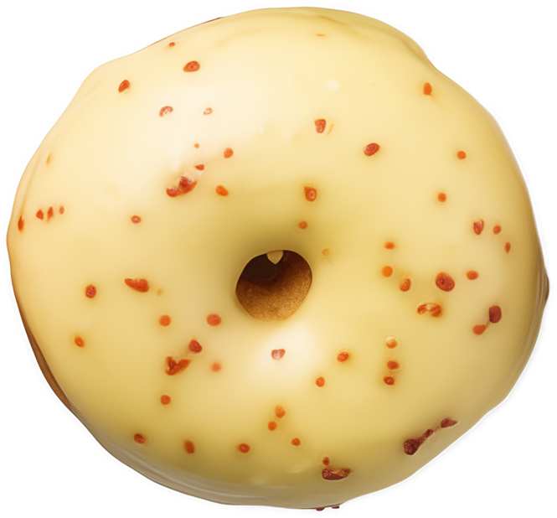
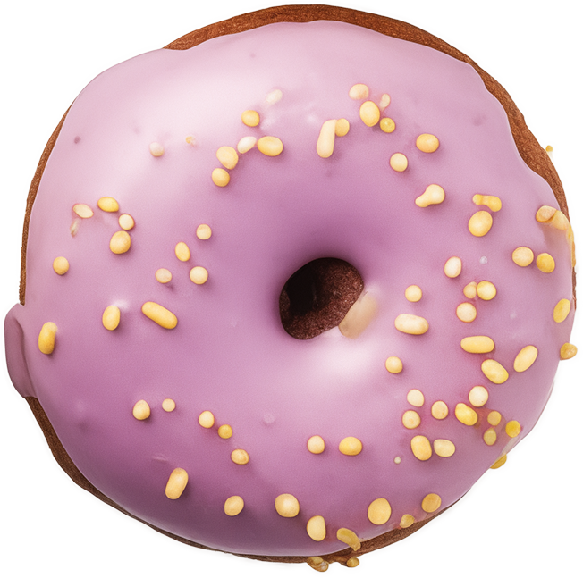
SCOOP YOUR HAPPINESS!
A BITE OF HAPPINESS!
$3.50
$3.80
$4.00
$3.50
$3.80
$4.00
"CHOCO DOTS"
"MINTY BLISS"
"DARK DELIGHT"
"CHOCO DOTS"
"PINK PARADISE"
"BERRY BLISS"
Ingredients: Vanilla ice cream
with chocolate chip sprinkles.
Ingredients: Mint-flavored ice cream with colorful candy sprinkles.
Ingredients: Rich chocolate ice cream with rainbow sprinkles.
Ingredients: Vanilla ice cream
with chocolate chip sprinkles.
Ingredients: Strawberry glaze with a sprinkle of green sugar crystals.
Ingredients: Raspberry glaze with red candy sprinkles.
$3.50
$3.80
$4.00
$3.50
$3.80
$4.00
"BERRY KISS"
"SUNNY LEMON"
"PINK GOLD"
"CRISPY CREAM"
"MINTY SPRINKLE"
"GOLDEN GLOW"
Ingredients: Strawberry ice cream with chocolate flakes.
Ingredients: Zesty lemon ice cream with sugar crystals.
Ingredients: Strawberry ice cream with golden caramel dots.
Ingredients: Vanilla glaze with chocolate cookie crumbs.
Ingredients: Mint glaze with colorful candy sprinkles.
Ingredients: Honey glaze
with yellow sugar pearls.
$3.50
$3.80
$4.00
$3.50
$3.80
$4.00
"COOKIES ‘N’ CREAM"
"CHERRY DREAM"
"VANILLA CONFETTI"
"PASTEL PINK"
"LEMON ZEST"
"VIOLET DREAM"
Ingredients: Creamy vanilla with chocolate cookie chunks.
Ingredients: Cherry-flavored ice cream with a hint of strawberry.
Ingredients: Classic vanilla ice cream with colorful candy bits.
Ingredients: Light pink frosting with pastel sugar dots.
Ingredients: Lemon glaze with a hint of vanilla and red sugar specks.
Ingredients: Lavender frosting
with golden sprinkles.

