Slide 1
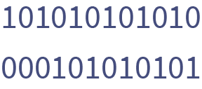
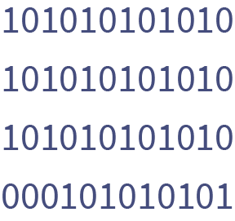
IT PROJECT
SCHOOL
Announcement
We invite everyone to take part in the annual competition for the best school project in the field of technology and programming.
APPLICATIONS ARE ACCEPTED UNTIL
SEPTEMBER 25, 2025
Registration link | gdoc.io

