Slide 1


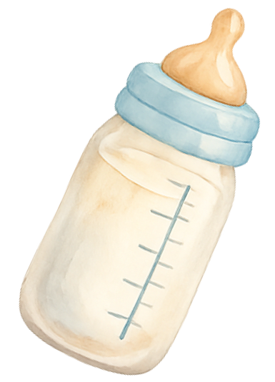
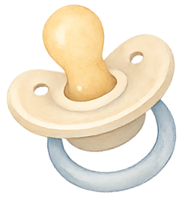

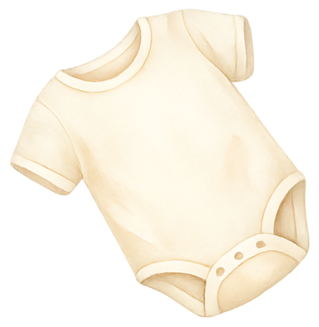
HOSPITAL BAG
Packing List
IMPORTANT DOCUMENTS
FOR MOM
LABOR COMFORT ITEMS
Photo ID
Health Insurance Card
Hospital Registration Forms
Pediatrician Info
Prenatal Medical Records
Birth Preferences Sheet
Wallet with Cash/Cards
Partner's ID
Maternity Nightgowns
Nipple Cream / Lanolin
Nursing Bra
Lightweight Robe
Cozy Slippers
Stretchy Leggings
Extra Underwear
Warm Cardigan
Glasses and Case
Maternity Pads
Perineal Spray Bottle
Hairbrush and Comb
Shampoo and Conditioner
Face Cleanser
Body Lotion
Comfortable Loungewear
Toothbrush and Toothpaste
Hair Clips or Scrunchies
Nursing Pads
Shower Flip-Flops
Relaxing Playlist
Wireless Earbuds
Breathing Exercise Cards
Massage Tool
Essential Oil
Reusable Heat Pack
Cooling Face Mist
Tennis Ball for Massage
Favorite Blanket
Portable Fan
FOR BABY
Newborn Bodysuits
Soft Beanie Hat
Receiving Blankets
Scratch Mittens
Baby Socks
Take-Home Outfit
Newborn Diapers
Baby Wipes
Gentle Baby Lotion
Pacifier (Optional)
Baby Nail File
Car Seat Installed
SNACKS & ESSENTIALS
Phone and Charger
Portable Power Bank
Reusable Water Bottle
Healthy Snack Bars
Electrolyte Drinks
Daily Medications
Vitamins
Travel Pillow
Extra Blanket
Camera or Phone Tripod
Notebook and Pen
Breastfeeding Supplies
Partner’s Overnight Bag
Clothes for Partner

