Slide 1
JAN 1875
VOL. 27
THE CHRONICLES OF TIME
Photo of the Great Pyramid of Giza with archaeologists exploring its newly discovered chamber.
ANCIENT WONDER UNVEILED
Breakthrough in archaeology. A team of explorers in Egypt has uncovered an untouched chamber within the Great Pyramid of Giza. Scholars believe this chamber may contain artifacts dating back to the time of Pharaoh Khufu. Breakthrough in archaeology. A team of explorers in Egypt has uncovered an untouched chamber within the Great Pyramid of Giza. Scholars believe this chamber may contain artifacts dating back to the time of Pharaoh Khufu.
Breakthrough in archaeology. A team of explorers in Egypt has uncovered an untouched chamber within the Great Pyramid of Giza. Scholars believe this chamber may contain artifacts dating back to the time of Pharaoh Khufu. Breakthrough in archaeology. A team of explorers in Egypt has uncovered an untouched chamber within the Great Pyramid of Giza.
Breakthrough in archaeology
Breakthrough in archaeology. A team of explorers in Egypt has uncovered an untouched chamber within the Great Pyramid of Giza. Scholars believe this chamber may contain artifacts dating back to the time of Pharaoh Khufu. Breakthrough in archaeology. A team of explorers in Egypt has uncovered an untouched chamber within the Great Pyramid of Giza. Scholars believe this chamber may contain artifacts dating back to the time of Pharaoh Khufu.
Breakthrough in archaeology. A team of explorers in Egypt has uncovered an untouched chamber within the Great Pyramid of Giza. Scholars believe this chamber may contain artifacts.

Slide 2
OUR WINDOW TO THE PAST
WWW.CHRONICLESTIMES.LTD
+44 7777 888 999
A ROYAL ENGAGEMENT ANNOUNCED
Crown Prince Frederick to wed Lady Eleanor
Crown Prince Frederick to wed Lady Eleanor The royal courts of Europe rejoice as the engagement of Crown Prince Frederick of Prussia and Lady Eleanor of England is officially declared. The grand wedding is expected to take place in the spring, bringing together two of the continent’s most influential houses. Crown Prince Frederick to wed Lady Eleanor The royal courts of Europe rejoice as the engagement of Crown Prince Frederick of Prussia and Lady Eleanor of England is officially declared.
The grand wedding is expected to take place in the spring, bringing together two of the continent’s most influential houses. Crown Prince Frederick to wed Lady Eleanor The royal courts of Europe rejoice as the engagement of Crown Prince Frederick of Prussia and Lady Eleanor of England is officially declared. The grand wedding is expected to take place in the spring, bringing together two of the continent’s most influential houses.
Crown Prince Frederick to wed Lady Eleanor The royal courts of Europe rejoice as the engagement of Crown Prince Frederick of Prussia and Lady Eleanor of England is officially declared. The grand wedding is expected to take place in the spring, The grand wedding is expected to take place in the spring, The grand wedding is expected to take place in the spring.
Painting of Crown Prince Frederick and Lady Eleanor at their engagement ball
The grand wedding is expected to take place in the spring, bringing together two of the continent’s most influential houses. Crown Prince Frederick to wed Lady Eleanor The royal courts of Europe rejoice as the engagement of Crown Prince Frederick of Prussia and Lady Eleanor of England is officially declared. The grand wedding is expected to take place in the spring, bringing together two of the continent’s most influential houses. Crown Prince Frederick to wed Lady Eleanor.

Slide 3
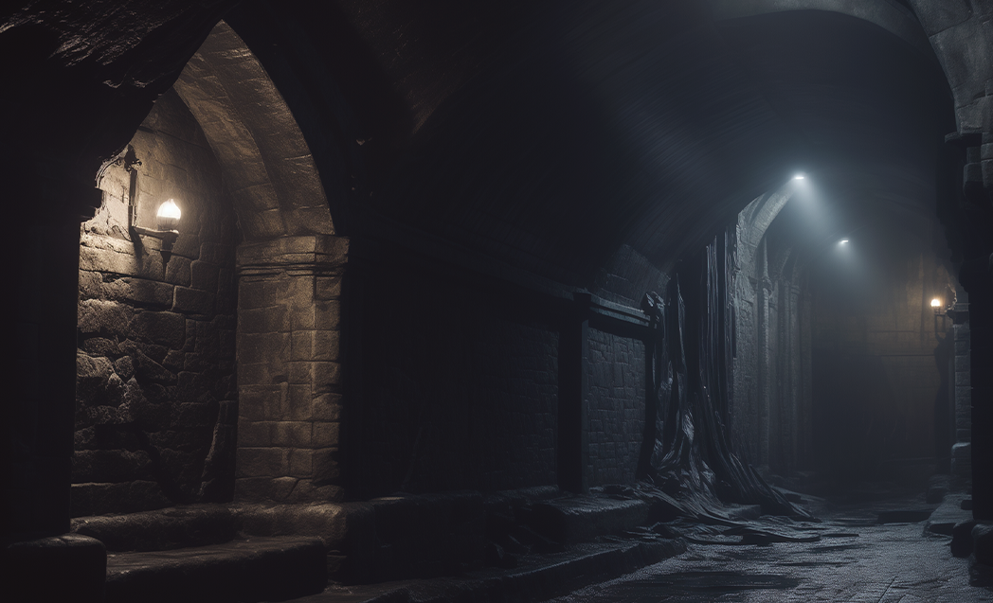
JAN 1875
VOL. 27
SECRETS OF THE CASTLE
Hidden passage discovered
Historians studying the ancient structure of Windsor Castle have stumbled upon a long-forgotten passageway beneath the castle’s Great Hall. Early theories suggest it may have been an escape route for medieval monarchs during times of war. Historians studying the ancient structure of Windsor Castle have stumbled upon a long-forgotten passageway beneath the castle’s Great Hall. Early theories suggest it may have been an escape route for medieval monarchs during times of war.
Early theories suggest it may have been an escape route for medieval monarchs during times of war. Historians studying the ancient structure of Windsor Castle.
Hidden passage in the castle discovered, revealing secrets of the past.
Historians studying the ancient structure of Windsor Castle have stumbled upon a long-forgotten passageway beneath the castle’s Great Hall. Early theories suggest it may have been an escape route for medieval monarchs during times of war Breakthrough in archaeology. A team of explorers in Egypt has uncovered an untouched chamber within the Great Pyramid of Giza. Scholars believe this chamber may contain artifacts.
Hidden passage in the castle discovered, revealing secrets of the past and sparking intrigue among historians and explorers.

Slide 4
OUR WINDOW TO THE PAST
WWW.CHRONICLESTIMES.LTD
+44 7777 888 999
THE RISE OF THE INDUSTRIAL EMPIRE
Factories and fortunes
Factories and fortunes Industrialists across Britain and the United States are rapidly expanding their manufacturing empires. Textile mills, steel factories, and railway companies are booming, creating new wealth for entrepreneurs while raising concerns about working conditions.
Will prosperity come at too high a cost? Factories and fortunes Industrialists across Britain and the United States are rapidly expanding their manufacturing empires. Textile mills, steel factories, and railway companies are booming, creating.
Photo of a steam locomotive pulling into a bustling industrial city, symbolizing the rapid advancements of the era.
Factories and fortunes Industrialists across Britain and the United States are rapidly expanding their manufacturing empires. Textile mills, steel factories, and railway companies are booming, creating new wealth for entrepreneurs while raising concerns about working conditions. Will prosperity come at too high a cost?
Textile mills, steel factories, and railway companies are booming, creating new wealth for entrepreneurs while raising concerns about working conditions. Will prosperity come at too high a cost? Textile mills, steel factories, and railway companies are booming, creating new wealth for entrepreneurs while raising concerns about working conditions. Will prosperity come at too high a cost?
Textile mills, steel factories, and railway companies are booming, creating new wealth for entrepreneurs while raising while raising while raising while raising concerns about working conditions.
Concerns over poor working conditions rise as industries thrive and expand.

