Slide 1
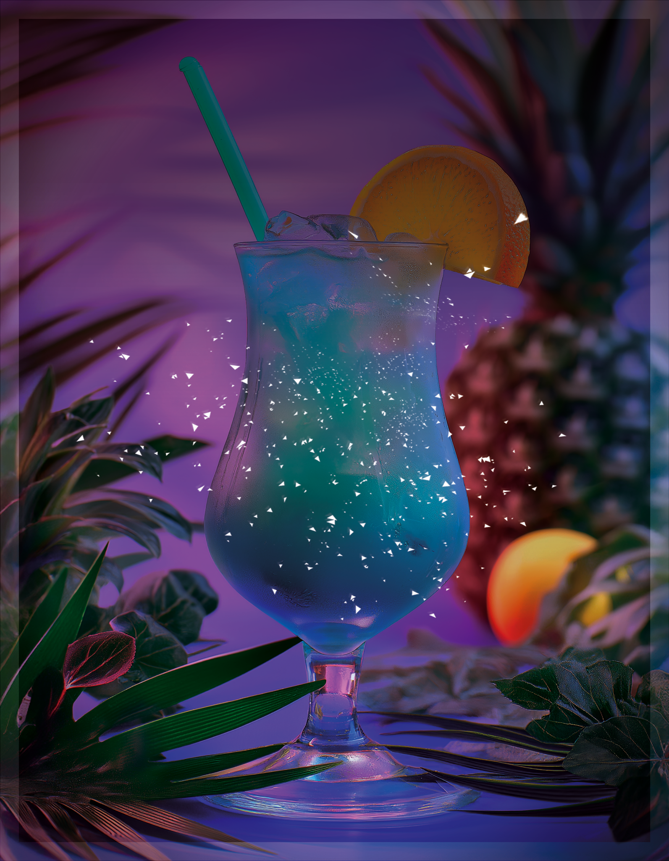
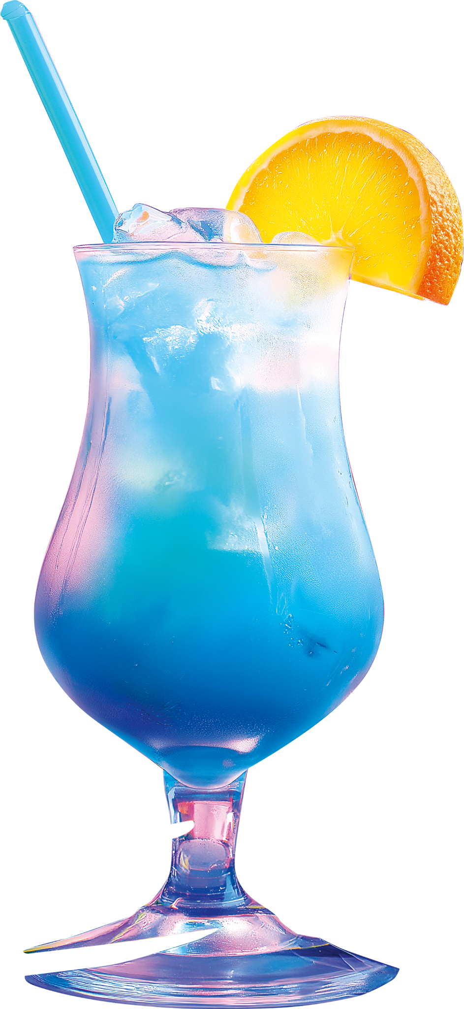

S U N S E T L O U N G E P R E S E N T S
HAPPY
HOUR
TROPICAL
DELIGHT SPECIAL
30
JULY
AT
8PM
Fridays
$90 BOTTLE SPECIALS ALL NIGHT
SUNSETLOUNGE.COM // OCEAN VIEW CLUB, 547 BEACHSIDE BLVD.
LIVE BEATS BY DJ RAY & DJ NOVA

