Slide 1
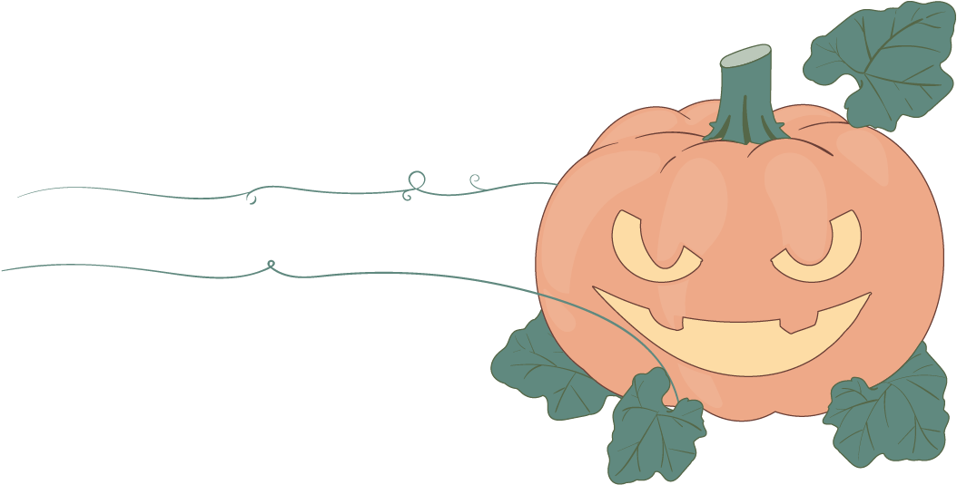
Halloween Potluck Sign Up
Activity / Event Name
В
list details about the what types of food to bring and what is already provided (eg. cups, plates, bowls, utensils, etc.)
Food Types: Appetizer. Dessert. Main Dish. Salad. Side Dish. Other
NAME
FOOD TYPE
DESCRIPTION
1
John Doe
Side Dish
Corn on the Cob
2
John Doe
Side Dish
Corn on the Cob
3
John Doe
Side Dish
Corn on the Cob
4
John Doe
Side Dish
Corn on the Cob
5
John Doe
Side Dish
Corn on the Cob
6
7
8
9
10
11
12
13
14
15
16
17
18
19
20
21
22
23
24
25

