Slide 1
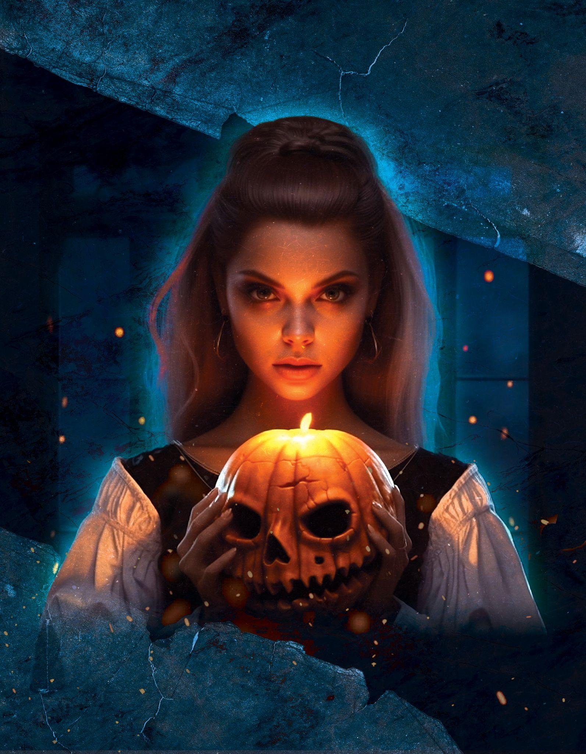


Night Party
HALLOWEEN
CHRISTIFER BUNNY
DJ FROZEN
ATLANTIDA BAND
31/10
AT 9PM
Special
Program
Night full of fear
F O R I N F O R M A T I O N C A L L : + 1 5 4 7 6 9 1 3 5 2 2
W E B S I T E : W W W . G D O C . I O
67890 Luisen platz bld, 90 Berlin, Germany
FREE PARKING - FREE DRINKS - HOOKAH - ENTRY $25

