Slide 1
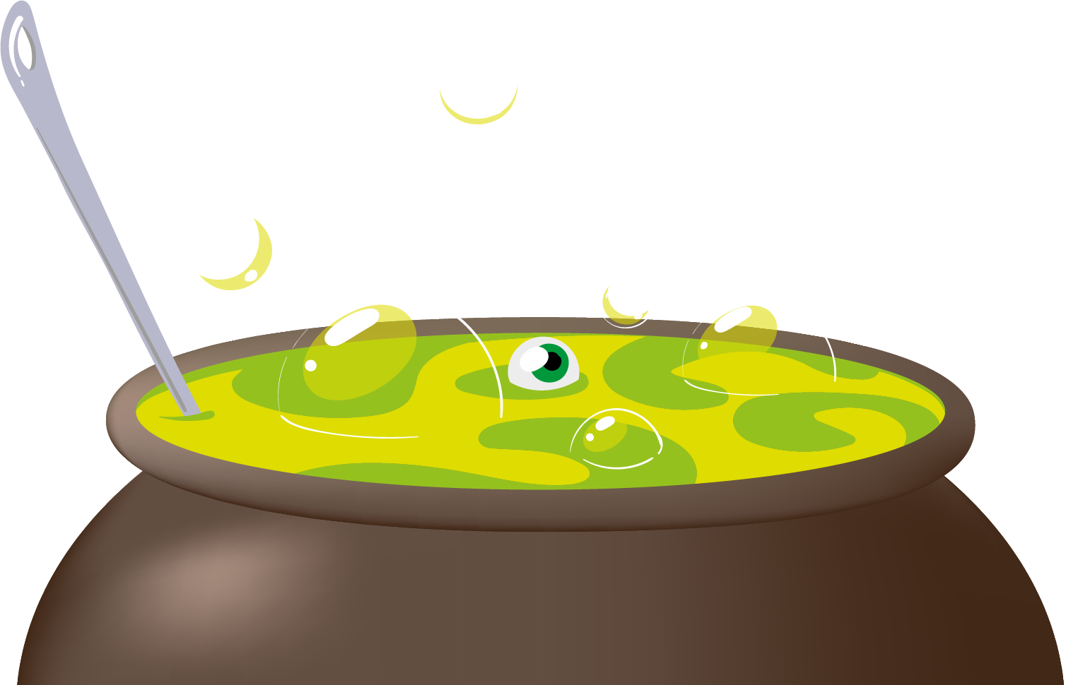
HALLOWEEN
BAR SPECIALS
CREEPY
COCKTAILS
SEASONAL
BEERS
Witches Brew
$4
Heinken
$6.5
raspberry vodka, pineapple juice, lime juice
Corona
$6.5
Zombie Virus
$2
TsingTao
$6.5
citrus vodka, blue vodka, lemaon lime soda
Cobweb Oil
$5
Draft
$15
vodka, grenadine, lime juice
Local Craft Beer
$15
Beetle Juice
$3
New Castle Ale
$15
brandy, coke, Irish cream
Organic Poison
$7
Green Lakes Organic Ale
$15
rum, coke, grenadine, gummy worms

