Slide 1
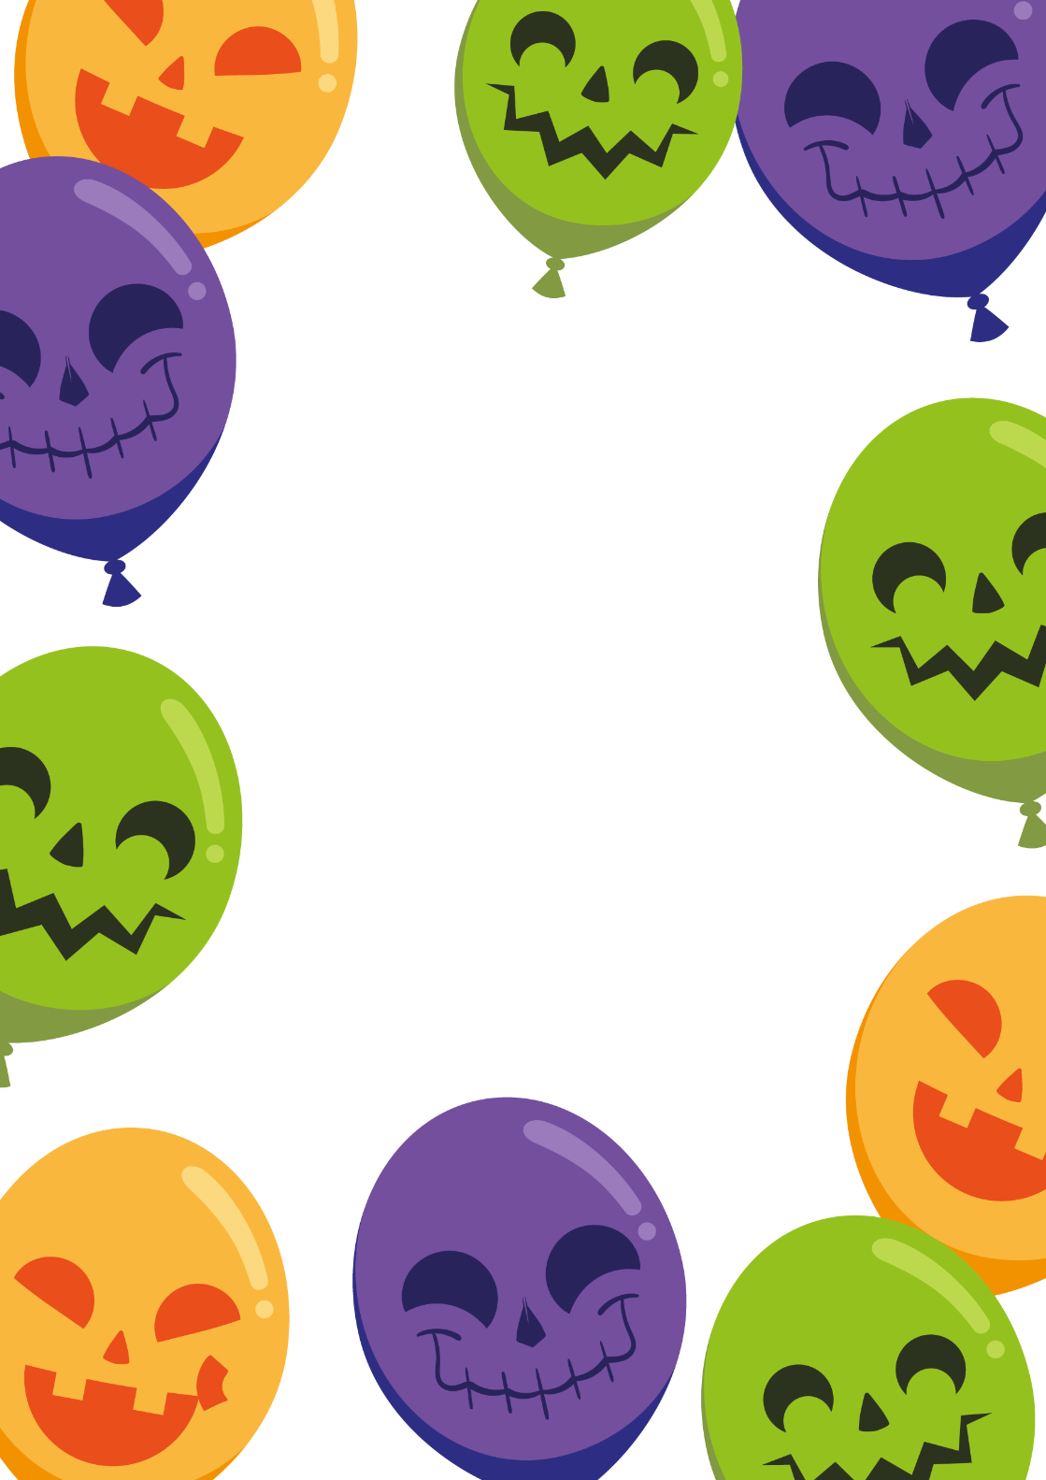
JOIN US FOR
Emma’s
BIRTHDAY PARTY
MONDAY, OCTOBER 31
3:00 PM
666 PARTY STREET

