Slide 1
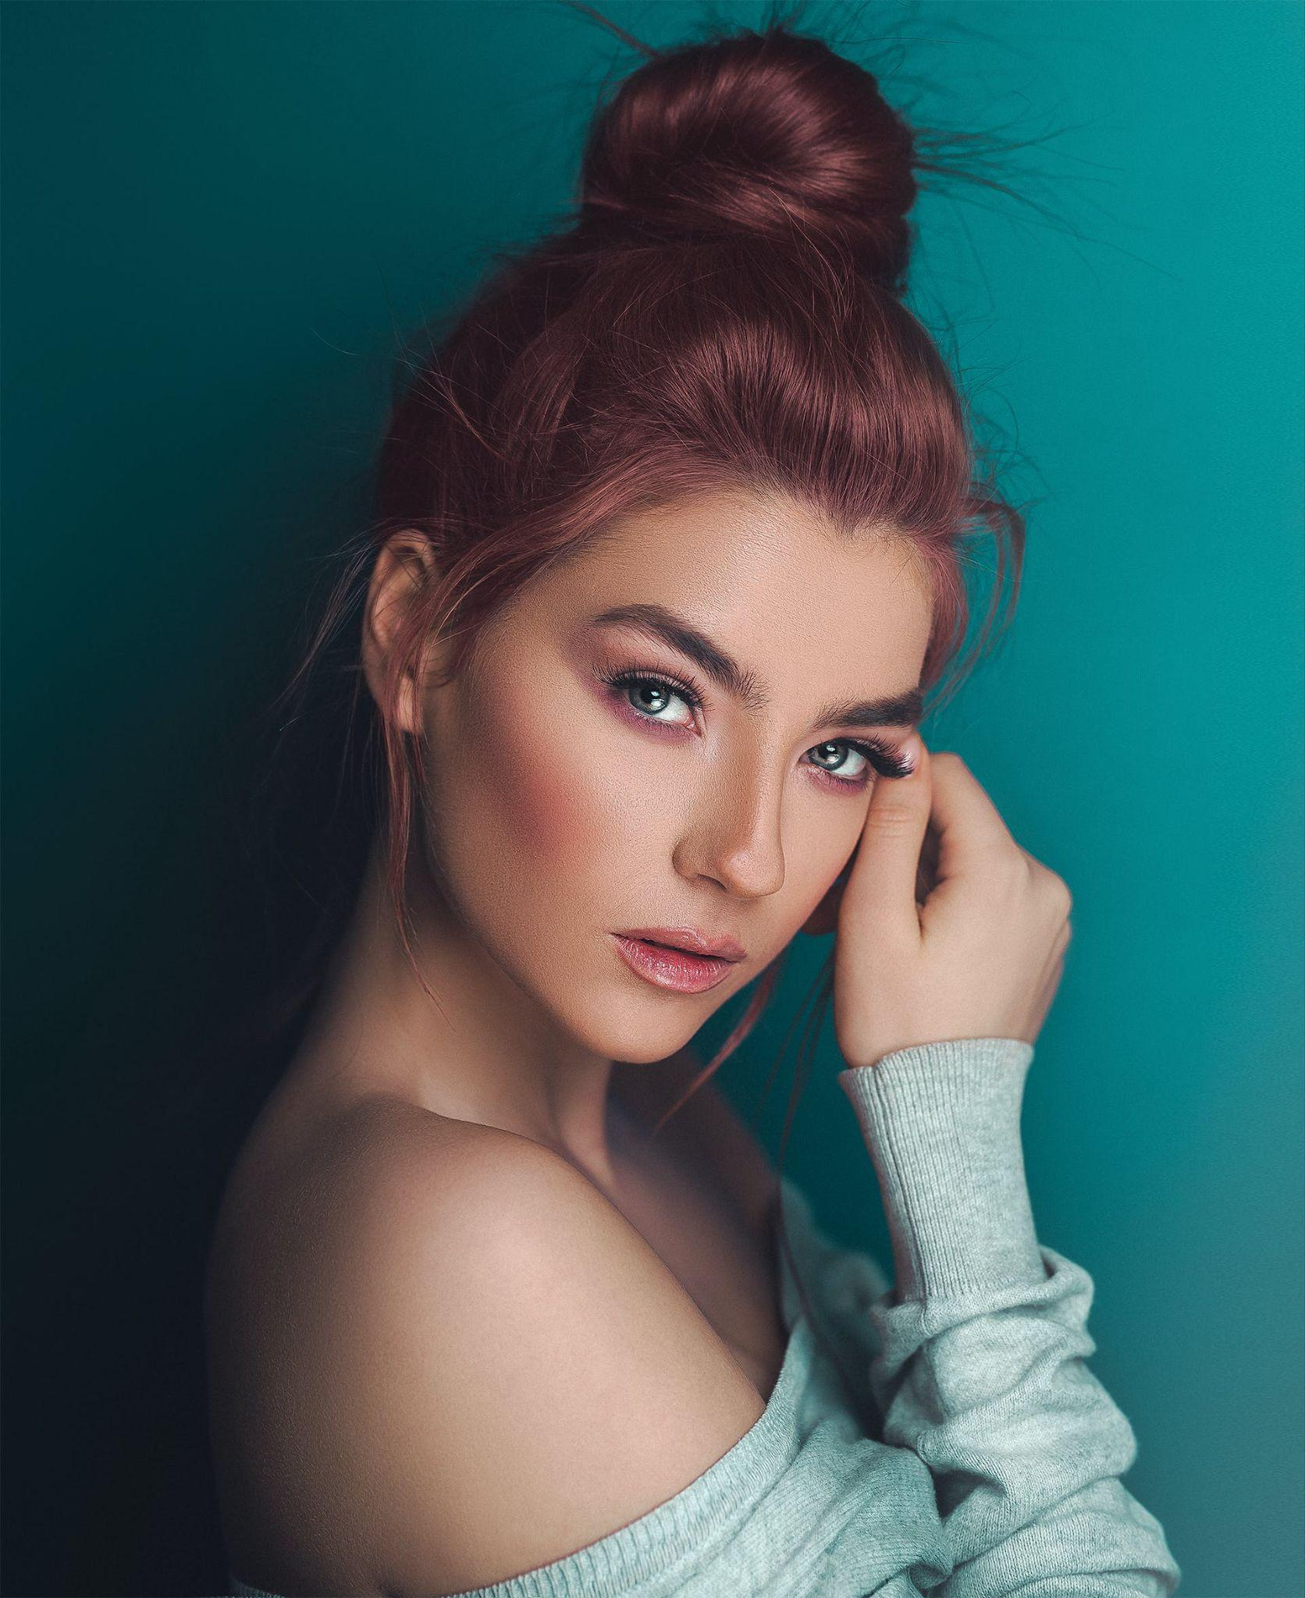
Contacts:
+1 615-618-2559
Walshbeautysalon@mail.com
Walshbeautysalon.com
261 Green Street, North Little Rock, Arkansas
Social Media:
Facebook.com/walshbeautysalon
Instagram.com/walshbeautysalon
Youtube.com/walshbeautysalon
Tiktok.com/walshbeautysalon
Walsh
Beauty Salon
UP TO
30%
OFF
WHERE BEAUTY COMES TO LIFE

Slide 2
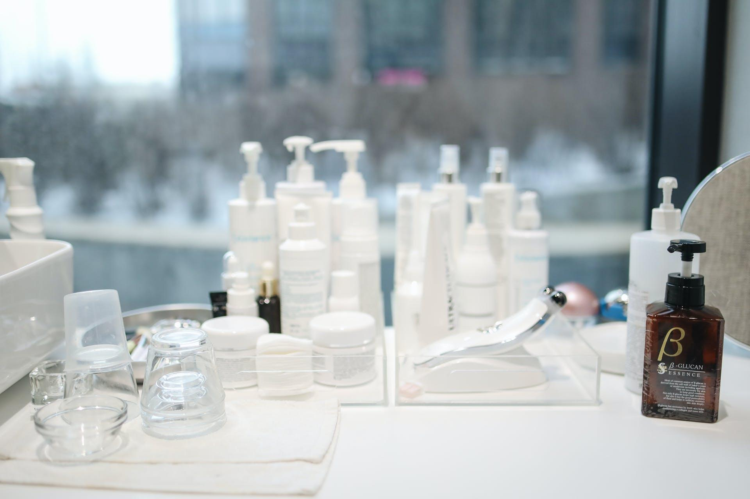
About Us
Services Offered
At Walsh Beauty Salon, beauty isn't just our expertise; it's our passion.
Our salon is more than just a place for hair and makeup. It's a haven
where beauty meets artistry, and each client is celebrated for their
unique style.
HAIR SERVICES:
• Haircuts....................................................................................
$35.00
• Styling......................................................................................
$30.00
• Coloring....................................................................................
$45.00
• Treatments...............................................................................
$55.00
Our Philosophy
SKINCARE:
• Facials......................................................................................
$45.00
At Walsh Beauty Salon, we believe beauty is more than skin deep. It's about confidence, self-care, and celebrating individuality. We strive to
create an inclusive environment where every client feels welcomed,
valued, and leaves feeling radiant.
• Peels........................................................................................
$35.00
• Treatments...............................................................................
$50.00
NAIL CARE:
• Manicures................................................................................
$45.00
• Pedicures.................................................................................
$55.00
• Nail art......................................................................................
$55.00
SPA TREATMENTS:
• Massages.................................................................................
$60.00
• Body wraps..............................................................................
$75.00
• Relaxation Therapies...............................................................
$55.00
ADDITIONAL SERVICES:
• Makeup....................................................................................
$45.00
• Waxing.....................................................................................
$35.00
• Special Packages....................................................................
$70.00

