Slide 1

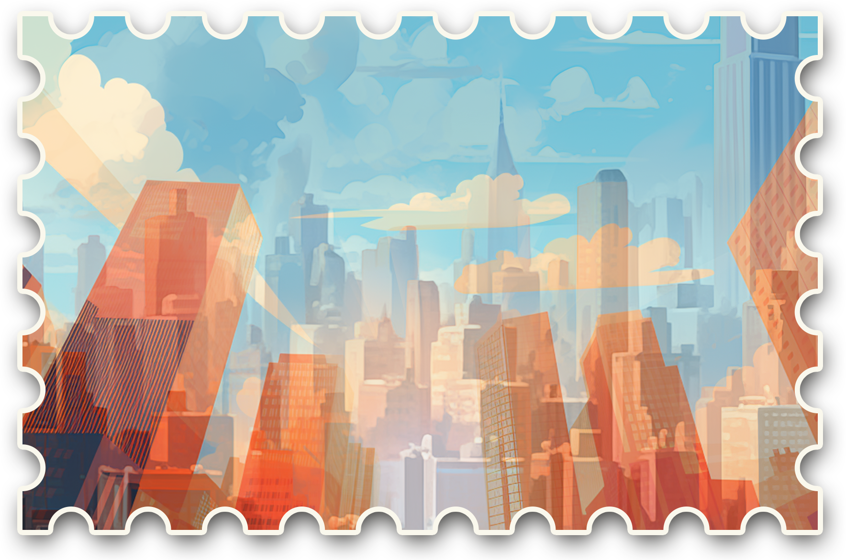


GREETINGS FROM
CITY

Slide 2

Greetings from New York Postcard

