Slide 1
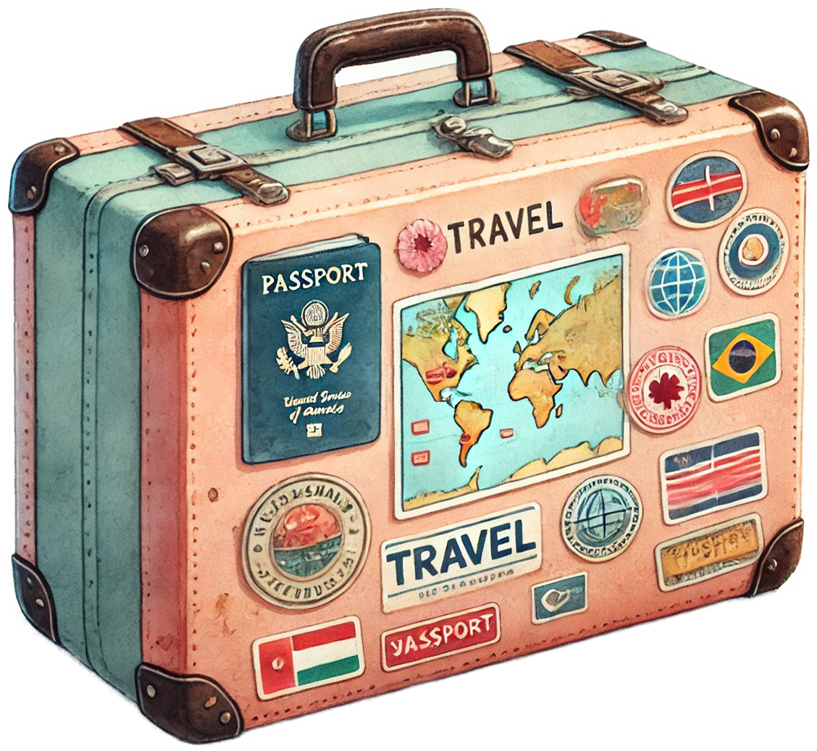
Off to New Beginnings!
Going Away
Party
THE CARTER FAMILY
as they embark on an exciting new journey!
SEPTEMBER 14th, 2028 at 6:30 PM
THE MAPLEWOOD HALL
215 Oakridge Ave, Asheville, NC 28801
Kindly RSVP Emma (828) 555-7890

