Slide 1
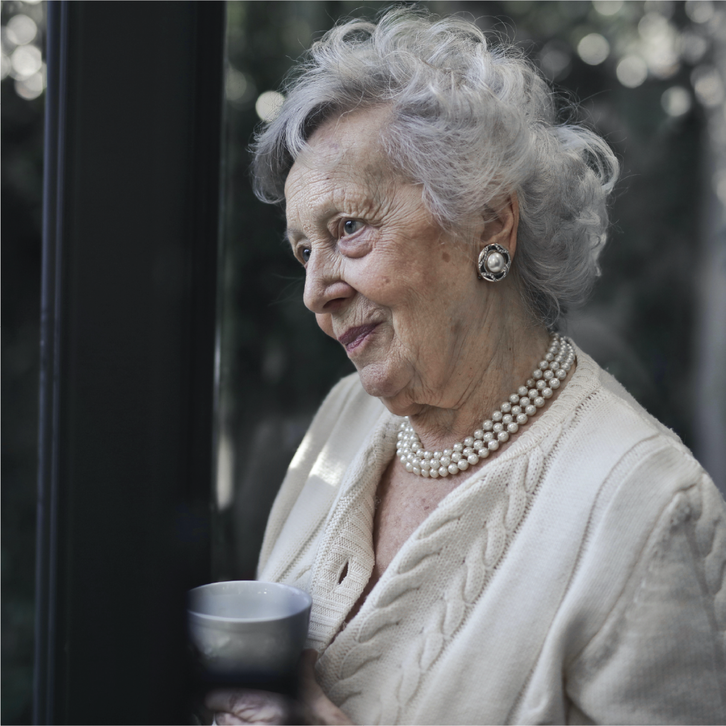
Celebrating the life of
Diane Parker
August 5, 1940 - September 10, 2022

Slide 2
Funeral Program
Musical prelude
Processional
Musical selection
Prayer
Cripture
Solo
Hymn
Obituary
Eulogy
Words of comfort
Pallbearers
April Fisher
Angela Evans
David Cook
Lorna Wilson
Acknowledgements
Thank you to our friends, family and
community for your support.

