Slide 1
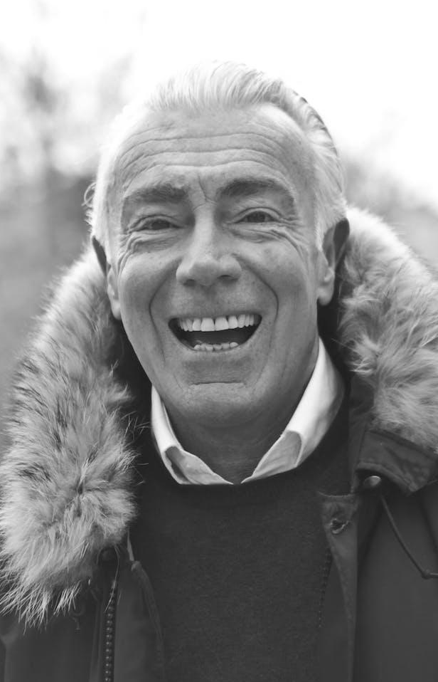
Contact Information
& Acknowledgments
Contact Details:
Cole Walter's life was a testament to his passions. He touched the lives of many with his kindness, humor, and generosity. He will be remembered for the good deeds he did.
Information about the funeral home or organizing entity handling arrangements.
Acknowledgments:
Thank you message to attendees, supporters, or anyone providing assistance.
In Loving Memory of
Additional Information:
KOLE
WALTER
Any relevant details, such as charity donation requests or reception information.
April 13, 19XX
November 14, 20XX

Slide 2
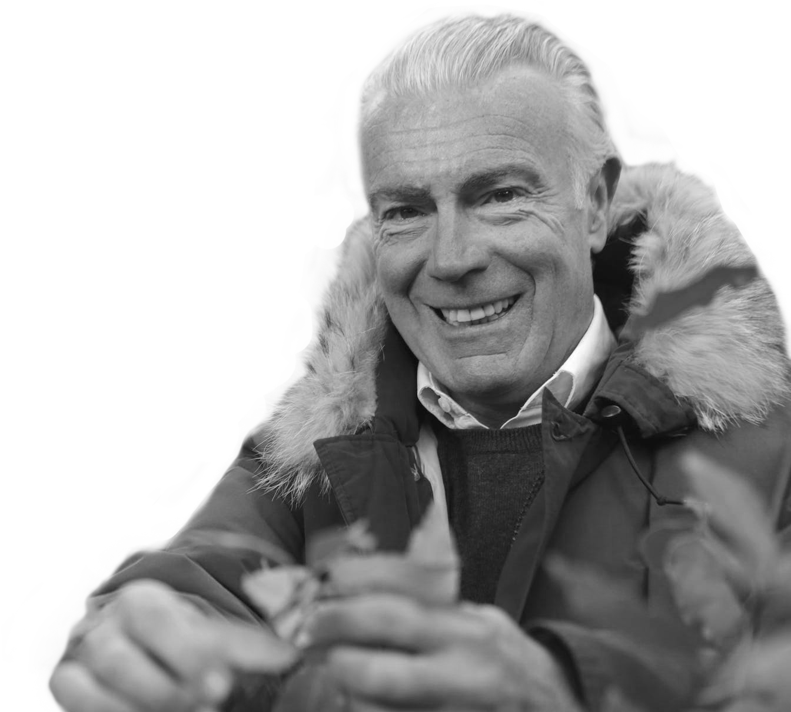
Memories Shared
for friends:
Funeral Service Details:
November 21, 20XX
at 10:00 Am
Kole was a true friend, always there to lend a listening ear, offer unwavering support, and share in both joy and sorrow. His genuine kindness and warmth brought us together, creating a bond that will forever be treasured.
1202 Kelly Drive, Bluefield,
West Virginia, Bluefield
Memories Shared
for Family:
Order of Service:
Kole had a remarkable way of bringing the family together. Whether it was holiday celebrations, Sunday dinners, or spontaneous get-togethers, he created a warm and inviting atmosphere that made everyone feel at home.
Opening Words
10:20-10:40 Am
Prayers/Readings
10:40-10:50 Am
Eulogy
10:50-11:20 Am
Reflections/Moments of Silence
11:21-11:22 Am
Musical Tributes
11:25-11:30 Am
Closing Words
11:39-12:30 Pm

