Slide 1








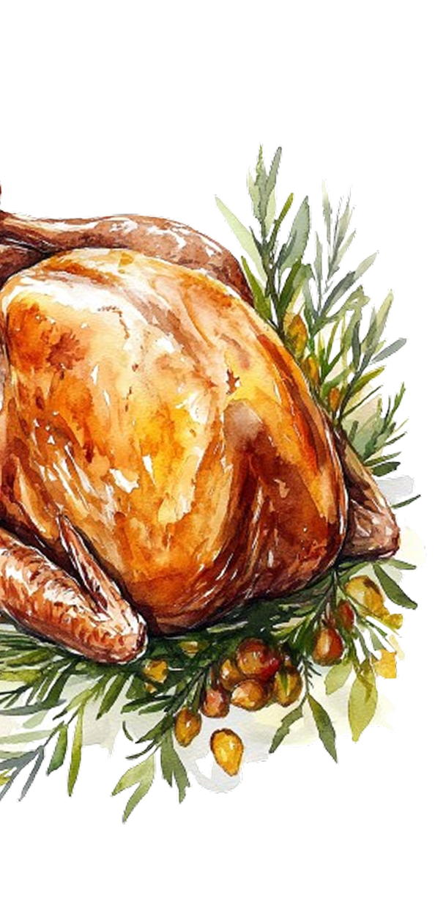




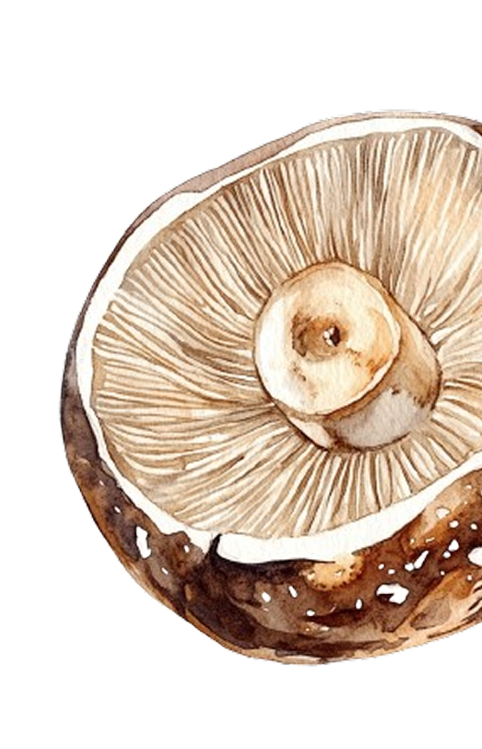
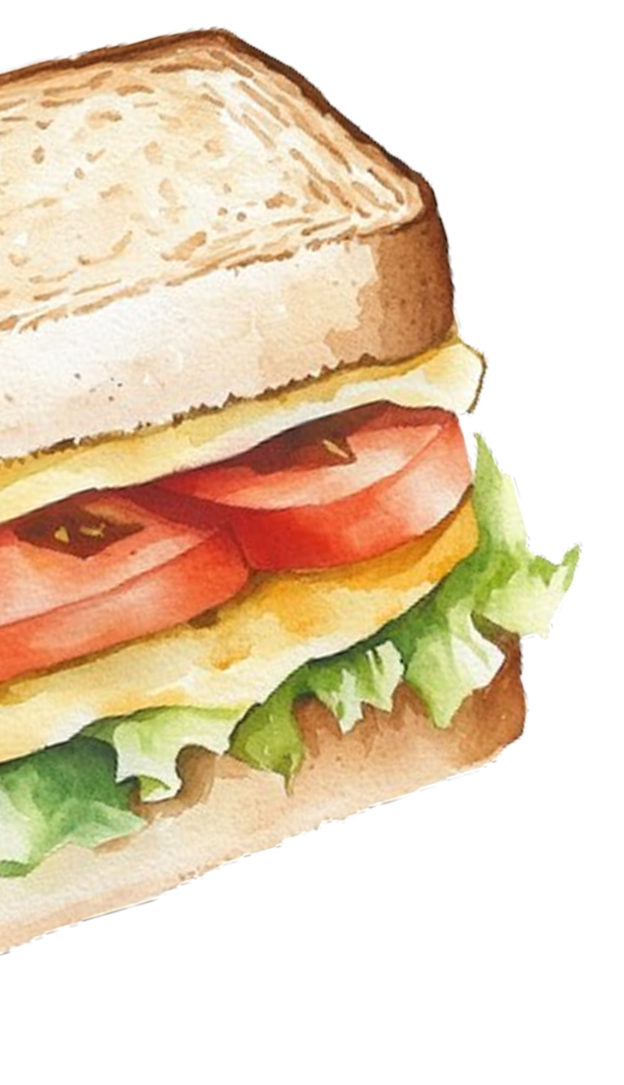



Friends
PLEASE JOIN US FOR A
giving
LET’S GATHER, FEAST,
AND GIVE THANKS — TOGETHER.
15
SATURDAY
7 PM - 10 PM
NOVEMBER, 2025
ANNA’S RESIDENCE
123 MANSFIELD AVE,
LOS ANGELES, CA 90001
RVSP +1 1234567890

