Slide 1

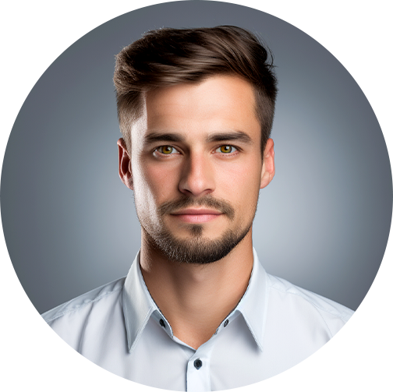
Alexander Hartley
Freelance Specialist
Results-driven freelance professional with over six years of experience in content writing, digital marketing, and graphic design. Skilled in delivering high-quality work for diverse clients, optimizing content for SEO, and developing impactful marketing strategies.
Profile
Employment
E
hartley@example.co.uk
Content Writer & Editor
P
+44 1234 567890
Freelance Work
A
London, UK, W1D 3BS
Jan 2018 — Present
Education
Wrote and edited over 300 high-quality articles for clients in diverse industries,
including technology, travel, and lifestyle.
University of London
Managed deadlines effectively, completing projects ahead of schedule 95%
of the time.
Bachelor of Arts in Communications,
Digital Marketing Consultant
GPA: 3.6/4.0
Self-Employed
Graduated: June 2014
Mar 2016 — Dec 2017
Freelance Academy
Developed and executed digital marketing campaigns for small to mid-sized
businesses, resulting in a 20% increase in lead generation.
Certificate in Project
Created email marketing strategies that improved open rates by 15% and
click-through rates by 10%.
Management, GPA: 4.0/4.0
Completed: August 2016
Conducted market research to optimize content strategy, enhancing client
brand visibility.
Skills
Content Writing
Graphic Designer
SEO Optimization
Freelance Projects
Digital Marketing
Jun 2014 — Feb 2016
Project Management
Designed logos, business cards, and social media graphics for over 50 clients,
ensuring brand consistency and aesthetic appeal.
Worked with
Collaborated with clients to understand their vision and deliver custom
solutions, earning a 98% satisfaction rate.
Google, Shopify, Canva
Utilized Adobe Creative Suite to produce high-quality visuals for print and
digital use.

