Slide 1
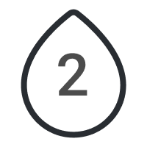
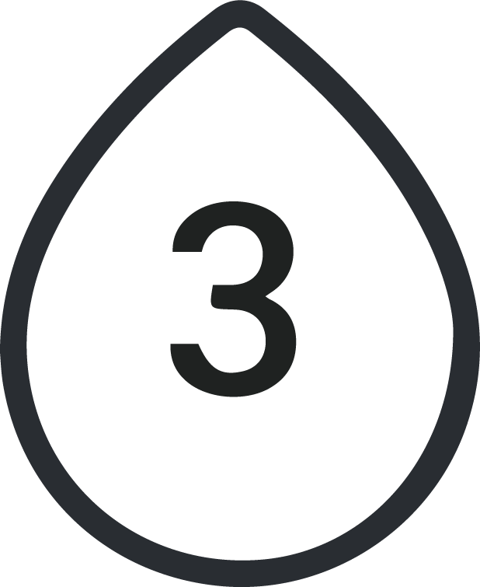
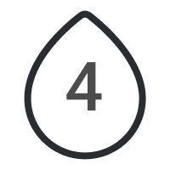
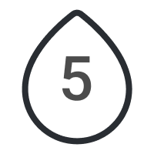
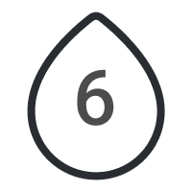
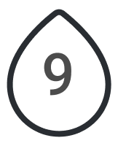
Food Diary
Breakfast
Calories
Goal
Mood
Lunch
Calories
Water Cups
Dinner
Calories
Sleep Hours
Exercises
Snacks
Calories
Notes
Total
Calories
Water
Exercise

Slide 2
Food Diary
Breakfast
Calories
Goal
Greek Salad
320
keep smiling to this life and
everything will go the right way.
study design, minimum 4 hours!!!
Apple smoothie
70
Total
390
Mood
Lunch
Calories
Creamy salmon pasta
680
coffee with milk
50
Water Cups
orange juice
30
Total
760
Dinner
Calories
Sleep Hours
tuna poke bowl
550
iced matcha latte
25
Exercises
Yoga - 30 min
Total
575
Breathing - 10 mins
Stretching - 25 min
Snacks
Calories
Granola
90
Candies
130
orange
25
Total
245
Notes
Don’t forget to buy the dog food!
Total
Calories
Water
Exercise
1,970
5 Cups
65 Min

