Slide 1
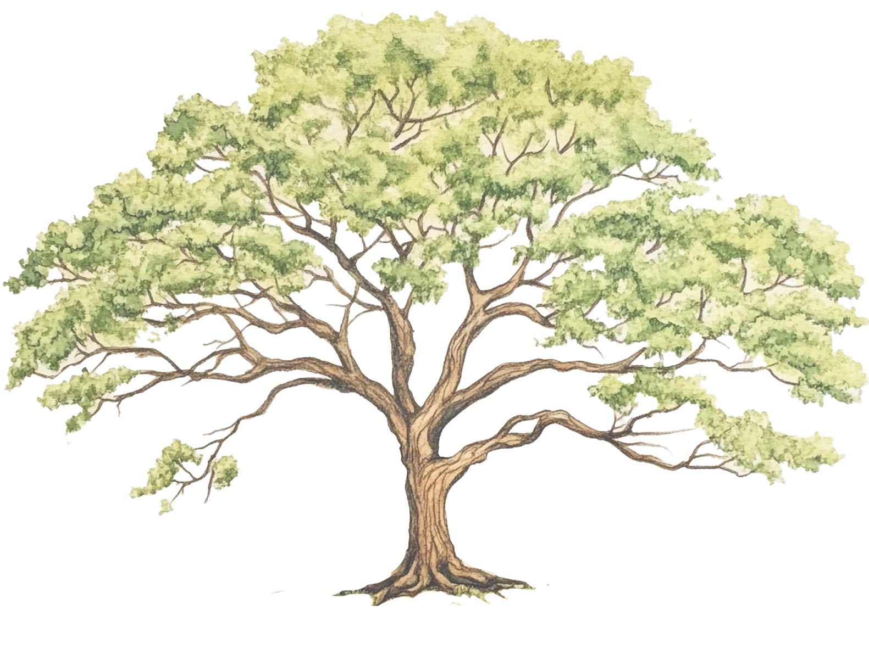
OUR FAMILY TREE
Grandmother
Grandfather
Grandmother
Grandfather
Mother
Father
Sibling
Sibling
Sibling
Sibling
Me
Sibling
Sibling
Sibling
Sibling

