Slide 1








Family Tree
Grandpa
Grandmother
Grandpa
Grandmother
Your Amazing Presentation
Starts Here
Dad
Mom
It's Me
Brother
01/20

Slide 2
Table of Contents
01
02
03
About the
Family Tree
How to
Create a Family Tree
Additional
Information
Briefly tell what will be discussed in this slide
Briefly tell what will be discussed in this slide
Briefly tell what will be discussed in this slide
02/20

Slide 3


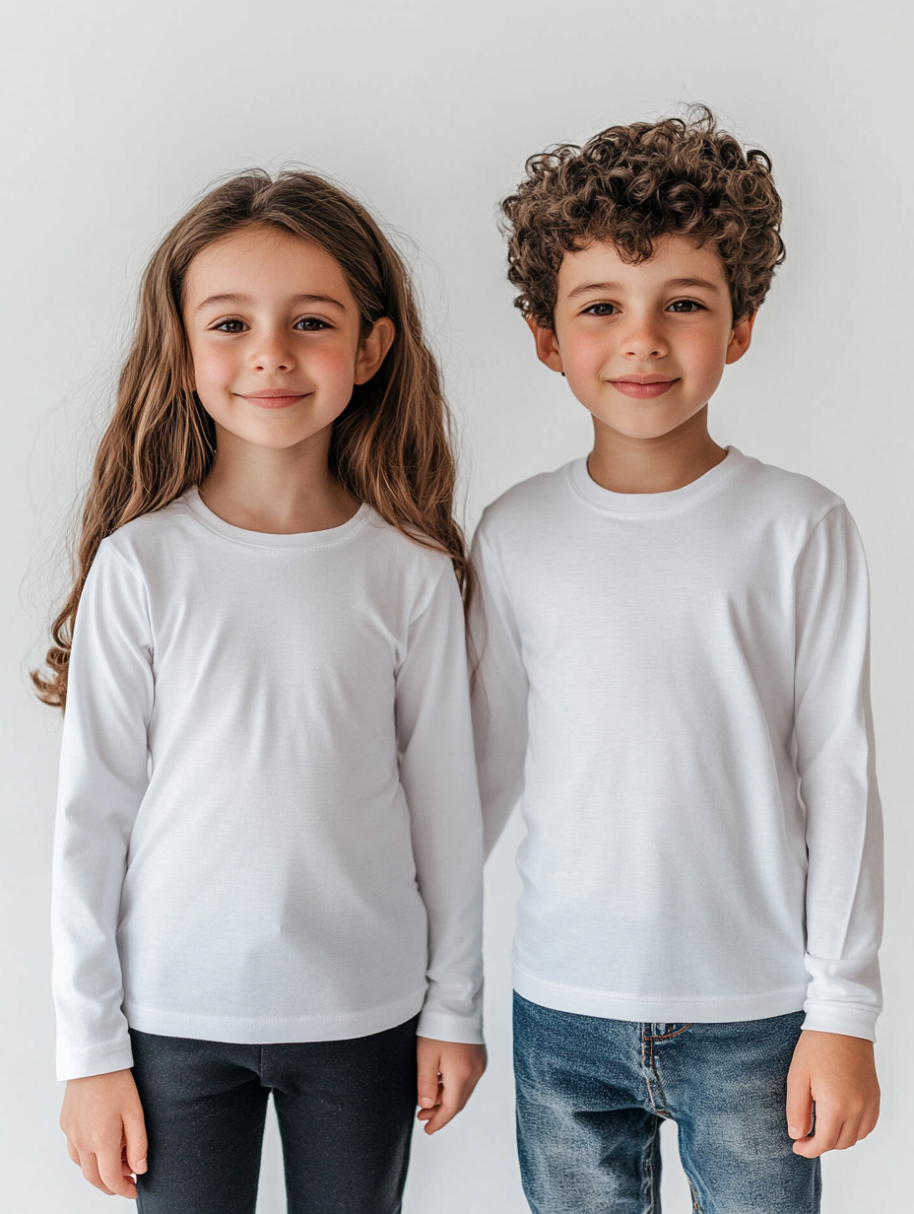
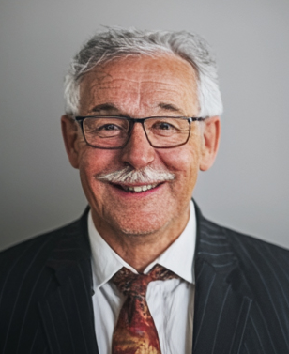
Whoa!
Briefly tell us about yourself or the speaker of the presentation.
03/20

Slide 4
01 About
the Family Tree
Briefly tell what will be discussed in this slide
04/20

Slide 5
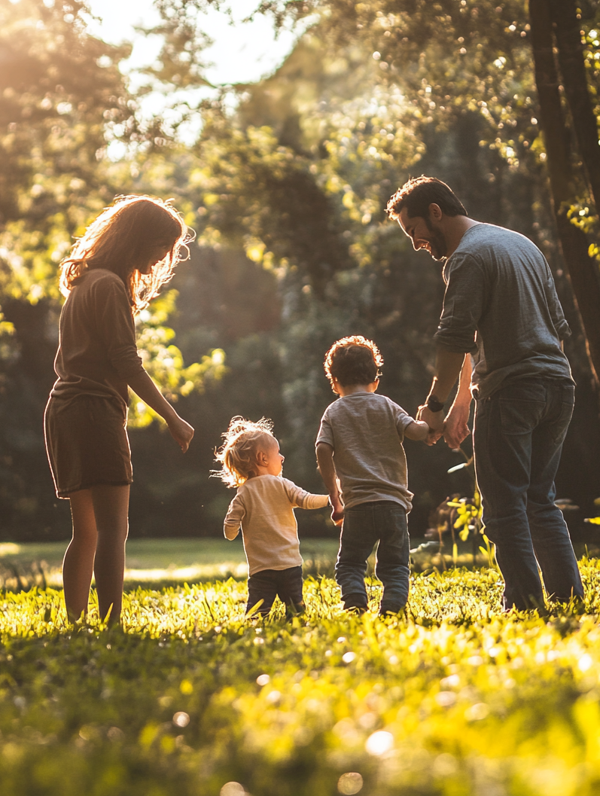
What a Family
Tree is?
Brief explanation of why it is important
to know your ancestry.
05/20

Slide 6

Why It’s Important?
Understanding family connections
Learning about heritage
Learning family traditions
06/20

Slide 7

Awesome
Words
Add inspiring words about why family values ​​are so important.
07/20

Slide 8
02 How to
Create a Family Tree
Steps to start researching and organizing information.
08/20

Slide 9
Step 01
Dad
Me
Brother
Mom
Make an initial diagram of the closest relatives:
parents, brothers and sisters, grandparents.
09/20

Slide 10
Example Basic Family Members
Simple diagram with labels.
Grandpa
Dad
Grandmother
Me
Grandpa
Brother
Mom
Grandmother
10/20

Slide 11



Step 02
Choose an illustration, a photo of a tree that you like.
11/20

Slide 12
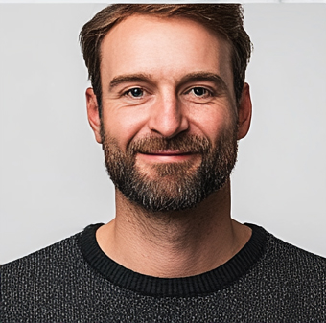
Step 03
Dad
+
+
Dad
Transfer the family chart to the tree and add a photo.
12/20

Slide 13
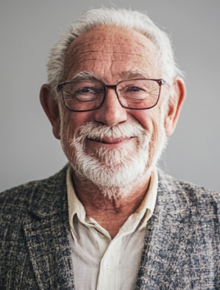
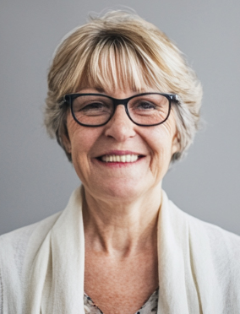
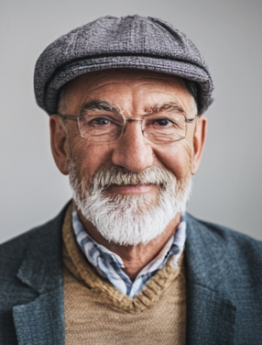
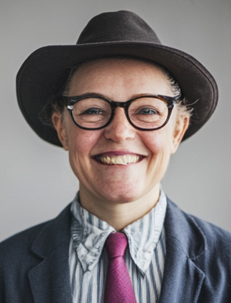
My
Family Tree
Grandpa
Grandmother
Grandpa
Grandmother
Dad
Mom
It's Me
Brother
13/20

Slide 14

03 Additional
Information
Add slides with additional information about your family.
14/20

Slide 15
Step 04 - Additionally
Great-grandfather
Great-grandmother
Aunt
Uncle
Cousin
You can expand your family tree by adding family members, great-grandparents, uncles, aunts, cousins, siblings
15/20

Slide 16
Extended Family
Great-grandfather
Aunt
Cousin
Grandpa
Great-grandmother
Uncle
Cousin
Great-grandfather
Grandmother
Dad
Great-grandmother
Me
Great-grandfather
Brother
Grandpa
Mom
Great-grandmother
Aunt
Great-grandfather
Cousin
Grandmother
Great-grandmother
Uncle
16/20

Slide 17
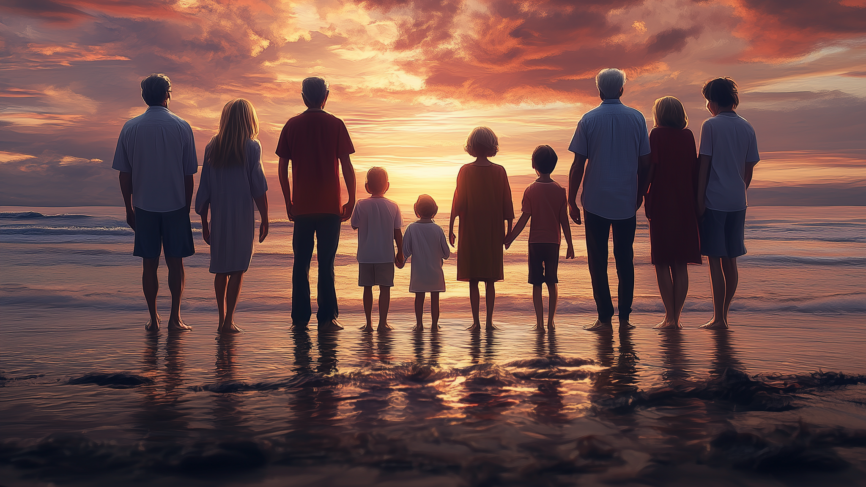
Sometimes a Good Picture is Worth a 1000 Words

Slide 18
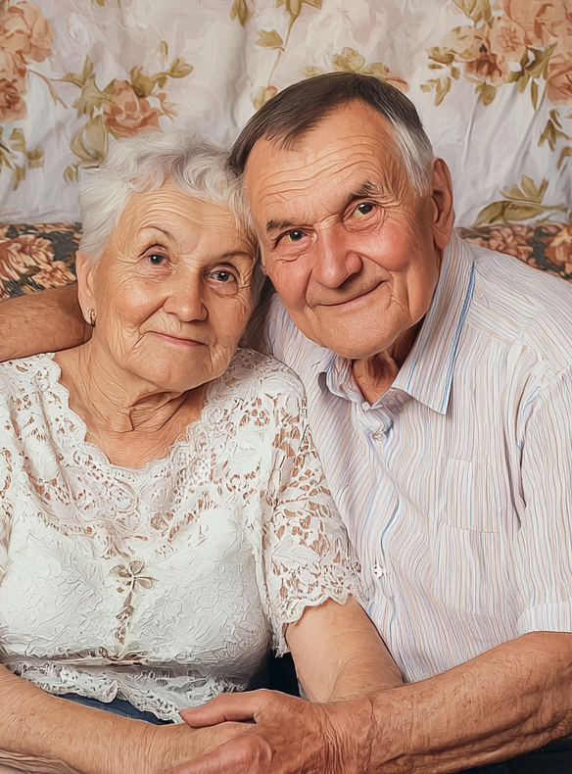
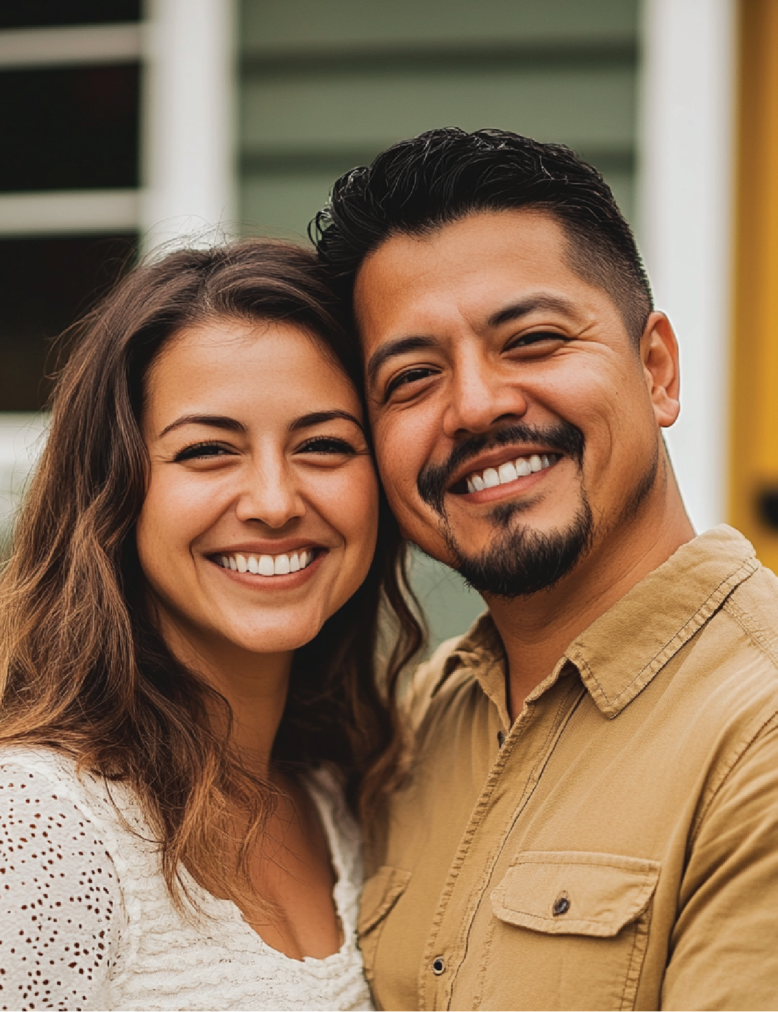
Generations of My Family
Grandparents
Parents
My Generation
18/20

Slide 19
”
On this slide, add a quote from someone famous about family values, about how
important it is to know about your roots.
“
Someone famous
19/20

Slide 20
It's Me
Thank For Your Attention
Do you have a question?
20/20

