Slide 1
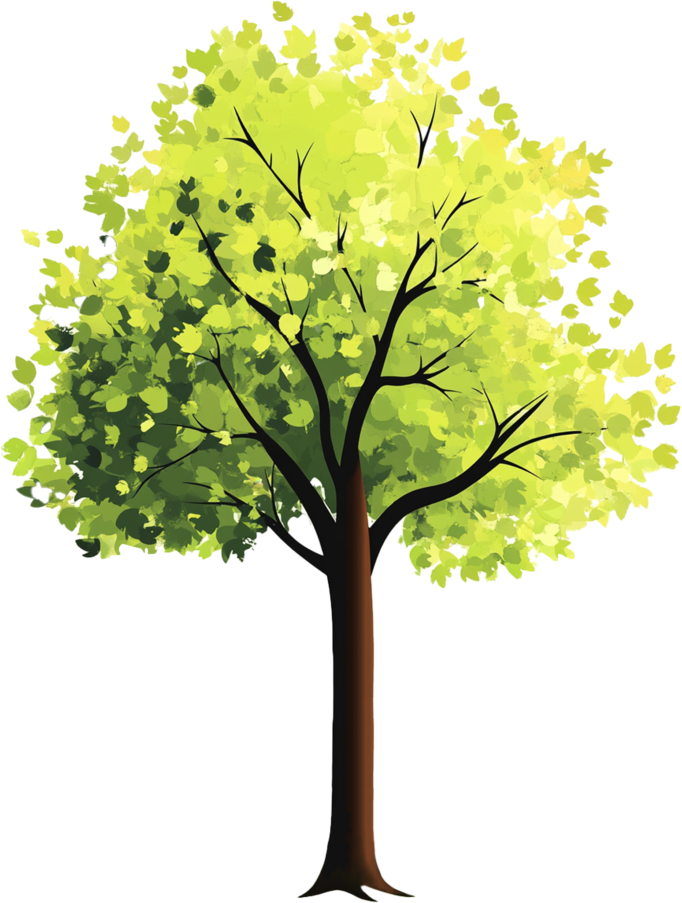

Family Tree
great-grandmother
great-grandmother
grandmother
grandmother
great-grandfather
great-grandfather
mother
father
great-grandmother
great-grandmother
grandfather
grandfather
Me
great-grandfather
great-grandfather

