Slide 1
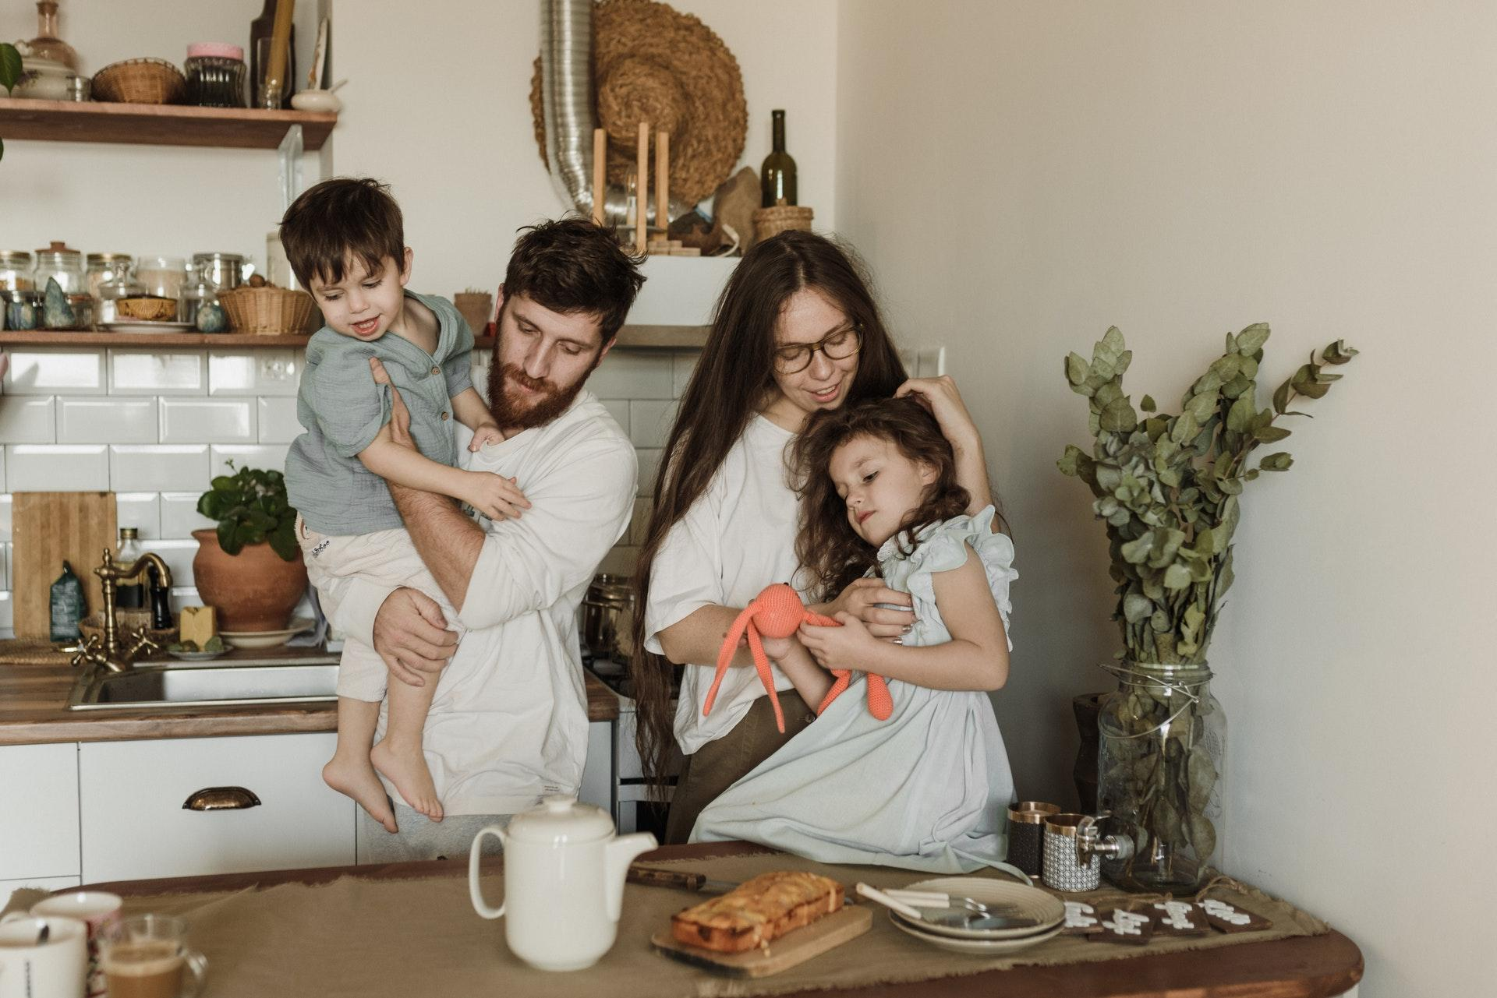
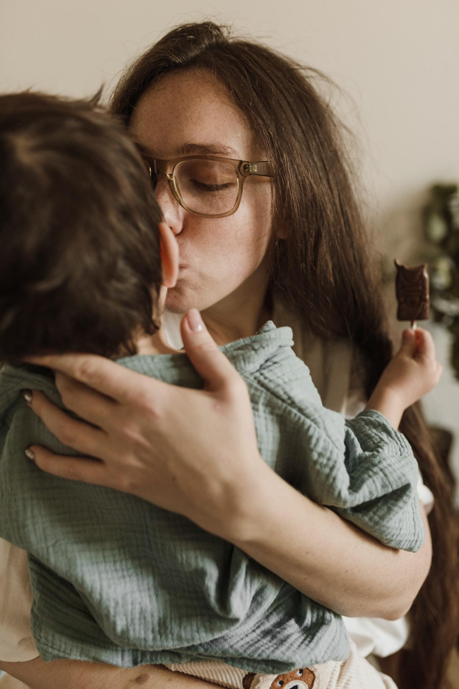
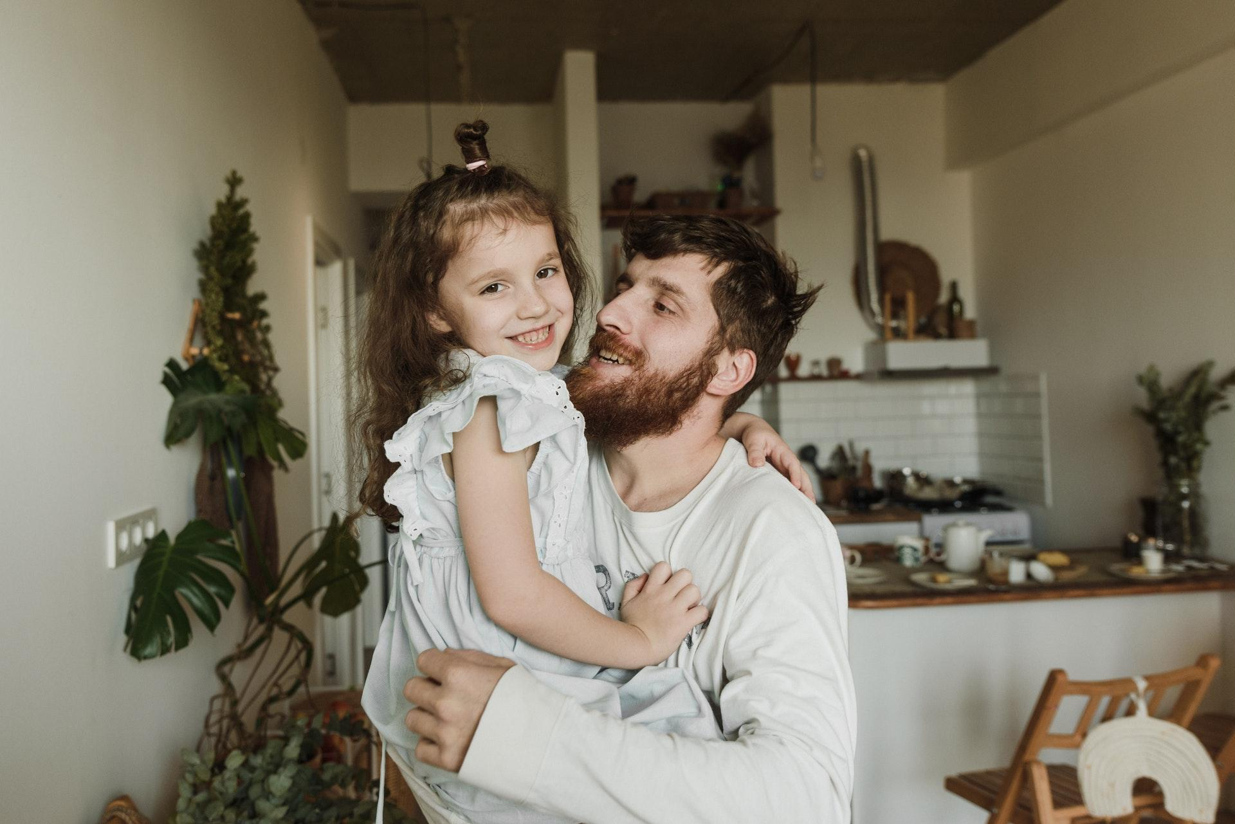
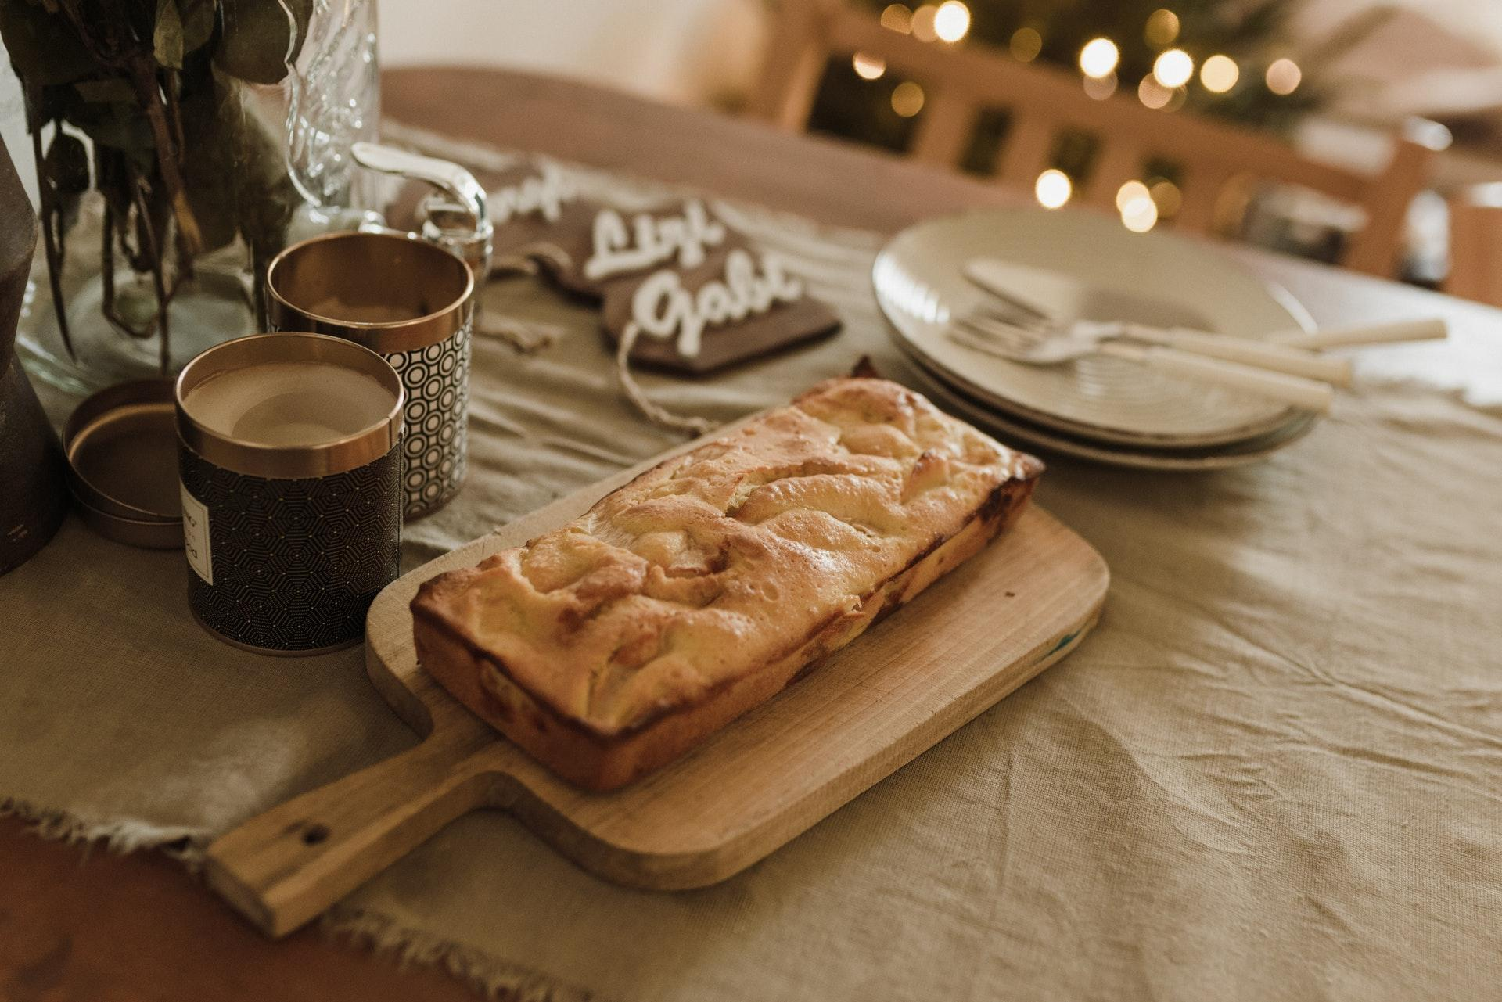
The Stephens Family
WEEKLY FAMILY NEWSLETTER
Preparing for family holiday
Suspendisse congue urna nec faucibus malesuada. Curabitur interdum luctus lacinia. Sed auctor venenatis volutpat. Phasellus in metus ante. Vivamus tincidunt velit vitae arcu tincidunt sagittis.
Highlights
Moments of
tenderness =)
Nam vel rutrum nibh. Donec augue risus, tincidunt eu lorem nec, hendrerit sagittis risus. Vivamus scelerisque dui at quam lacinia, et laoreet est congue. Sed et leo leo.
Family holiday
Delicious family pie
We make healthy sweets
New family photo session
An old family pie recipe
Ut ipsum turpis, lacinia ac diam sed, vehicula fringilla quam. Suspendisse in augue maximus, lacinia libero at, rhoncus lectus. Ut mollis velit in lacus imperdiet, nec finibus lectus imperdiet.

Slide 2
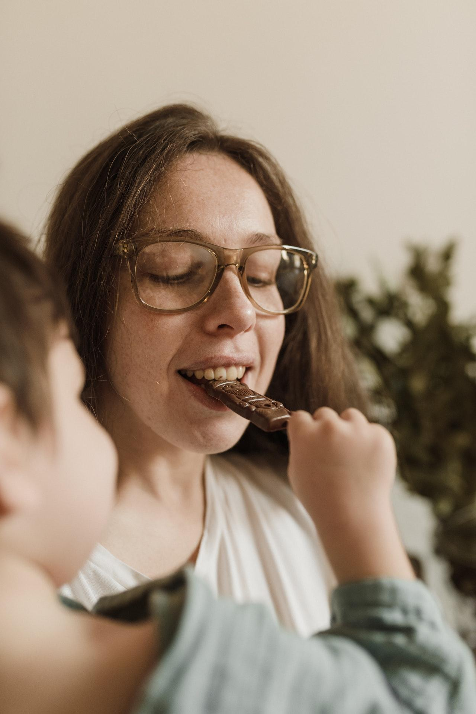
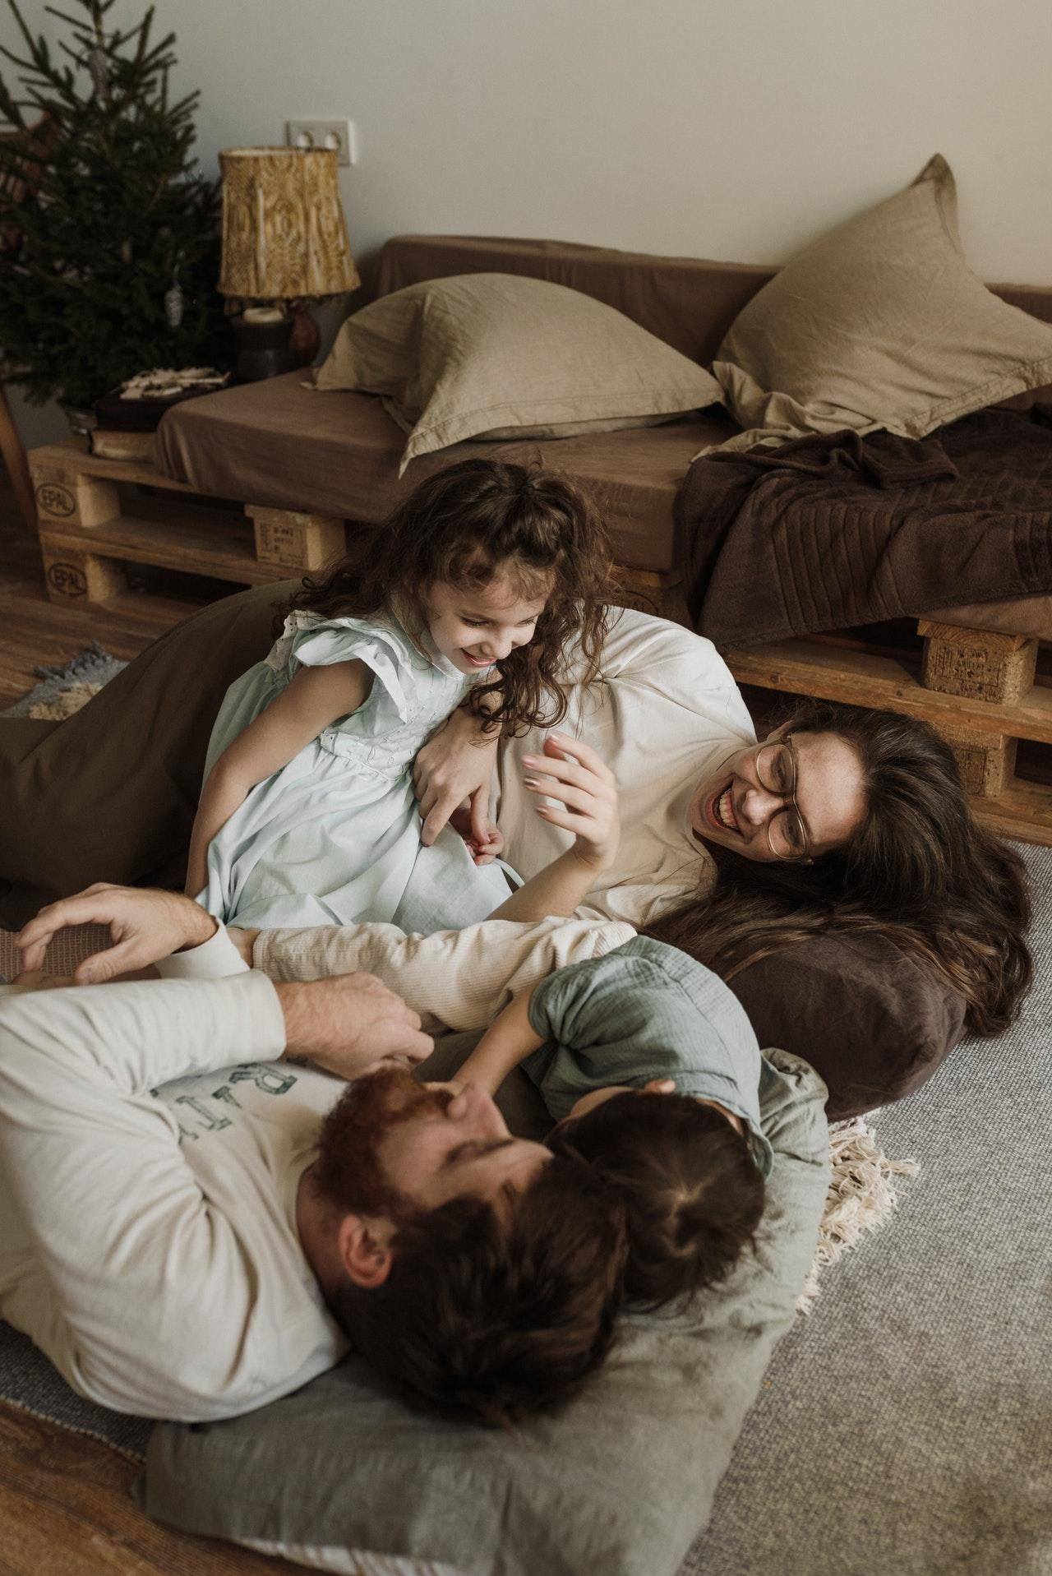
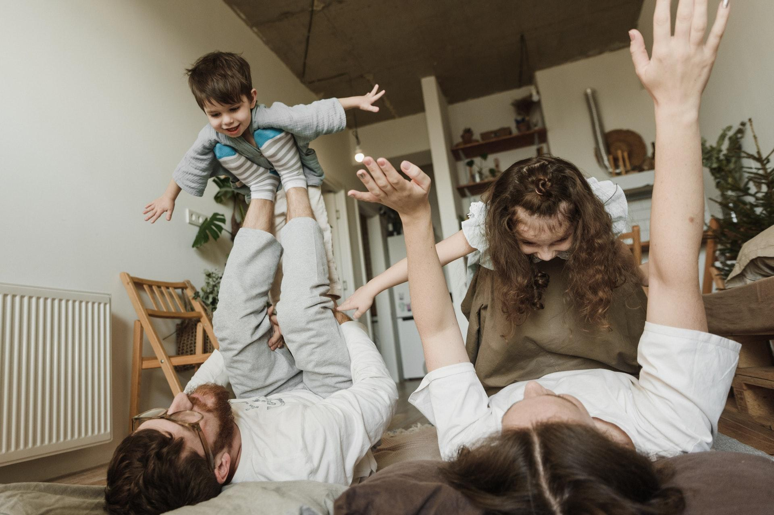
We make healthy sweets
Donec rhoncus, elit in condimentum feugiat, velit libero accumsan nisl, eu pretium dui purus a arcu. Proin sit amet elementum lectus. Vivamus a velit at metus lacinia lacinia. Cras in convallis magna.
Health is the most
important thing in our family!!
New family photo session
Suspendisse congue urna nec faucibus malesuada. Curabitur interdum luctus lacinia. Sed auctor venenatis volutpat. Phasellus in metus ante. Vivamus tincidunt velit vitae arcu tincidunt sagittis.
Another reason to have fun with the kids =)

