Slide 1
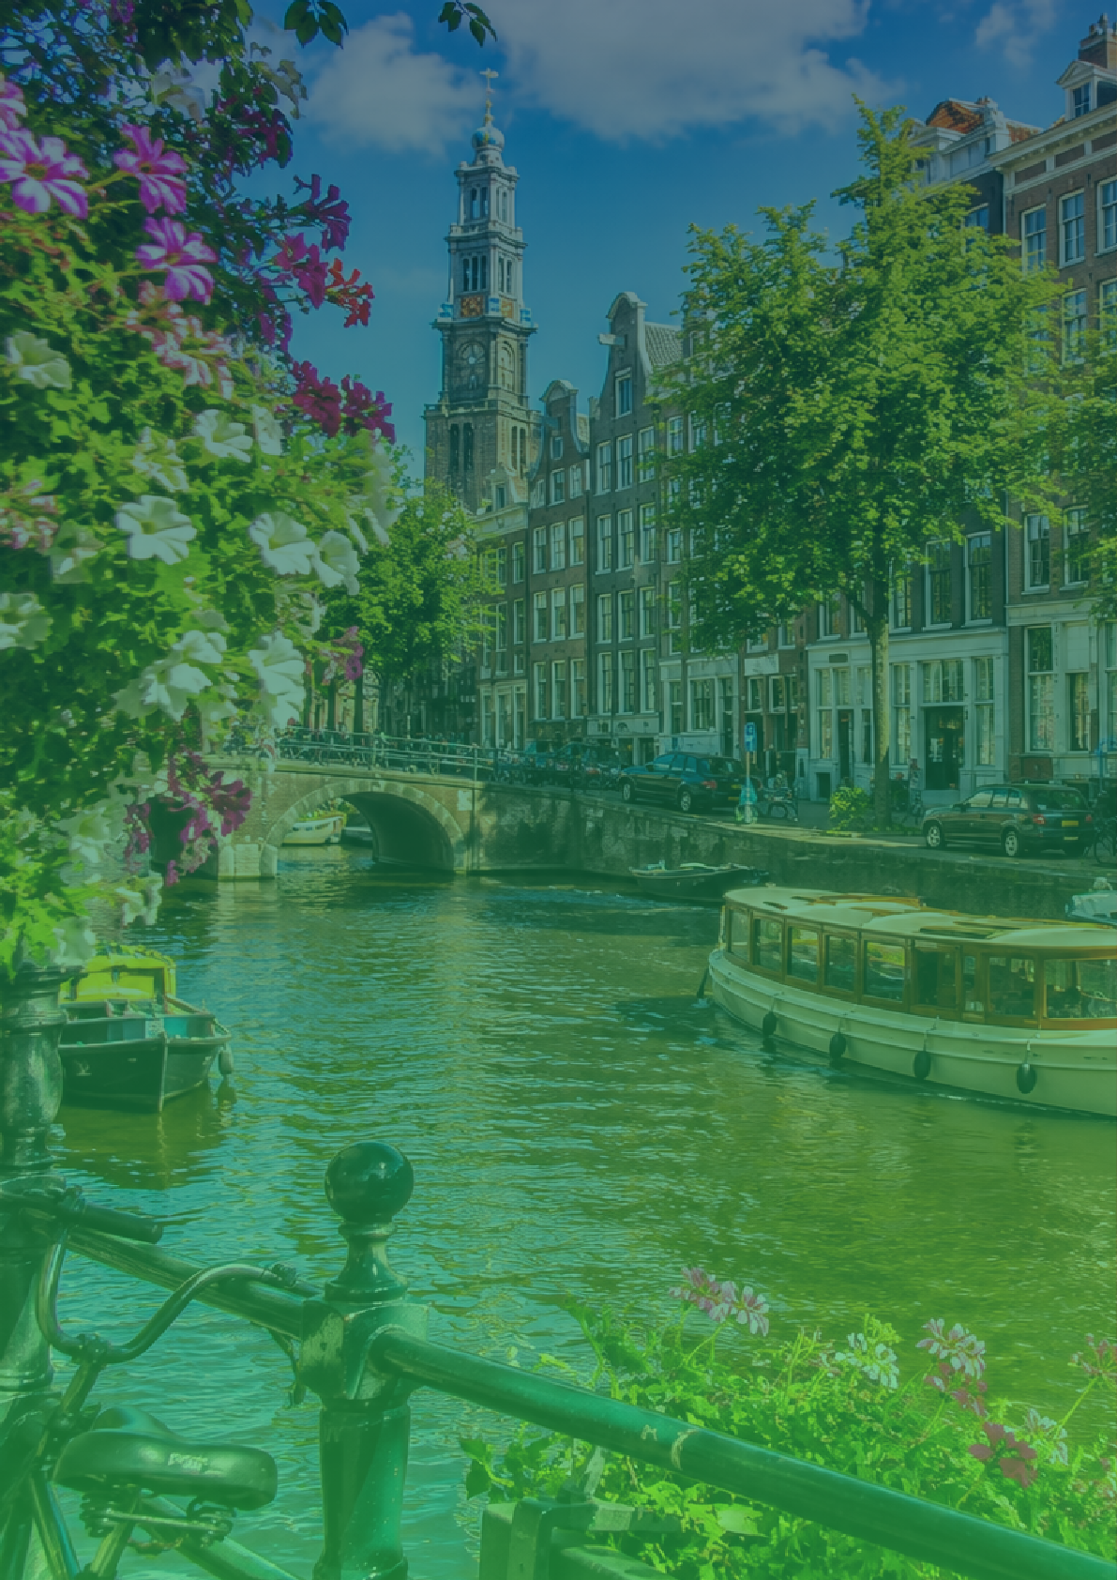
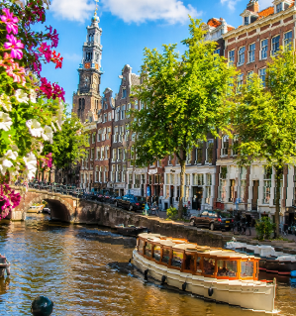
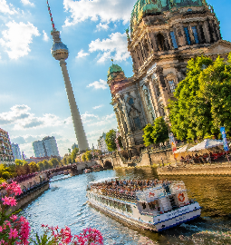
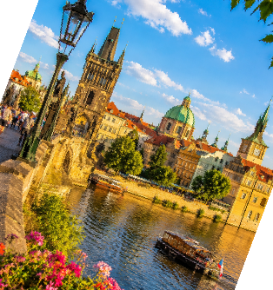
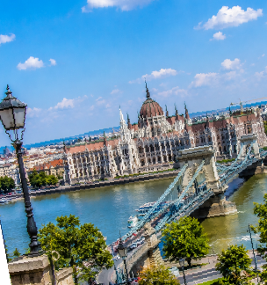
Europe
Travel Itinerary
1 DAY
AMSTERDAM
Welcome | Arrival in Amsterdam
Arrive, check in, enjoy a relaxed walk along the canals and dinner in Jordaan.
2 DAY
AMSTERDAM
Explore Amsterdam Highlights
Visit Anne Frank House, take a canal cruise, explore the 9 Streets, relaxed evening.
3 DAY
AMSTERDAM
Slow City Day
Rijksmuseum or Van Gogh Museum, Vondelpark, coffee spots and a calm day.
4 DAY
BERLIN
Amsterdam → Berlin
Morning train, hotel check in, evening walk in Mitte.
5 DAY
BERLIN
Explore Berlin Highlights
Brandenburg Gate, Reichstag, Berlin Wall, museums or galleries.
6 DAY
BERLIN
Berlin Deep Dive
Explore Kreuzberg or Prenzlauer Berg, local cafes, street vibe and free time.
7 DAY
PRAGUE
Berlin → Prague
Travel to Prague, check in, evening walk through Old Town.
8 DAY
PRAGUE
Explore Prague Highlights
Prague Castle, Charles Bridge, Old Town Square, sunset viewpoints.
9 DAY
BUDAPEST
Prague → Budapest
Travel day, evening walk along the Danube and Parliament views.
10 DAY
BUDAPEST
Explore Budapest Highlights
Explore Buda Castle, Fisherman's Bastion and St. Stephen's Basilica.
11 DAY
BUDAPEST
Relax & Experience
Thermal baths, local food, relaxed evening.
12 DAY
DEPARTURE
Return Home
Check out and transfer to the airport.

