Slide 1
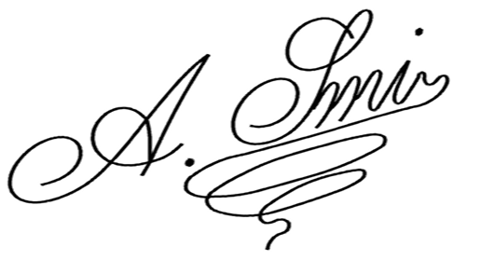
ADAM SMITH
SOFTWARE ENGINEER
ADAM_SMITH@MAIL.LTD | (123) 456-7890
To:
Jane Doe
Head of Human Resources
B2B Company
5678 Market Avenue
Seattle, WA 98109
Subject: Resignation Notice – Effective September 17, 2027
Dear Jane Doe,
I am writing to formally resign from my position as Software Engineer at B2B, effective two weeks from today, with my final working day being September 17, 2027.
I want to express my sincere gratitude for the opportunities and experiences I have gained while working at B2B. It has been a privilege to be part of the team, and I truly appreciate the support and guidance I have received throughout my time here.
Over the next two weeks, I am committed to ensuring a smooth transition. I will complete all outstanding tasks, assist in training my replacement if needed, and provide any necessary documentation to support the handover process.
Thank you once again for the opportunity to contribute to B2B. I wish the company continued success in the future.
Sincerely,
Adam Smith

