Slide 1
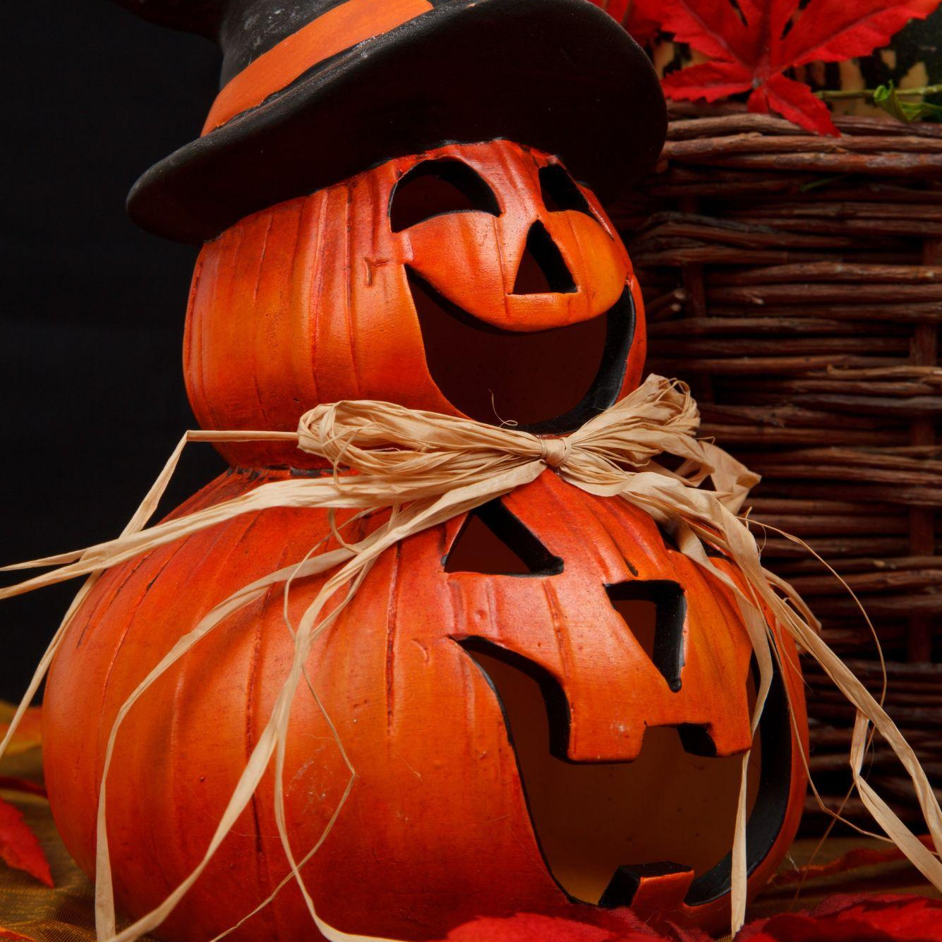
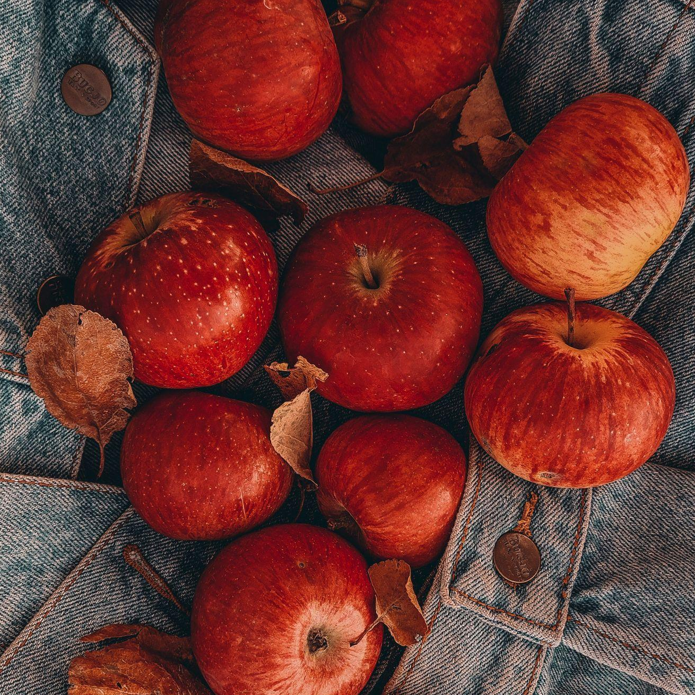
Elementary School
Daily Announcement
Dear Parents
Tomorrow there will be an autumn holiday at our school. Come with your children, there will be a lot of fun, funny contests, and a sea of good mood.
Elementary school teacher
Rachel Bergnaum
Fore more Information:
+123-456-7890

