Slide 1
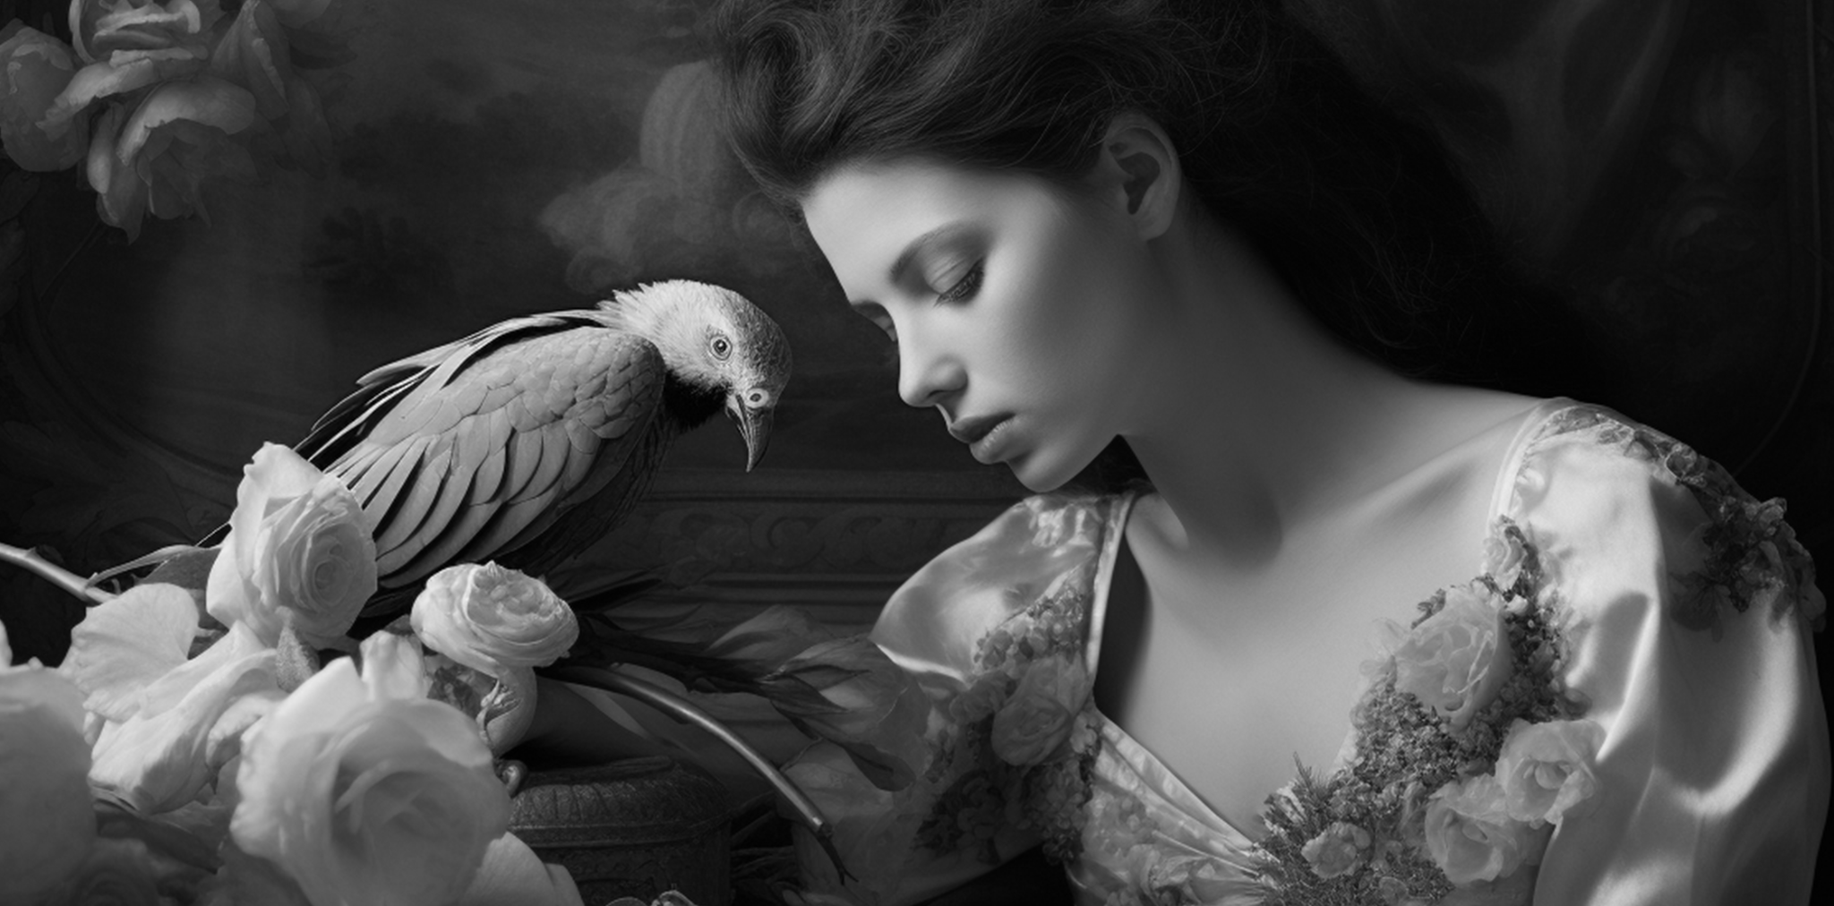
Edition#20
THE ENCHANTING HERALD
July 2024
Elegance Unveiled: Introducing
ELEGANCE IN EVERY LINE:
Introducing Our Sophisticated Gazette
Elegance Unveiled: Introducing "The Enchanting Herald"
INTRODUCTION:
Welcome to the inaugural edition of "The Enchanting Herald"—where elegance and intellect converge to create a reading experience unlike any other. In a world inundated with information overload, we stand as a sanctuary of sophistication, offering our discerning readers a haven of refined discourse. Сaptivating narratives lead.
In our lead feature, we delve into the essence of elegance itself, exploring its multifaceted nature across various domains of life. From the graceful movements of ballet to the intricate melodies of classical music, we celebrate the enduring allure of refined taste and cultural appreciation. From the graceful movements ballet to the intricate celebrate.
Our editorial reflects on the importance of infusing elegance into the fabric of our daily lives. From the way we dress to the manner in which we conduct ourselves, we advocate for a return to the timeless virtues of poise, grace, and refinement. Сaptivating narratives. Our editorial reflects on the importance into the fabric of our.

Slide 2
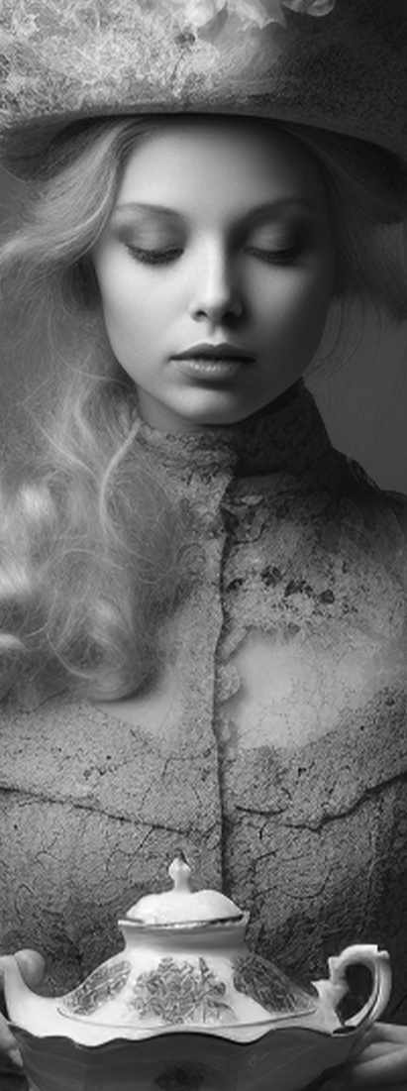
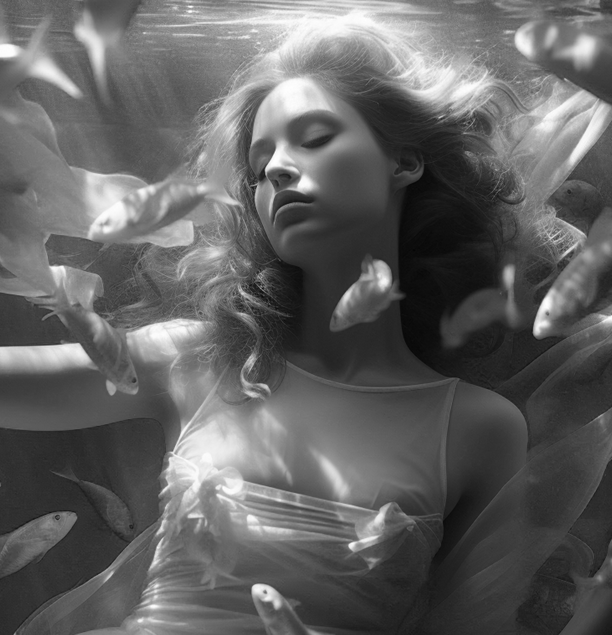
Edition#20
THE ENCHANTING HERALD
July 2024
CULTURE CORNER:
Spotlight on Timeless Classics
Welcome to the refined world of our elegant gazette, where every word is crafted with finesse and every story exudes sophistication. In today's fast-paced digital era, where brevity often trumps depth, we stand as a beacon of timeless elegance, offering our readers a sanctuary of thoughtfully curated. Within our pages, you'll discover a symphony of diverse voices, perspectives, and narratives meticulously woven together to create a tapestry of enlightenment and entertainment. From insightful analyses of current affairs to captivating tales of human experience, we strive to captivate your intellect and stir your emotions.
But elegance isn't merely found in our content—it permeates every aspect of our publication. From the graceful typography adorning our pages to the artful layout designed to delight the eye, we believe in the power of aesthetics to elevate the reading experience Join us on a journey where sophistication meets substance, where every turn of the page brings a new revelation, and where the pursuit of knowledge is synonymous with the appreciation of beauty. In our elegant gazette, enlightenment is not just a destination—it's a way of life. where the pursuit of knowledge is synonymous with the appreciation of beauty. In our elegant , enlightenment is not just a destination—it's a way life.
Welcome to the refined world of our elegant gazette, where every word is crafted with finesse and every story exudes sophistication. In today's fast-paced digital era, where brevity often trumps depth, we stand as a beacon of timeless elegance, offering our readers a sanctuary of thoughtfully curated. Within our pages, you'll discover a symphony of diverse voices, perspectives, and narratives meticulously woven together to create a tapestry of enlightenment and entertainment. From insightful analyses of current affairs to captivating tales of human experience, we strive to captivate your intellect and stir your emotions.
But elegance isn't merely found in our content—it permeates every aspect of our publication. From the graceful typography adorning our pages to the artful layout designed to delight the eye, we believe in the power of aesthetics to elevate the reading experience Join us on a journey where sophistication meets substance, where every turn of the page brings a new revelation, and where the pursuit of knowledge is synonymous with the appreciation of beauty. In our elegant gazette, enlightenment is not just a destination—it's a way of life. where the pursuit of knowledge is synonymous with the appreciation of beauty. In our elegant , enlightenment is not just a destination—it's a way life.
Serene Depths:
A Subaquatic Ballet
In this captivating photograph, a vision of elegance unfolds as a young woman gracefully moves amidst a school of shimmering fish. Her form, suspended in the gentle embrace of the water, exudes a serene poise reminiscent of a ballet dancer on stage. Adorned in flowing fabric that mimics the undulating currents, she becomes one with the aquatic environment, a living embodiment of harmony and grace.
As the fish swirl around her, their iridescent scales catching the play of light, they seem to join in her aquatic ballet, creating a scene of breathtaking beauty and serenity. Each movement, each ripple in the water, is a testament to the inherent grace of the natural world.
Arthur Morgan Mystical Encounter: Beneath the Waves
The photograph depicts a stunning young woman submerged in water, surrounded by enchanting fish.

Slide 3
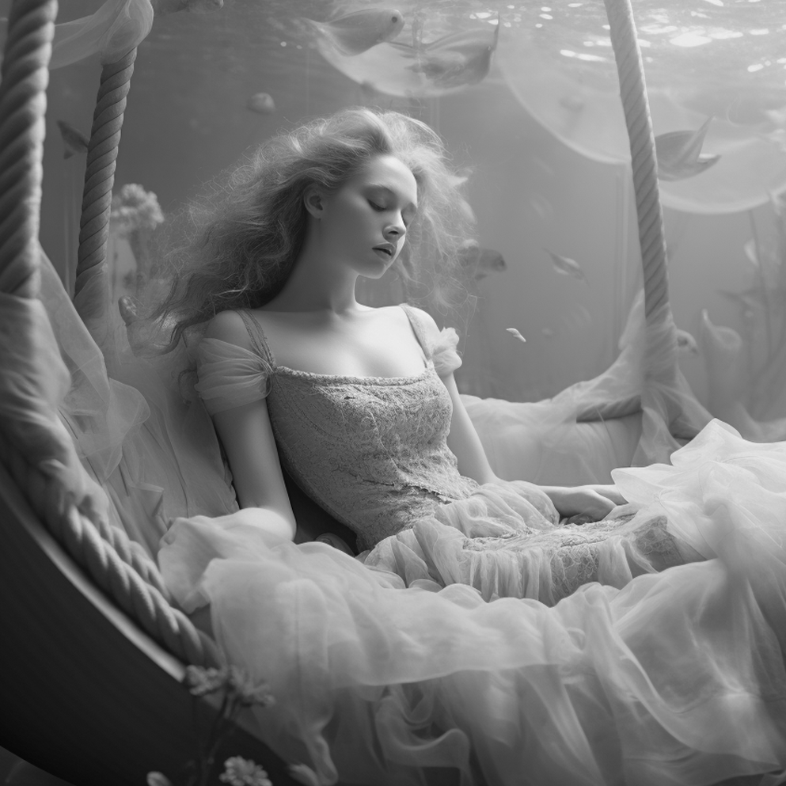
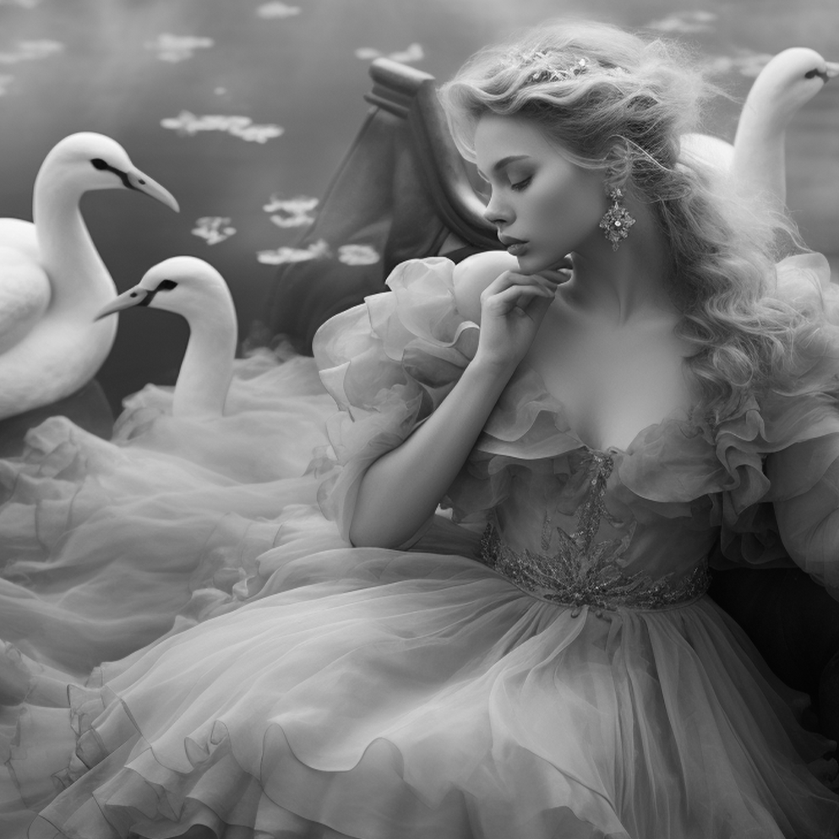
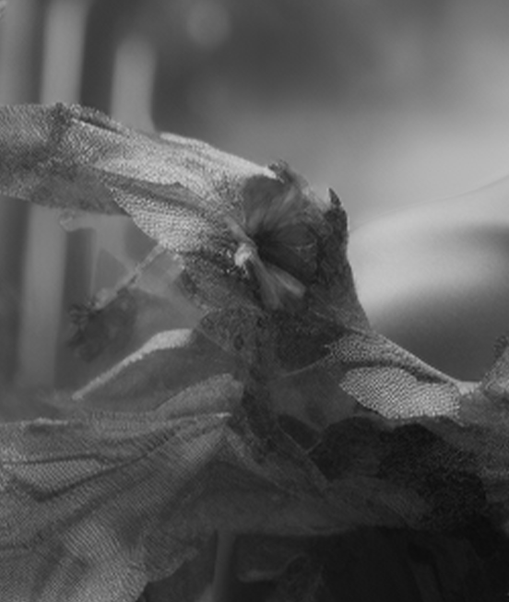
SPARKING CREATIVITY:
Unleashing the Power
of Imagination
SEEKING INSPIRATION EVERYWHERE
Embracing Playfulness
Welcome to the refined world of our elegant gazette, where every word is crafted with finesse and every story exudes sophistication. In today's fast-paced digital era, where brevity often trumps depth, we stand as a beacon of timeless elegance, offering our readers a sanctuary of thoughtfully curated content. Within our pages, you'll discover a symphony of diverse voices, perspectives, and narratives meticulously woven together to create a tapestry of enlightenment and entertainment.
From insightful analyses of current affairs to captivating tales of human experience, we strive to captivate your intellect and stir your emotions. Welcome to the refined world of our elegant gazette, where every word is crafted with finesse and every story exudes sophistication. In today's fast-paced digital era, where brevity often trumps depth, we stand as a beacon of timeless elegance, offering our readers a sanctuary of thoughtfully curated content. Within our pages, you'll discover a symphony of diverse voices, perspectives, and narratives meticulously woven together to create a tapestry of enlightenment and entertainment. From insightful analyses of current affairs to captivating tales of human experience, we strive to captivate your intellect and stir your emotions. From insightful analyses. From insightful analyses.
In the pursuit of creativity, failure is not a setback but a stepping stone. Every misstep, every setback, is an opportunity to learn and grow. Embrace the process of experimentation, knowing that it's through trial and error that true innovation is born. Remember, the most celebrated creators often faced numerous rejections before achieving success. Inspiration is all around us, waiting to be discovered in the most unexpected places. From the vibrant colors of a sunset to the rhythmic cadence of raindrops on a windowpane, train yourself to see the beauty in the ordinary. Keep a notebook handy to jot down fleeting ideas or snap photos of scenes that capture your imagination. Inspiration is all around us, waiting to be discovered in the most unexpected places. From the vibrant colors of a sunset to the rhythmic cadence of raindrops on a windowpane, train yourself to see the beauty in the ordinary. Keep a notebook handy to jot down fleeting ideas or snap photos of scenes that capture your imagination.
Graceful Beauty: Swan Serenade
The
Enchanting
Herald
SEEKING INSPIRATION
EVERYWHERE
Legendary Lightness: Soaring Fantasy
Elegance Unveiled: Introducing "The Enchanting Herald"

Slide 4
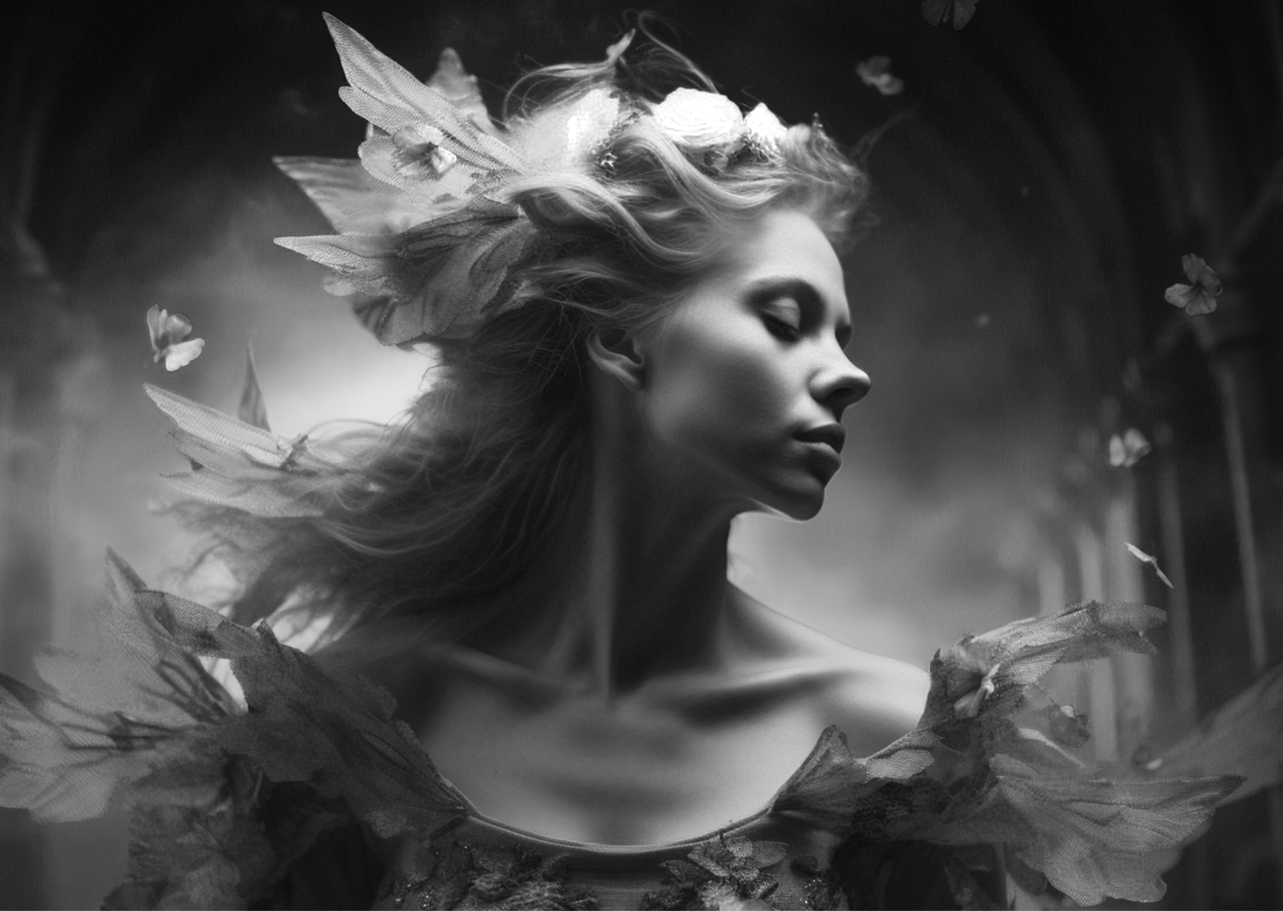
Alexander Sterling
"Graceful Reverie"
The photo depicts a graceful young woman seemingly floating in mid-air in a beautiful gown. Her elegance and delicacy are reflected in her smooth movements and the expression on her face. The background, resembling a pastel shade of blue, creates an impression of lightness and weightlessness, accentuating the model's grace.
ELEGANT ESCAPADES:
Navigating the World of Style
In a world where trends come and go like fleeting whispers on the wind, there remains a timeless allure to style and elegance that transcends the whims of fashion. It's not just about what we wear, but how we carry ourselves and the statement we make with every step. Welcome to "Elegant Escapades," where we embark on a journey through the realms of sophistication and refinement.
In this column, we delve deep into the essence of style, exploring its roots in history and its evolution through the ages. From the iconic fashion icons of the past to the contemporary tastemakers, we uncover the secrets of elegance.
But elegance isn't confined to the realm of fashion alone—it permeates every aspect of our lives. It's in the way we adorn our homes, the art we appreciate, and the grace with which we navigate the world around us. "Elegant Escapades" seeks to illuminate the myriad ways in which elegance enriches our lives and elevates our experiences.
Join us as we unravel the mysteries of style and sophistication, offering insights, inspiration, and perhaps a touch of whimsy along the way. Whether you're a seasoned connoisseur or a curious novice, there's always something new to discover in the enchanting world of elegance.

