Slide 1
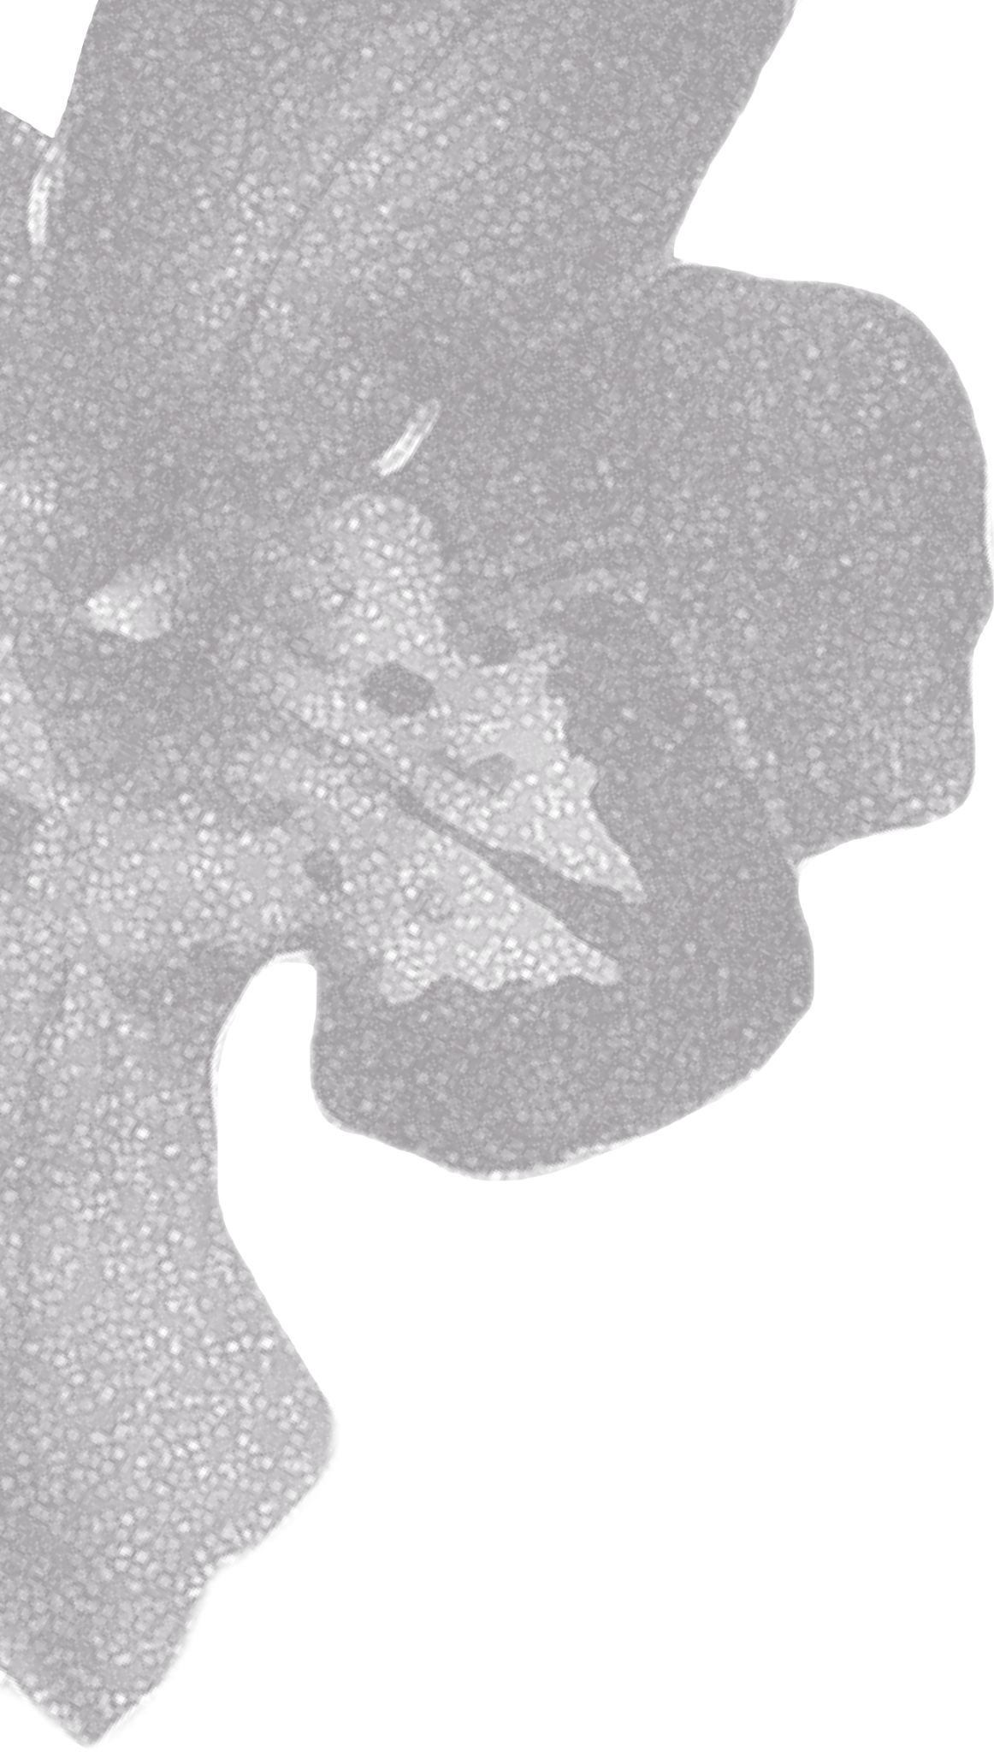
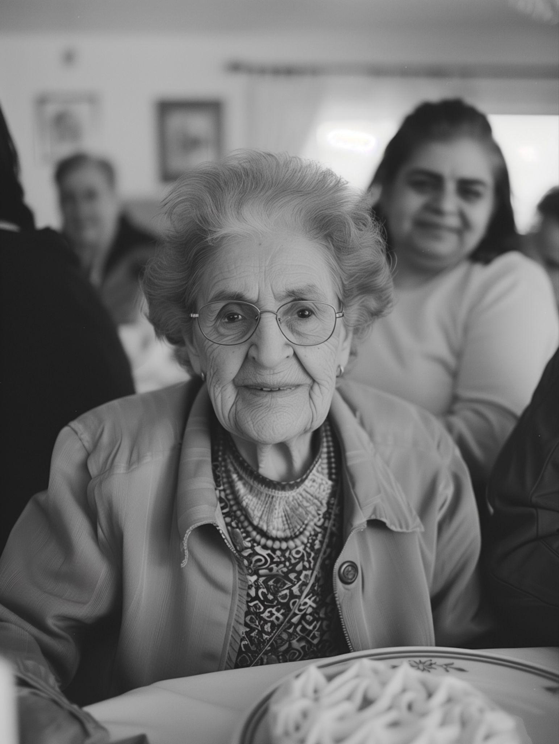
IN LOVING MEMORY OF
JULIA WESTWOOD
AUGUST 13, 1943 — JULY 3, 2025
SUNDAY, JULY 10, 2025
AT THREE O’CLOCK IN THE AFTERNOON
SERVICE TO BE HELD AT:
THE CEREMONY HALL, PACIFIC CITY

