Slide 1
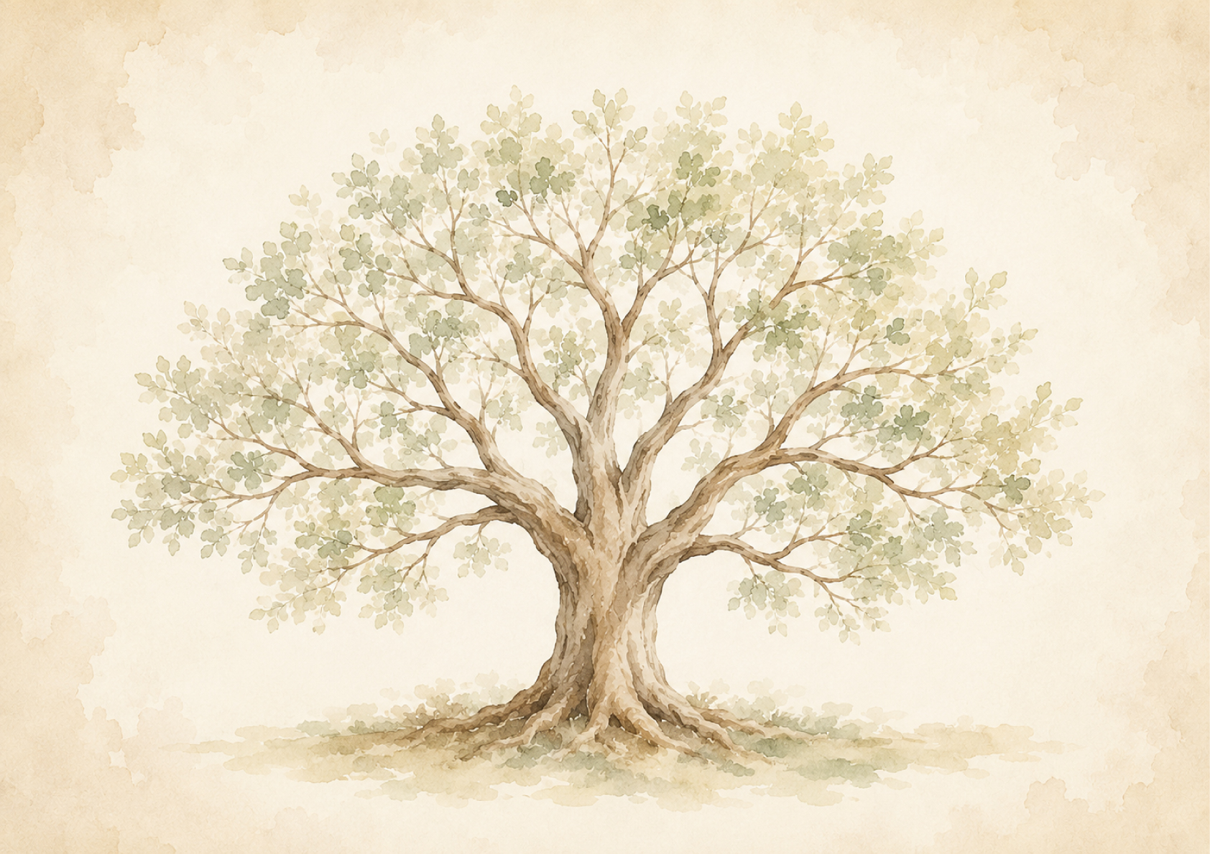
FAMILY TREE
Notes
Sources

