Slide 1
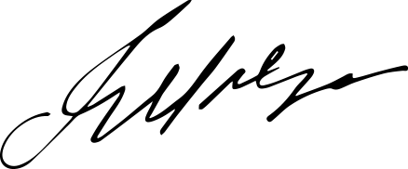
Name of Issuing Authority
Certificate of Completion
This is to certify that
Ms. Serena Evergreen
known for her indefatigable spirit and insatiable curiosity, has triumphantly completed all the requirements of the "Empowering Women in Leadership" program.
K
Emily Smith
E
Signature
Name

