Slide 1
Driving School
Business Card

Slide 2
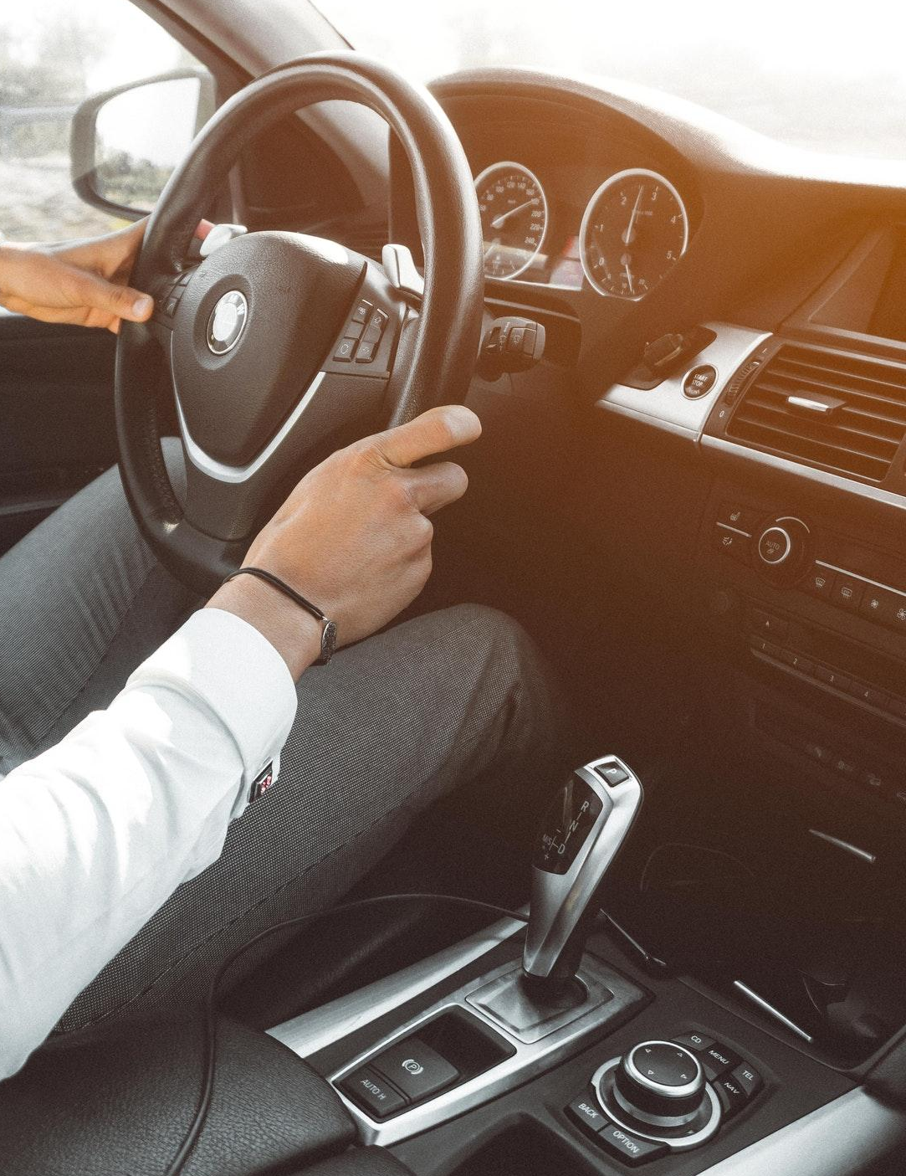
Isaac VonRueden
Business Card
+1 012-345-6789
example@mail.com
example.com
5703 Rippin Crescent Apt.
85, New Tremaine

