Slide 1
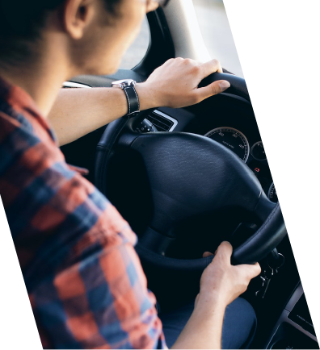
Driving School
BUSINESS CARD

Slide 2
Keven Connelly
DRIVING INSTRUCTOR
+1 012-345-6789
example@mail.com
example.com
5703 Rippin Crescent Apt. 85, New Tremaine

